Slide 1


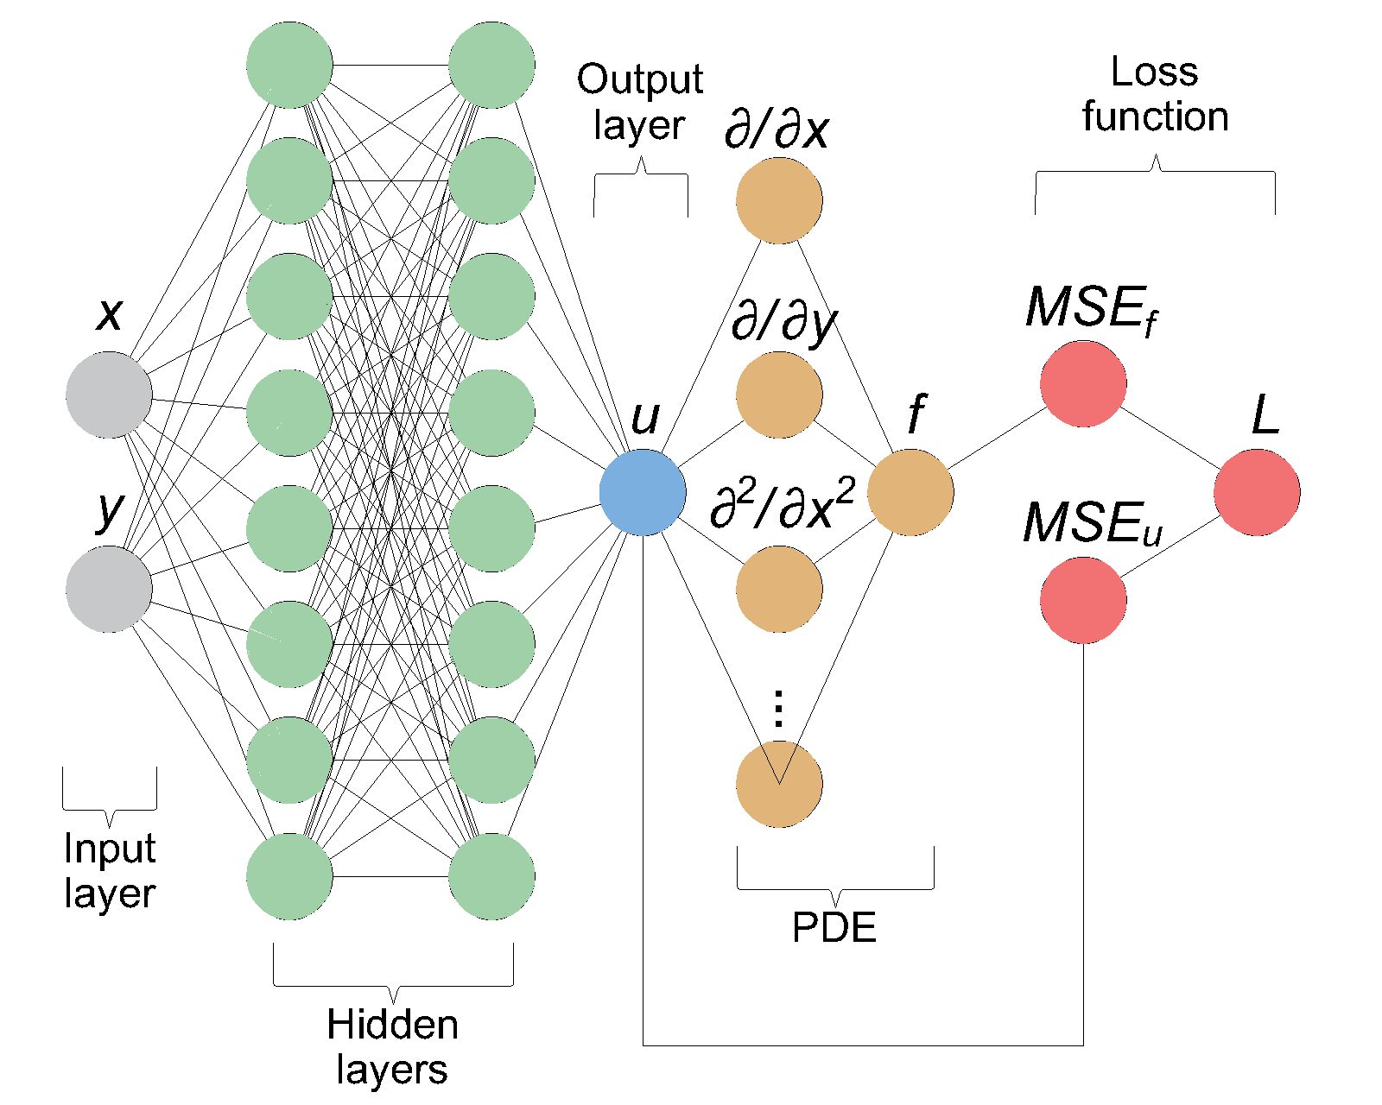
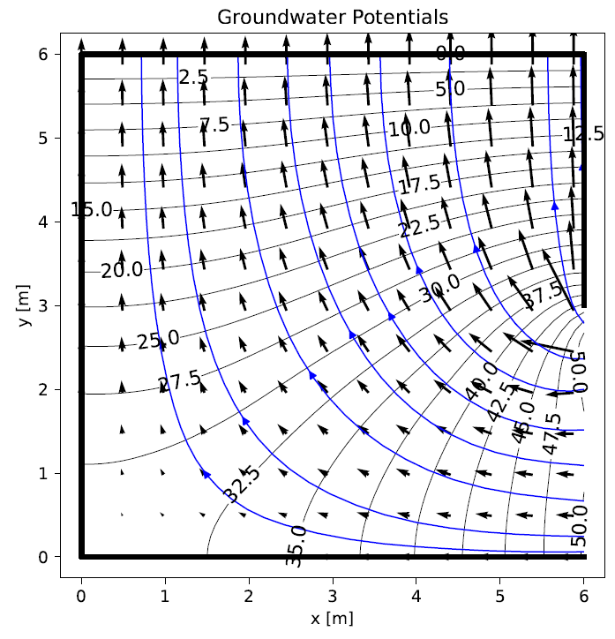
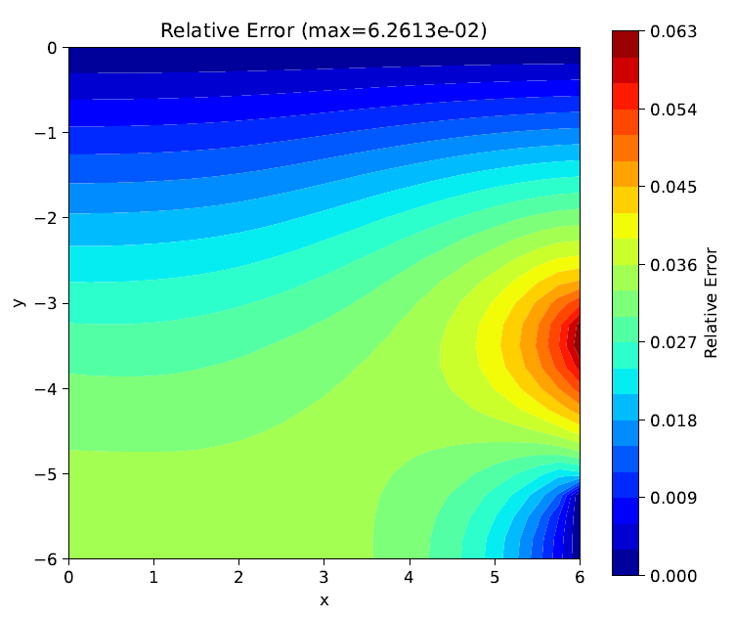
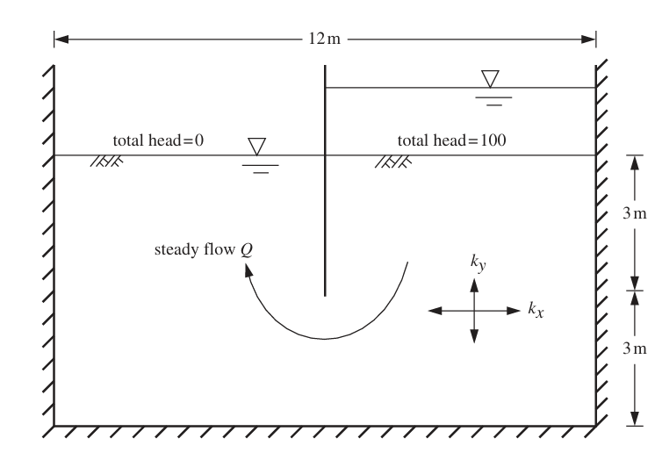
Physics-Informed Neural Network for 2D Steady Seepage
TRANSCOM 2025: 16th International Scientific Conference on Sustainable, Modern and Safe Transport
Filip Cigáň¹, Martina Buková², Tomáš Bukový³
1 University of Zilina, Faculty of Civil Engineering, Univerzitná 8215 /1, 010 26 Zilina, Slovakia
introduction
Physics-informed neural networks represent an innovative approach in computational modeling by embedding mathematical physics directly into neural networks. This method solve complex geotechnical problems by integrating governing equations into the training process. | Traditional numerical methods in geotechnical engineering face challenges with complex, high-dimensional problems and sparse data. PINNs can efficiently incorporate underlying physics without extensive preprocessing. | We utilize physics-informed neural networks (PINNs) to solve 2D steady-state seepage problems beneath impermeable structures. PINNs can streamline complex computations and integrate data efficiently.
materials, methods & implementation
This study implements a physics-informed neural network (PINN) to model 2D steady-state seepage beneath an impermeable sheet-pile wall. The neural network integrates Laplace’s equation into its architecture, ensuring that governing equations and boundary conditions are embedded into the training process. Utilizing PyTorch for neural network construction, a fully connected architecture with four hidden layers and 40 neurons each is employed, using hyperbolic tangent activation to capture nonlinearity. The model's loss function combines PDE residuals, Dirichlet, and Neumann losses, with weights adjusted for optimal boundary condition enforcement.
results
A physics-informed neural network (PINN) was used to solve the 2D steady seepage problem under a sheet pile wall. By embedding Laplace’s equation and boundary conditions (total head of 50 on one side, zero on the other, and no flow elsewhere) into the network’s loss function, the PINN produced a groundwater head distribution and flow velocity field indicating smooth contours and a quiver pattern consistent with expected seepage paths. The total flow rate 48.6 aligns closely with an approximate method (47.0) and approaches the infinite-domain solution (50).
A comparison with a 50 × 50 quadratic finite element mesh yielded a maximum relative error of 6.2613 × 10⁻², primarily near the boundary where the head is fixed at 50. This indicates the PINN’s difficulty in strictly enforcing constant Dirichlet conditions. Despite this localized discrepancy, the overall solution satisfied the continuity of flow, confirming steady-state behaviour.
Implementation details
Network Construction: The network is initialized with user-defined hidden layers and neurons.
Loss Evaluation: Calculate Laplacian and compute residuals for boundary conditions.
Backpropagation: Automatic differentiation computes gradients of total loss.
Parameter Updates: Adam optimizer adjusts weights and biases.
Resampling: New domain and boundary points are generated periodically.
Model Saving and Post-Processing: Optimized parameters are saved, and results are exported.
conclusion & implementation path
In conclusion, the physics-informed neural network demonstrated strong potential for analyzing 2D steady seepage beneath a sheet pile wall, matching flow rates computed via approximate methods and approaching the infinite-domain solution. Although there was a localized discrepancy in strictly enforcing constant head values at the boundary, the overall contour and velocity field reflected the expected seepage paths, confirming that the PINN solution satisfied the continuity of flow and captured the essential steady-state behaviour. The approach carries a higher computational burden than classical finite element or finite difference methods, particularly for network training and hyperparameter tuning. Nevertheless, its ability to embed governing equations directly into the learning process—alongside flexible handling of geometry, automatic differentiation for flux calculations, and straightforward incorporation of measurement data—offers a distinct advantage. By avoiding manual mesh generation and relying instead on domain point sampling and boundary enforcement via loss terms, PINNs can be especially appealing for problems involving complex boundaries, variable materials, or data assimilation in real-world geotechnical investigations. Consequently, despite the time investment in training, PINNs can serve as a valuable complement or alternative to traditional numerical approaches when mesh complexity, parameter uncertainties, or the need for data-driven modelling become significant considerations.
acknowledgements
This contribution is supported by the Scientific Grant Agency of Slovak Republic (VEGA) No. 1/0752/24 “Research of composite foamed concrete-based panels for applications in traffic construction“

