Slide 1


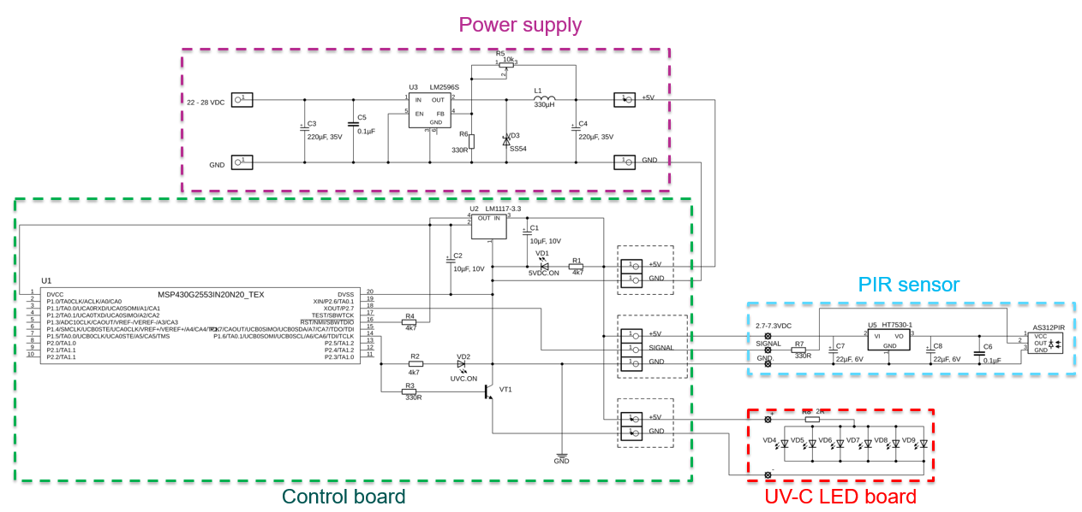
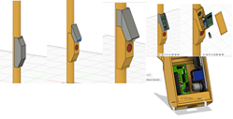
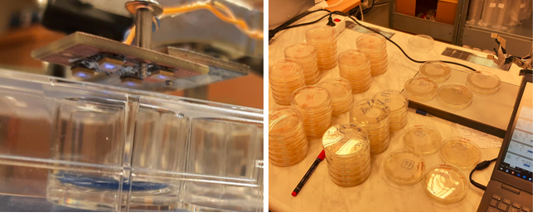
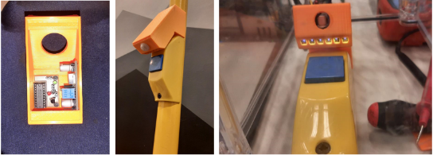
Design of a UV-C-LED-Based Prototype for Disinfecting Small Surfaces in Public Transport System under Uncertain Epidemiological Conditions
TRANSCOM 2025: 16th International Scientific Conference on Sustainable, Modern and Safe Transport
Antons Patlins¹, Klavs Vabulnieks², Linda Mezule³, Pavels Gavrilovs⁴
1 Riga Technical University (RTU), Institute of Industrial Electronics, Electrical Engineering and Energy, Riga, Latvia
2 Riga Technical University (RTU), Riga, Latvia
3 Riga Technical University (RTU), Riga, Latvia
4 Riga Technical University (RTU), Riga, Latvia
introduction
Background & Market Context. Epidemics and pandemics have historically shaped humanity, with COVID-19 exposing vulnerabilities in public transport due to high-touch surfaces and enclosed spaces. | Problem & Stakeholders. Public transport poses infection risks, affecting passengers, operators, and policymakers who seek effective disinfection solutions. | Objectives & Impact. This research develops a UV-C LED disinfection device to enhance hygiene, reduce infections, and improve transport safety.
materials, methods & implementation
Materials. The prototype utilizes UV-C LEDs for disinfection, a PIR sensor for safety, a voltage regulator for stable power supply, and a modular control system. The estimated material cost is 50 euros, with UV-C LEDs making up 80% of the cost. Methods & Implementation. The UV-C LED device was designed using Fusion 360, 3D printed, and wired using EAGLE software. Electrical performance was tested using a Mean Well power supply and LM-2596S voltage regulator. Microbiological tests were conducted with E. coli and S. aureus cultures, measuring inactivation efficiency at various distances and exposure times. Analysis & Validation. Laboratory tests confirmed the device’s disinfection effectiveness, with controlled experiments showing bacterial reduction. While results were promising, further improvements and real-world testing are needed before implementation. Microbiological test by irradiating a culture of E.coli at a distance of 2 cm Scheme of prototype The concept and 3-D model of the device
results
Academic Findings & Innovation. This paper highlights research advancements, new methodologies, and technological developments, particularly in UV-C LED disinfection. It focuses on scientific validation, efficiency testing, and contributions to academic knowledge in public health and engineering. Practical Applications. Paper addresses real-world implementation, showing how research findings translate into functional solutions. It emphasizes the integration of UV-C LED technology into public transport sanitation, ensuring safety, efficiency, and feasibility for widespread use.
Tests in laboratory
conclusion & implementation path
Conclusions. The study successfully developed a prototype UV-C disinfection device, including design, 3D modeling, and implementation. UV-C light's effectiveness in disinfecting surfaces and air was confirmed, though safety measures are critical to prevent human exposure. While UV-C LEDs enable safe disinfection with proper safety systems, diverse public transport systems require customized solutions. Given the potential for future pandemics, further exploration of UV-C technology is essential for public health preparedness. Limitations. Public transport’s 24 V DC system and thin wiring require additional setup for high-power devices. Effective UV-C LED disinfection depends on exposure time, intensity, wavelength, and placement. Heat management is crucial, and low-power operation extends irradiation time. Installation is best in controlled environments, with current UV-C LEDs suited for small, frequently disinfected surfaces. While costs remain high, prices are expected to drop with technological progress.

