Slide 1


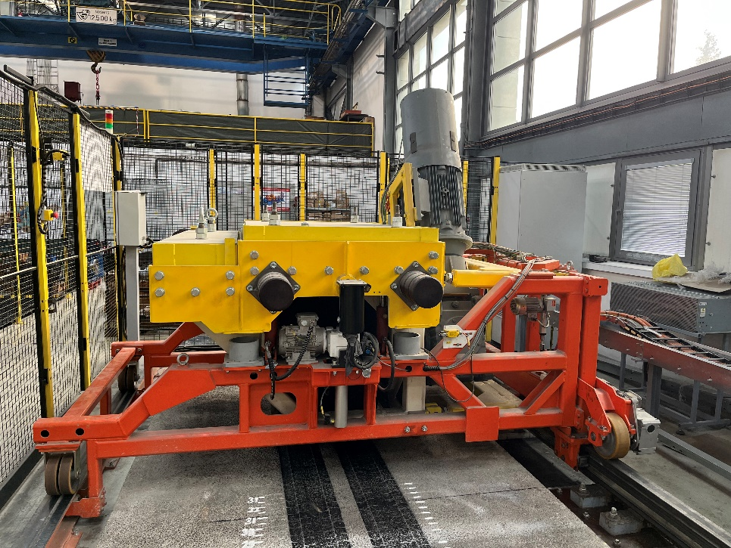
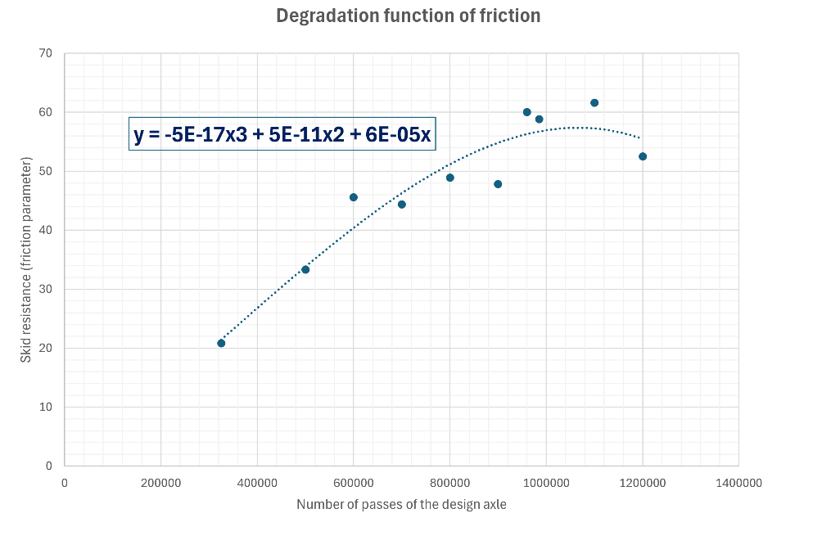
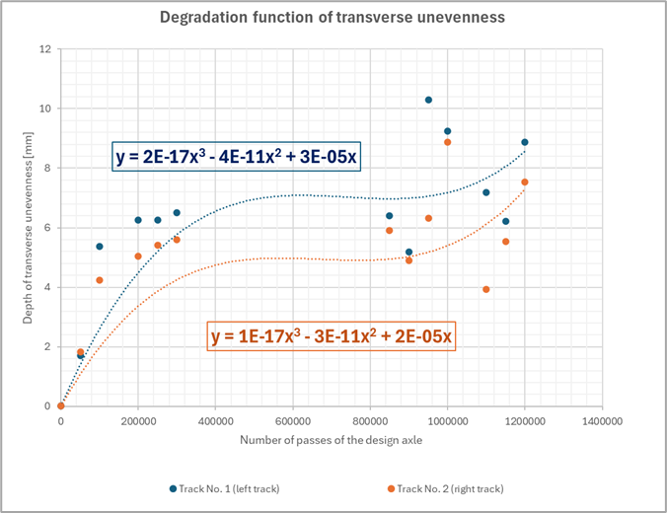
The Application of Pavement Performance Models in Pavement Asset Management System for the Purpose of Improving the Structural Pavement Condition
TRANSCOM 2025: 16th International Scientific Conference on Sustainable, Modern and Safe Transport
Júlia Mešková¹, Ján Mikolaj²
1 Department of Construction Management, Faculty of Civil Engineering, University of Zilina, 010 26 Zilina, Slovakia
2 Department of Construction Management, Faculty of Civil Engineering, University of Zilina, 010 26 Zilina, Slovakia
introduction
Road infrastructure has a significant role in economic and social development. During their life serviceability, roads are exposed to various degrading influences that gradually deteriorate their functional and structural properties. | The dynamic character of degradation processes creates the need for effective tools to predict changes in pavement properties over their life cycle when pavement performance models enter the process. Degradation models allow the prediction of the evolution of the condition of the road network and help to identify the optimal times to carry out maintenance or repairs, thus providing the possibility of efficient maintenance planning and the allocation of funds for the management of the road network. | The aim of the research is to determine the pavement performance models of the variable parameters of the experimental pavement section and to demonstrate their applicability in practice.
materials, methods & implementation
Research is realized on the campus of the University of Žilina, specifically in the laboratory of the Technology and Management Department. Within the experiment, we are talking about accelerated pavement testing, due to the laboratory facilities providing constant climatic conditions and the cyclic loading device Pavement Tester Type 105-05-01. Pavement Tester Type 105-05-01 provides data on the number of design axle loads and represents the pavement traffic loading. Because of the experimental process and the degradation functions based on long-term measurements, the resulting functions are among the empirical degradation models. The experimental measurements were focused on two types of variable parameters, namely friction and transverse unevenness of the experimental pavement. The transverse unevenness was measured using a ZScanner 800 handheld scanner. Friction was measured by a Cooper pendulum. Data were obtained by periodic measurements every 50,000 design axle passes.
results
The determined degradation functions demonstrate the dependence of the transverse unevenness and friction parameters on the number of repetitions of the design axle load. Figures graphically depict the degradation functions for the two selected variable parameters of the experimental pavement and also provide their mathematical expression. Because the maximum number of design axle passes assumed to be 2 million has not yet been reached in the experiment, the experiment is still in progress, and further measurements may refine the progress of the degradation model. From the course of the degradation function of the transverse unevenness and friction, we can predict that the critical moment occurs around 1 – 1.1 million number of passes of the design axle. The resulting degradation functions showed that the tested pavement is above the critical moment in the number of passes, which in practice would mean that the optimum time for repair has already occurred and the necessary repair and maintenance of the pavement surface is becoming economically inefficient, and costs are increasing faster. The next evolution of the function and the continuation of the experiment will demonstrate the speed of change of the tendency of the curve after the critical moment.
conclusion & implementation path
Pavement performance models and degradation functions are a crucial tools for the effective management of road assets. Their application enables accurate prediction of changes in pavement properties, optimizes maintenance and repair planning, and helps to allocate financial resources economically. Experimental measurements carried out at the University of Žilina have shown that correct identification of critical moments of surface degradation is necessary to prevent economically ineffective solutions and to ensure safety and comfort of road traffic. The deterministic models developed in this study, which focus on friction and transverse unevenness parameters, are part of the process of updating existing degradation models and increasing the ability to predict pavement behavior over time. These models provide important information that can contribute significantly to the optimization of road maintenance costs. The results of the experiment show the importance of identifying critical degradation moments. Future experiments and further model calibrations can increase the accuracy of predicting changes in road surface properties and contribute to the development of sustainable and modern road infrastructure.
acknowledgements
This paper was supported by the Slovak Research and Development Agency under the contract No. APVV-22-0040.

