Slide 1


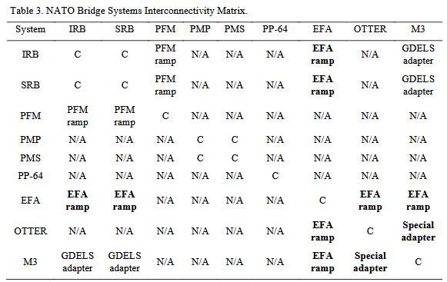
Interoperability requirements for enhanced military mobility during water crossing operations
TRANSCOM 2025: 16th International Scientific Conference on Sustainable, Modern and Safe Transport
Jaroslav Kompan¹, Daniel Brezina¹, Michal Hrnčiar¹
1 Armed Forces Academy of General Milan Rastislav Štefánik, Demänová 393, 031 01 Liptovský Mikuláš 1, Slovak republic
introduction
It is clear from the assured mobility framework that bridge assets are becoming a critical determinant in the conduct of current and future military operations, particularly on the eastern flank of NATO. | The paper addresses the interoperability of NATO's military bridging assets capable of replacing permanent bridges. The paper respects current NATO concepts and practices for crossing water obstacles, while taking into account lessons identified during the high-intensity conflict in Ukraine. | The aim of this paper is to propose relevant directions for the development of NATO interoperability in the specific area of military bridging assets for contemporary operating environment.
materials, methods & implementation
The value of the paper lies in formulating answers to two research questions, namely: “Which bridge assets are available to NATO as part of the equipment of the armed forces of NATO members?”, and “Which technological measures need to be implemented to increase the level of interoperability of the most commonly used bridging assets identified?” In developing the paper, the authors did not focus on the technical solution itself, but rather on a conceptual design that would be feasible, cost-effective and, most importantly, implementable after a relatively short period of preparation. The individual bridges were evaluated from the point of view of the user-commander responsible for crossing the water obstacle. The paper is based on the authors' theoretical research, while applying to the results knowledge from a wide portfolio of references dealing with military mobility and the use of military forces in overcoming water obstacles, as well as using the technical parameters of individual bridging assets.
results
n summary, NATO member nations have a broad portfolio of pontoon bridge systems that can be technically divided into three main design groups that are not compatible with each other. For self-propelled amphibious bridges within NATO, there are 3 types of assets in service that are partially compatible. The Interconnectivity Matrix in Table 3 allows the identification of different types of interconnections of NATO bridge systems. In the matrix, full compatibility is indicated by C and full technical incompatibility is indicated by N/A. Existing interconnectivity elements are shown in normal font. In the matrix, we also propose potential interconnections, shown in bold, that would allow the creation of interconnections between different types of systems that are technically and MLC similar, which would significantly improve the interoperability of bridge systems.
conclusion & implementation path
Future water obstacle crossing systems will not only have to improve on the capabilities of current systems but will also have to incorporate many other technological measures. Increasing demands for higher MLC loads will require the implementation of new technologies to enable greater structural buoyancy, as this can currently only be achieved by increasing the size of the obstacle crossing systems. However, the increase in size will ultimately lead to an increase in weight. It will therefore be necessary to develop materials that will ensure that the increasing load requirements of the bridge systems can be met without increasing the weight of the bridge structures. A comparative analysis of the current status of the pontoon and amphibious systems in use by NATO member states leads to the following conclusions: Most current bridging systems do not meet the requirements set for MLC. The quantity and quality of the systems is not sufficient to cross the water obstacles. Most bridging systems are currently incompatible with each other. To ensure compatibility, it is essential from the Alliance's perspective to coordinate a common approach to the introduction of new bridging assets.
acknowledgements
The paper has been supported by the outputs of the research project “NI4200646 – Concept of the Slovak Armed Forces operations in the information domain” funded by the Ministry of Defence of the Slovak Republic through the inter-ministerial sub-program 06E0I-Research and development in support of state defence.

