Slide 1





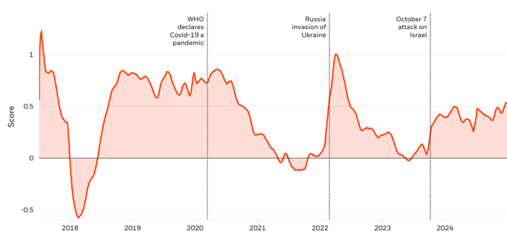
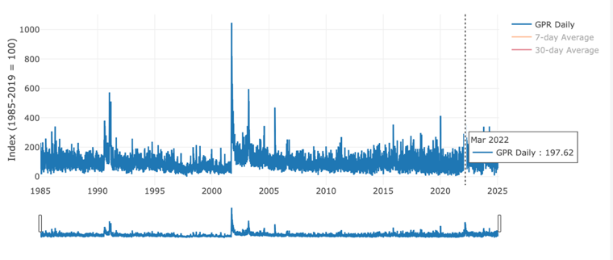
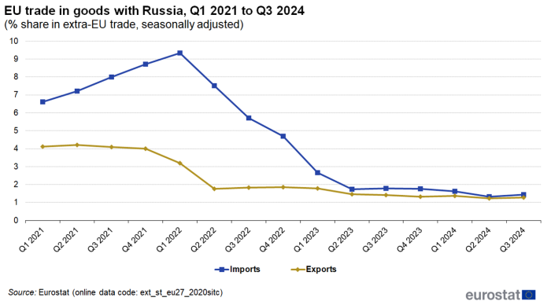
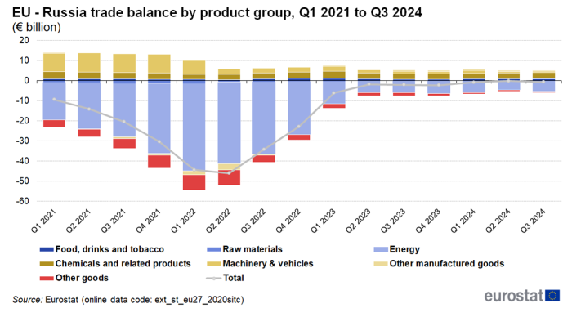
Geopolitical Risk and Its Measurable Impacts on International Trade and Transport Systems
TRANSCOM 2025: 16th International Scientific Conference on Sustainable, Modern and Safe Transport
Ing. Maryna Konovalova¹, Dr. h. c. prof. Ing. Tatiana Čorejová, PhD.²
1 Faculty of Operation and Economics of Transport and Communications, University of Žilina, Žilina, 01026, Slovakia
2 Faculty of Operation and Economics of Transport and Communications, University of Žilina, Žilina, 01026, Slovakia
introduction
Background information & Market Context The study examines the impact of geopolitical risk, specifically the Russia-Ukraine conflict, on international trade and transportation between the EU and Russia from 2022 to 2024. | Problem Statement & Stakeholders The disruption in global supply chains, especially between the EU and Russia, caused by the conflict and associated sanctions. EU governments, Russian Federation, international trade organizations, transportation companies. | Research Objectives & Expected Impact To quantify the impact of the Russia-Ukraine conflict on trade flows and transportation dynamics, specifically focusing on air, maritime, and rail transport. Provide insights into how geopolitical risks affect global supply chains and help stakeholders in transport and trade.
materials, methods & implementation
This study employs a mixed-methods approach, integrating an extensive literature review with quantitative analysis of trade and transport data. The primary data sources include Eurostat statistics, the Geopolitical Risk Index (GPRI), and the BlackRock Geopolitical Risk Indicator (BGRI).
The analysis focuses on the assessment of changes in trade volumes, transport capacities, and the adaptation of logistical networks between 2022 and 2024, with particular attention to the influence of geopolitical risks on international trade and transportation systems. The analysis draws upon Eurostat data, which spans three principal modes of transportation: aviation, maritime, and rail. Key indicators include trade volumes, transport capacities, and logistical network adaptations.
results
Academic Findings & Innovation Geopolitical risks significantly influence international trade and logistics, affecting their stability and efficiency during global crises. The study quantifies these risks using indices like the BRGRI and GPRI, which track the intensity of geopolitical events and their economic impact. Fig. 1. (a) The Global BlackRock Geopolitical Risk Indicator (2018–2024); (b) Historical Trends in the Global Geopolitical Risk Index (1985–2025). The analysis highlights the dramatic shifts in EU-Russia trade relations, with EU exports to Russia falling by 58% and imports by 86% due to the Russia-Ukraine conflict. Fig. 2. (a) EU trade in goods with Russia, Q1 2021 to Q3 2024; (b) EU – Russia trade balance by product group, Q1 2021 to Q3 2024 (%). | Practical Applications The study underscores the need for enhanced risk management strategies in international trade and logistics, particularly in response to geopolitical disruptions. Companies and policymakers must prioritize the diversification of trade routes, particularly in maritime and air transport, to minimize the impact of geopolitical conflicts. The significant shifts in EU-Russia trade and the restructuring of transportation networks highlight the importance of developing resilient supply chains and alternative logistics solutions. Additionally, the findings emphasize the need for increased investments in infrastructure protection and security measures to safeguard road and rail transport from potential geopolitical risks. Additionally, the study identifies substantial declines in maritime, air, and road transport volumes, with maritime transport seeing a 2.9% decrease in short-sea shipping and a 3.4% decline in deep-sea shipping. Air transport experienced increased operational costs due to rerouted flights and higher fuel prices, while road transport also suffered from infrastructure disruptions and heightened security costs. These findings underline the vulnerability of global transport systems to geopolitical events, emphasizing the need for strategic adaptations to mitigate these risks. | Practical Applications The study identifies substantial declines in maritime, air, and road transport volumes, with maritime transport seeing a 2.9% decrease in short-sea shipping and a 3.4% decline in deep-sea shipping. Air transport experienced increased operational costs due to rerouted flights and higher fuel prices, while road transport also suffered from infrastructure disruptions and heightened security costs. These findings underline the vulnerability of global transport systems to geopolitical events, emphasizing the need for strategic adaptations to mitigate these risks. The study underscores the need for enhanced risk management strategies in international trade and logistics, particularly in response to geopolitical disruptions. Companies and policymakers must prioritize the diversification of trade routes, particularly in maritime and air transport, to minimize the impact of geopolitical conflicts. The significant shifts in EU-Russia trade and the restructuring of transportation networks highlight the importance of developing resilient supply chains and alternative logistics solutions. Additionally, the findings emphasize the need for increased investments in infrastructure protection and security measures to safeguard road and rail transport from potential geopolitical risks.
conclusion & implementation path
This study demonstrates that geopolitical risks, particularly the Russia-Ukraine conflict, significantly disrupt international trade and transportation, with EU-Russia trade plummeting and transport volumes impacted across maritime, air, and road modes. However, intra-EU trade increased, emphasizing the growing importance of regional logistics networks. The risk of deglobalization, driven by geopolitical tensions, poses a threat to global economic integration, though countries are strengthening resilience through energy diversification and innovative logistics solutions. Future research should focus on the long-term effects of geopolitical risks on trade patterns and the role of technology in enhancing transport system resilience.
acknowledgements
This contribution was undertaken as a part of the projects: VEGA 1/0333/24 Innovative business models in the urban circular economy and 17040 Memorandum of NUT China - UNIZA Slovakia on the cooperation in education for transportation engineering and in technology transfer.

