Slide 1


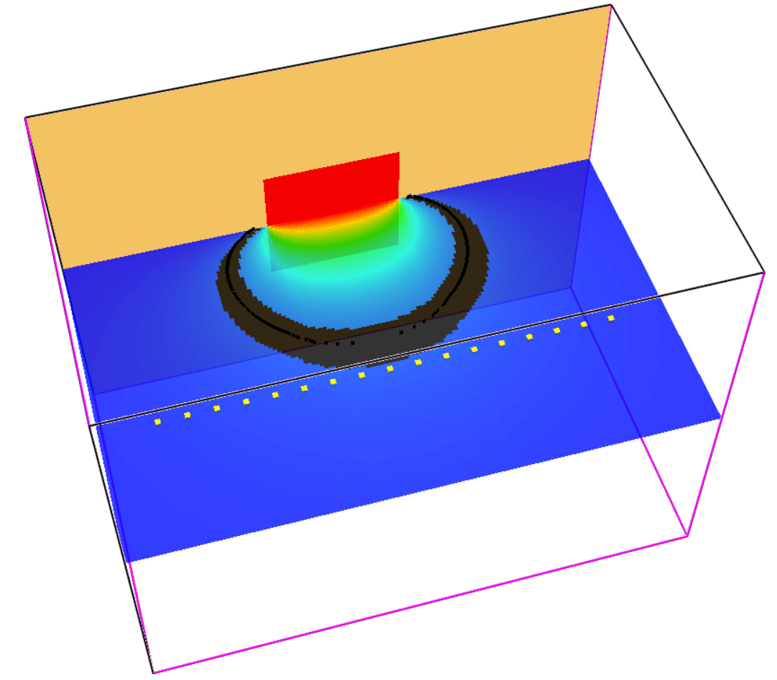
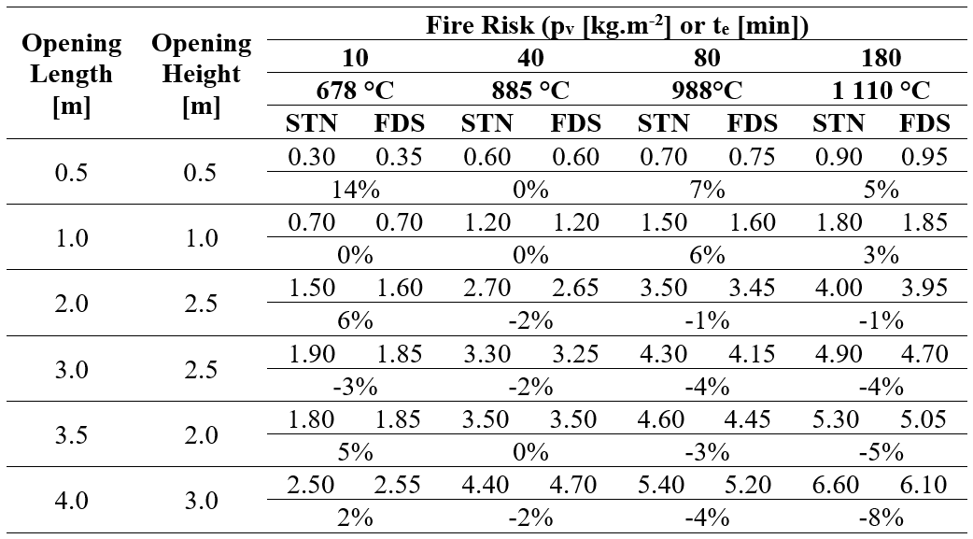
Options for simulating stand-off distances with fire models
TRANSCOM 2025: 16th International Scientific Conference on Sustainable, Modern and Safe Transport
Ing. Dorota Hodúlová¹, doc. Ing. Bc. Stanislava Gašpercová, PhD.²
1 University of Žilina, 1. Mája 32, Žilina, 010 01, Slovakia
2 University of Žilina, 1. Mája 32, Žilina, 010 01, Slovakia
introduction
Every part of building fire safety is important, especially nowadays when technology allows new buildings to be constructed nearby. Factors such as the purpose of the building, its height and distance from other buildings affect fire safety. Also, the human factor and its effect not only directly on the building but also on surrounding facilities such as traffic routes and accidents. | As construction grows, building plots decrease, raising the risk of fire spread between buildings. Understanding spacing and fire behavior is crucial. While predicting fire behavior precisely is difficult, fire models simulating fires in confined spaces can help estimate it. These models aid in fire prevention, damage reduction, and life protection. Although challenging to implement, with proper conditions, they can yield results similar to traditional methods. | To analyze spacing distances in Slovakia, general legislation and fire safety standards are used. Construction must meet all fire safety requirements outlined in the fire safety project documentation, including fire compartmentalization, fire risk assessment, building construction, evacuation plans, escape routes, stand-off distances, and fire safety measures. Fire safety is governed by STNs, which are not legally binding but mandatory when referenced in implementing regulations.
materials, methods & implementation
The FDS program was used to analyze the stand-off distances by fire models. First, a sensitivity analysis had to be performed to determine the boundary conditions and the values of the input parameters. The parameters examined in the sensitivity analysis were:
  The size of the computational cells in the computational grid.
  Path Length.
  Number of Spatial Radiation Angles.
  Time Step Increment and Angle Increment.
  Relative Humidity - this parameter takes values in the range of 0-100, with a default value of 40%.
results
The sensitivity analysis examined the effect of selected parameters on the total computational time of the simulations and on the resulting values of the stand-off distances. After the sensitivity analysis was performed and the influence of the individual input parameters was determined, a general model for the solution of stand-off distances from production and non-production buildings was developed. This model was subsequently validated. The verification was carried out by comparing the values of stand-off distances for separate openings according to STN 92 0201 - 4 with the values of stand-off distances obtained from the FDS. The verification was performed on a total of 540 simulations, but due to the amount of data, only some of the results are presented.
The results obtained from the simulations show that the FDS program is suitable for solving the spacing distances from fully fire open areas, only when all input parameters are set correctly. The largest differences where the FDS value came out greater than the STN value were 0.25 m and 0.3 m. These differences were mainly observed by the larger openings representing the fully fire open area, i.e. openings with lengths of 4.0 m and 4.5 m. In percentage terms, these differences were between 8% and 19%. In many cases, a difference between the values was also observed, where the value of the resulting distance from the FDS came out smaller than in the standard. In this case, the percentage value of the difference was recorded as negative. Such outputs are particularly noticeable for openings with a length of more than 1.5 m. The differences in this case ranged from 0.05 m to 0.5 m, which accounted for approximately 1-8 % of the difference.
conclusion & implementation path
In fire safety, factors such as building purpose, height, and distance from other buildings influence fire risk. As building density increases and plots shrink, determining spacing distances becomes crucial to minimize fire spread. Modern fire models, like the Fire Dynamics Simulator (FDS), can simulate fires in different conditions, helping design key fire safety elements, such as spacing distances. These models allow for the simulation of fire spread and measurement of thermal exposure variables, essential for determining optimal separation distances. Based on simulations, we can better understand how parameters like computational cell size or heat transfer length affect fire risk. Although still in the research stage, these models show great potential for fire prediction and safety optimization, validated through comparisons of prescriptive approach values and simulations. The use of fire models significantly contributes to protecting lives, minimizing damage, and improving the design of safe building spacing, crucial for modern urban construction, including administrative, commercial, educational, and transport buildings.
Acknowledgements
This article was supported by the project KEGA 041ŽU-4/2023 Educational and training module expanding the knowledge, skills and competences of students of the rescue services program.

