Slide 1


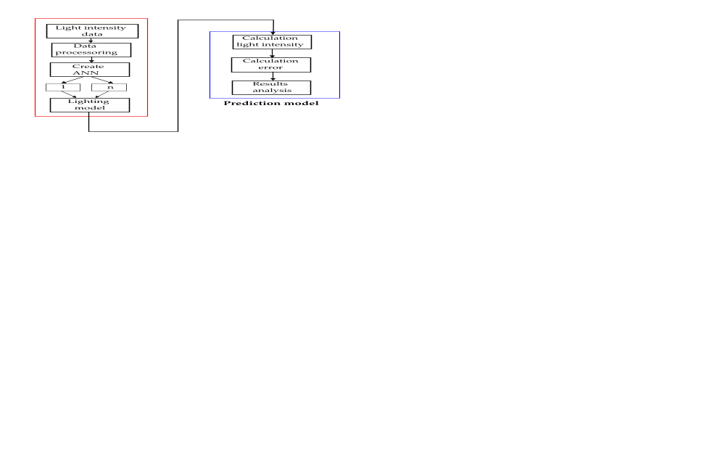
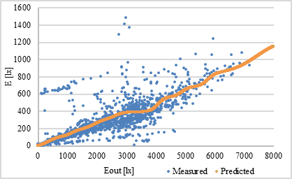
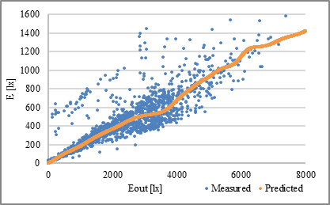
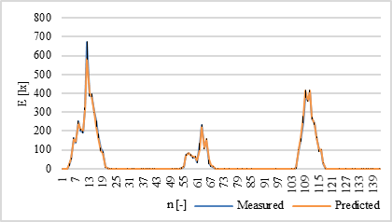
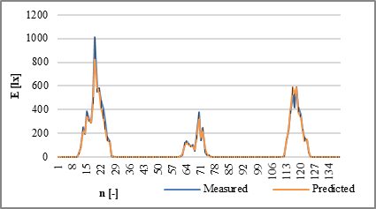

Neural Network-Based Prediction of Illumination Intensity in Workplace Environments
TRANSCOM 2025: 16th International Scientific Conference on Sustainable, Modern and Safe Transport
Pavol Belany¹, Peter Hrabovsky¹, Zuzana Florkova¹, Ingrid Zuziakova¹
1 Research Centre, University of Zilina, Univerzitna 1, 010 26 Zilina
introduction
Backround information & Market Context As energy efficiency and sustainability become global priorities, smart lighting systems are rapidly gaining momentum. Traditional lighting is being replaced by LED technology, offering superior energy savings, flexibility, and longevity.To fully unlock their potential, real-time predictive control is essential. Artificial Neural Networks (ANNs) provide an ideal solution—capable of managing complex data with high accuracy and low computational cost. As the demand for intelligent, energy-efficient environments grows, ANN-driven lighting control emerges as a powerful tool to enhance user comfort while significantly cutting energy usage. | Problem Statement & Stakeholders Traditional methods for managing workplace lighting are time-consuming and unsuitable for real-time use. There’s a need for efficient, accurate prediction tools to optimize lighting for comfort and energy savings. Stakeholders: Facility managers – aiming to reduce energy use. Office workers – needing comfortable lighting. System designers – implementing smart control. Researchers – improving predictive models. Regulators – supporting sustainable standards. | Research Objectives & Expected Impact Objectives: Develop neural network models to predict illumination intensity in workplace settings. Ensure high prediction accuracy with minimal input data. Validate model robustness through testing and performance metrics Expected Impact: Enable real-time, energy-efficient lighting control. Improve workplace comfort and productivity. Support the development of intelligent building systems aligned with sustainability goals
materials, methods & implementation
The study used two neural network models to predict illumination intensity at selected workplace points. Data were collected through targeted measurements and processed using MATLAB 2020b. A backpropagation neural network with one hidden layer of 10 neurons was trained over 1000 iterations. Approximately 75% of the data was used for training and validation, while 25% was reserved for independent testing. Model performance was evaluated using metrics such as RMSE, correlation coefficient (R), and R². The approach ensured both high accuracy and computational efficiency. Model 2 outperformed Model 1 with a higher correlation coefficient (R = 0.95 vs. 0.94), a significantly lower Mean Squared Error (MSE = 118.3 vs. 385.4), a better coefficient of determination (R² = 0.91 vs. 0.89), and a reduced Root Mean Square Error (RMSE = 34.39 vs. 62.08).
results
Both developed models achieved high accuracy, with correlation coefficients up to 0.98 and low error rates. This confirms the potential of neural networks as effective tools for modeling complex lighting behavior in indoor environments. The innovation lies in simplifying the prediction process without sacrificing precision, paving the way for smarter, data-efficient lighting control systems. The developed models can be integrated into intelligent lighting systems for offices and industrial buildings. By enabling real-time adjustments based on predicted light conditions, they enhance user comfort, reduce energy consumption, and support sustainability goals. Facility managers, engineers, and system designers can use these models to optimize lighting performance with lower operational costs and minimal infrastructure changes.
 | RMSE [lx] | Error [%] | R [-] | R² [-] | Standard error [lx]
1 | 43.22 | 3.42% | 0.97 | 0.94 | 42.8
2 | 46.57 | 3.13% | 0.98 | 0.96 | 46.03
conclusion & implementation path
This research confirmed that neural networks can effectively predict workplace illumination intensity with high accuracy and reduced input requirements. The models demonstrated strong performance in both training and testing phases, validating their robustness and practical relevance. The impact of this work lies in its contribution to energy-efficient building management, offering a scalable solution for adaptive lighting control that improves comfort while reducing consumption. These findings support the shift toward intelligent, sustainable infrastructure. Future research could explore more complex lighting environments, integrate additional environmental variables (e.g., occupancy or daylight), and expand the models for use in dynamic, multi-room systems or smart city frameworks.
acknowledgements
Funded by the EU NextGenerationEU through the Recovery and Resilience Plan for Slovakia under the project No. 09I03-03-V04-00312

