Slide 1


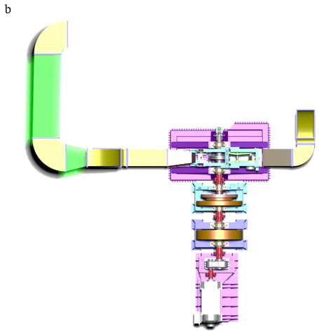
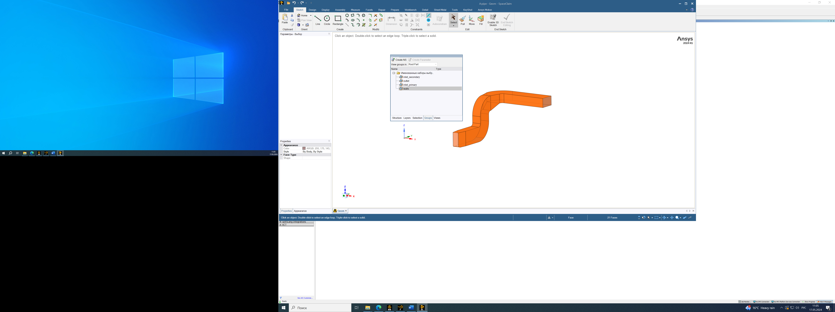
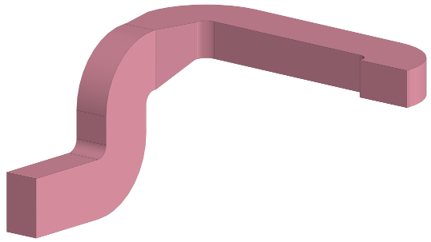
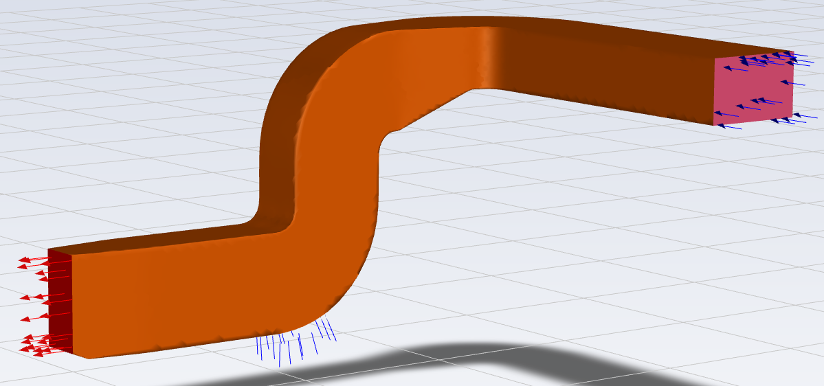
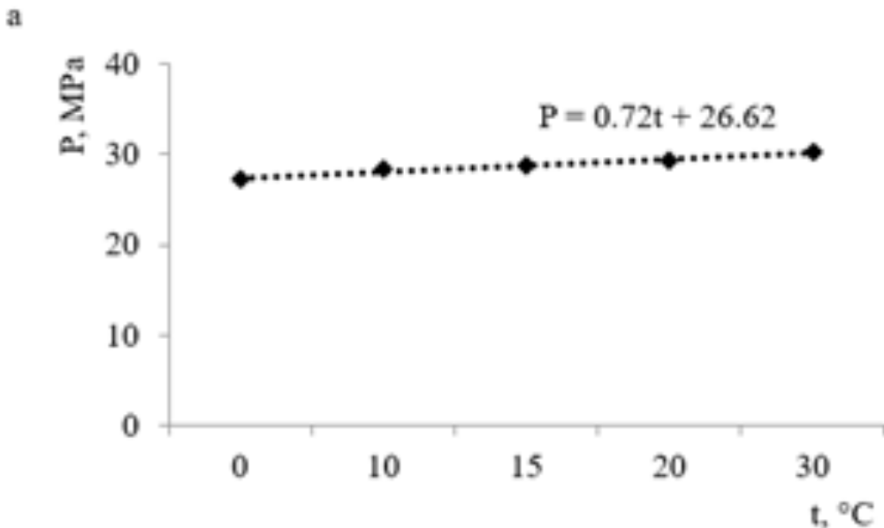
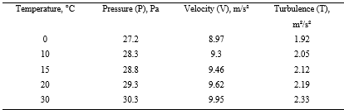
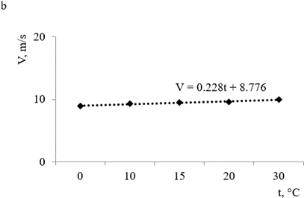
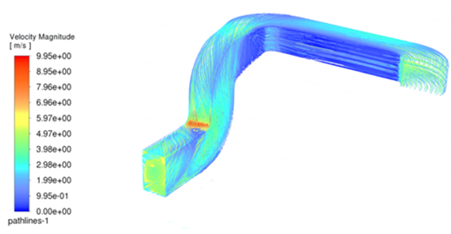
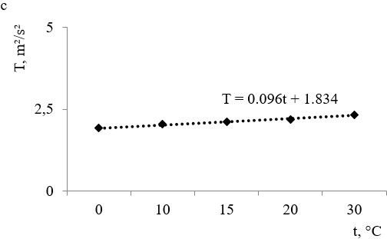
The influence of air parameters on the indicators of air movement in the air pipe of a brake test bench
TRANSCOM 2025: 16th International Scientific Conference on Sustainable, Modern and Safe Transport
Juraj Gerlici¹, Alyona Lovska¹, Matúš Adamkovič¹
1 University of Žilina, Žilina, Slovak Republic
introduction
One of the primary tasks currently facing the railway industry is to ensure the safety of rolling stock movement. This can be achieved not only by improving the design of rolling stock and methods of calculation, but also by introducing | new brake designs with improved technical and operational characteristics. Disc brakes are used on rolling stock operating at speeds of more than 140 km/h. Due to the high speeds, special requirements are placed on the discs. | Therefore, at the stage of designing and modernizing disc brakes, it is important to ensure that they are tested to a high standard, wherein the investigation of the effect of air parameters on brake performance is most essential.
materials, methods & implementation
For the purpose of experimental testing of disc brakes, a special stand was used in the laboratory of the Department of Transport and Handling Machines at the University of Zilina (Fig. 1).
Air was supplied to the disk through the air pipe (Fig. 2).The parameters of air movement in the air pipe were determined by means of a simulation conducted in ANSYS in which FLOW-SIMULATION was implemented. The initial stage of the calculations included the assignment of the appropriate surfaces of the air pipe (Fig. 3), which were corresponded with the air inlet, air movement between individual components, the air outlet, and air pipe walls.
The next stage of the calculations included the development of a finite element model of the air pipe using tetrahedra the optimal number of which was calculated by the graphic analytical method. The maximum size of the mesh element was 0.11 mm, and the minimum size was 0.004 mm. The design diagram of the air pipe is shown in Fig. 4. The air inlet to the pipe is shown in blue, and the outlet is shown in red.
At subsequent stages of the study, the authors plan to conduct full-scale tests to determine the air parameters during its flow in the pipeline.
Fig. 1. The disc brake test bench (top view)
Fig. 3. The assignment of surfaces
Fig. 2. The air pipe of the test bench.
Fig. 4. The design diagram of the air pipe.
results
Air temperature, °С |  | Air density, kg/m³
0 | 1.293 |  | 17.2
10 | 1.247 |  | 17.6
15 | 1.226 |  | 17.9
20 | 1.205 |  | 18.1
30 | 1.165 |  | 18.6
The calculation was performed at different values of temperature, density and viscosity. These parameters were chosen as an example, and they were chosen as variational. These parameters were chosen based on recommendation in the relationships in the related literature. This allows, that the corresponding input parameters to be incorporated into the computer model. Based on the calculations, the corresponding results were obtained (Table 1).By analysing the results, it can be concluded that the controlled parameters (P, V, T) are directly proportional to the air temperature (Fig. 5). The analysis of the obtained dependencies demonstrates that the change in air temperature has a slight effect on the parameters studied. This follows from the obtained dependencies shown in Fig. 5, which are flat. Therefore, the corresponding conclusion was made. However, it should be noted that this conclusion is valid for the case of variation in three air parameters.Using the options of ANSYS, the pressure, velocity and turbulence fields in the air pipe were also determined. Fig. 6 shows the results of calculating the air velocity at a temperature of 30°; as seen, the maximum air velocity occurs at the outlet of the air pipe.
Table 1. The air parameters..
Fig. 5. The dependence of air parameters on air temperature (a) pressure; (b) velocity; (c) turbulence.
Fig. 6. The air velocity in the air pipe
conclusion & implementation path
The movement of air in the air pipe of the brake test bench is modelled. The influence of air parameters on the indicators of air movement is investigated. The pressure, velocity, and turbulence were considered as controlled parameters. It is found that the controlled parameters are directly proportional to the air temperature. However, changes in air temperature have little effect on the indicators controlled. The results of the calculations will help reproduce the actual braking conditions of a railway car in the laboratory, in addition they can be used in the development of modern disc brakes for rolling stock with improved characteristics.
acknowledgements
This research was supported by the Cultural and Educational Grant Agency of the Ministry of Education of the Slovak Republic under the project KEGA 024ZU-4/2024: Deepening the knowledge of university students in the field of construction of means of transport by carrying out professional and scientific research activities in the field. It was also supported by the Slovak Research and Development Agency of the Ministry of Education, Science, Research, and Sport under the project VEGA 1/0513/22: Investigation of the properties of railway brake components in simulated operating conditions on a flywheel brake stand. “Funded by the EU NextGenerationEU under the Recovery and Resilience Plan for Slovakia under the project No. 09I03-03-V01-00131”.

