Slide 1


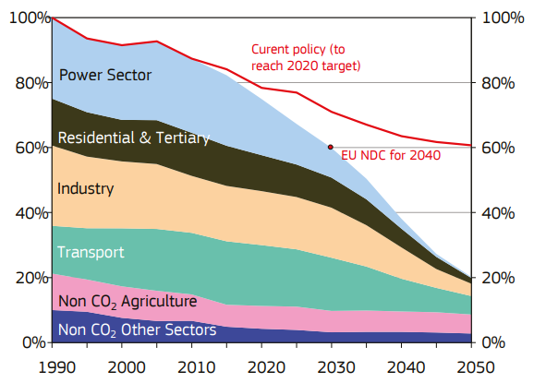
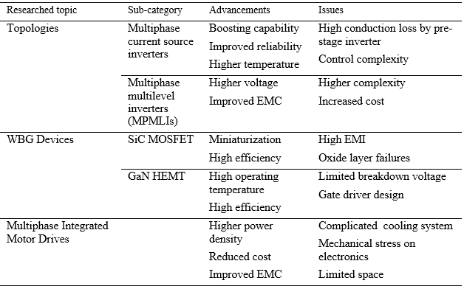
New trends in automotive – Electric drives and power electronics
TRANSCOM 2025: 16th International Scientific Conference on Sustainable, Modern and Safe Transport
Ján Markovič¹, Michal Frivaldský¹
1 University of Žilina, Univerzitná 8215, 010 26 Žilina, Slovakia
introduction
Worldwide pressure on green mobility brings the mobility industry into the most disruptive period of all time, challenging it with requirements for improvement of electric vehicles, its fundamentals while preserving environmental protection and reduction of emissions. | Main two challenges of EV is cost and size of energy storage with traction drive system. Targets set by European union and USDrive partnership require decreased target pricing per kW of traction drives, while retaining reliability and sustainability at adequate levels. | Utilization of high voltage levels, single traction drive electric motor and power converters containing advanced semiconductor devices.
materials, methods & implementation
Analysis of the actual and future plans for development of transportation sector with the intention for lowering carbon emissions while retaining the sustainability and reliability of the vehicle usage. Inspecting the plans reveals actual and future targets set for the development, as they are required by authorities or research groups. Continuing by analysis of the state-of-art devices and technologies in automotive sector as electric machines (EMs) and power converters reveals the most actual trends from research and development (R&D) sector. Implementation of described points brings insight into possible solutions for raised main questions in automotive and environmental sectors for urban and logistical transportation.
results
European Commission published a plan for transforming EU into a low-carbon economy by year 2050. As transportation sector holds major part in terms of producing emissions, implementation of EVs is a promising solution for described issue. Environmental stress and political pressure evoked public pressure for clean, sustainable and efficient vehicles suited for urban transport. While described implementation of electrification is in progress, there is a rising demand for more efficient electric traction drive systems with higher power, ensuring better range for given battery charge. USDrive partnership proposed support to the mass market adaption of EVs. Their focus is set on electric drives, power electronics and traction drive systems, while maintaining technology, cost and reliability. Due to progression of the EV market, innovation needs to provide greater portable power and lower energy consumption. USDrive already set goal for utilizing high voltage levels and single traction drive electric motor, together combined with wide-bandgap switching devices and more appropriate technical instructions for advanced integrated power module design. Recently discovered carbon nanotube incorporated copper windings are gaining traction in interest for usage. Permanent magnet machines rely on NdFeB magnets due to high energy density, but they come with high cost. Currently there are available alternative types of magnets, free of expensive heavy rare-earth (HRE) materials. Improvement in materials of stator and rotor laminations for EMs improve magnetic properties and reduce core losses. Power density targets are counting on the wide band-gap (WBG) switching devices, which ensure reduced power losses and chip sizes. Proposed WBG devices are made from Silicon carbide (SiC) and Gallium Nitride (GaN) materials. Advancements in packaging of switching devices can deliver superior thermal and electrical performance. By usage of multilevel inverters (MLIs) and multiphase drives (MPDs), manufacturers can offer high-torque and high-performance applications in EVs, while MPDs can also operate in fault-tolerant mode.
Fig. 1. EU Plan for Carbon neutrality till year 2050.
European Commission (2016)
conclusion & implementation path
R&D teams and manufacturers are continuously working on delivering new promising technologies and materials in terms of electrical machines, traction inverters and optimizations. There are still a lot of challenges that require examination and solutions. Proposed and described technologies, materials and topologies are state-of-art promising solutions, those are available for usage or still in a development phase. Challenging targets set by European commission and USDrive partnership require further growth of power density levels. Because of the aggressive nature of determined goals, it is still questionable whether the requirements will be accomplished or at least realized up to close margin. Implementation of WBG devices, advanced topologies of traction inverters and integrated motor drives are magnificent step forward, rendering high-performance devices with greater power density levels. Together with EMs designed with advanced non-HRE materials and CNT windings are a promising positive response for current major automotive challenges and questions.
Fig. 2. Table of up-to-date R&D trends.
W. Taha, et. al. (2022)
acknowledgements
The authors would like to thank for the financial grant support for the projects: VEGA 1/24/0274. P. Leteinturier, C. Mueller, 2020, Power Semiconductors – the Keys for a Future Green Mobility M. Pahlevani, P. K. Jain, 2020, Soft-Switching Power Electronics Technology for Electric Vehicles: A technology review W. Taha, P. Azer, A. D. Callegaro, A. Emadi, 2022, Multiphase Traction Inverters: Satet-of-the-Art Review and Future Trends I. Husain, B. Ozpineci, M. S. Islam, E. Gurpinar, Gui-Jia Su, Wensong Yu, S. Chowdhury, L Xue, D. Rahman, Raj Sahu, 2021, Electric Drive Technology Trends, Challenges, and Opportunities for Future Electric Vehicle European Commission, 2016, The roadmap for transforming the EU into a competitive, low-carbon economy by 2050

