Slide 1


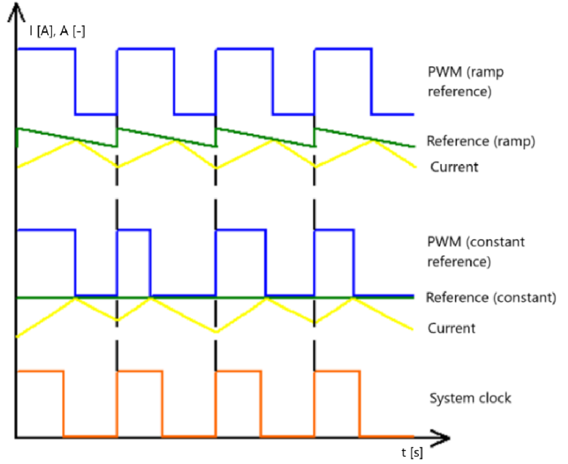
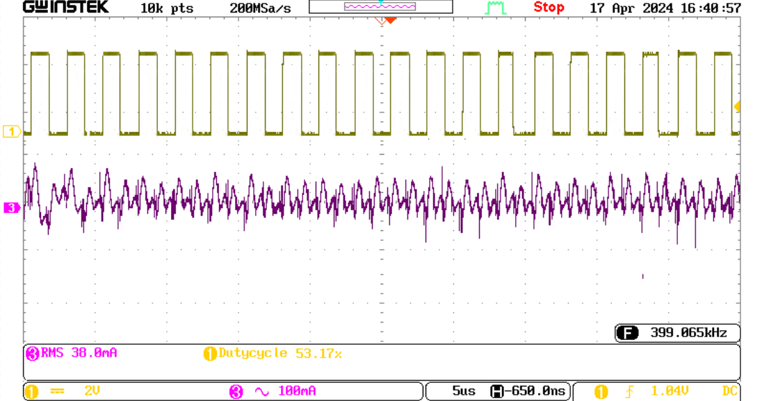
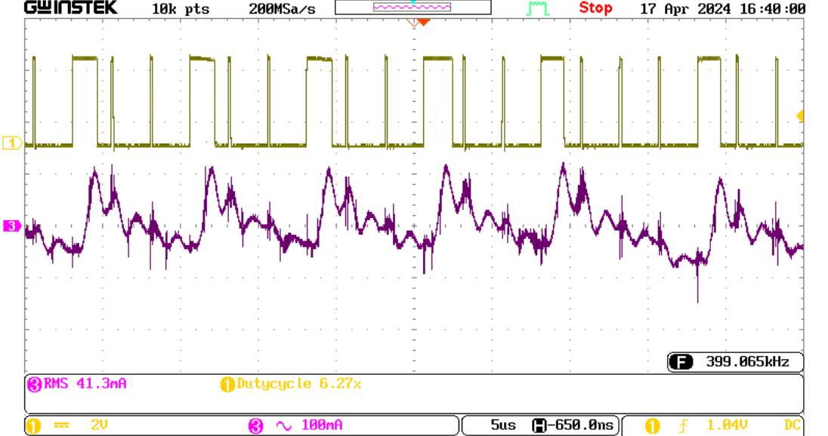
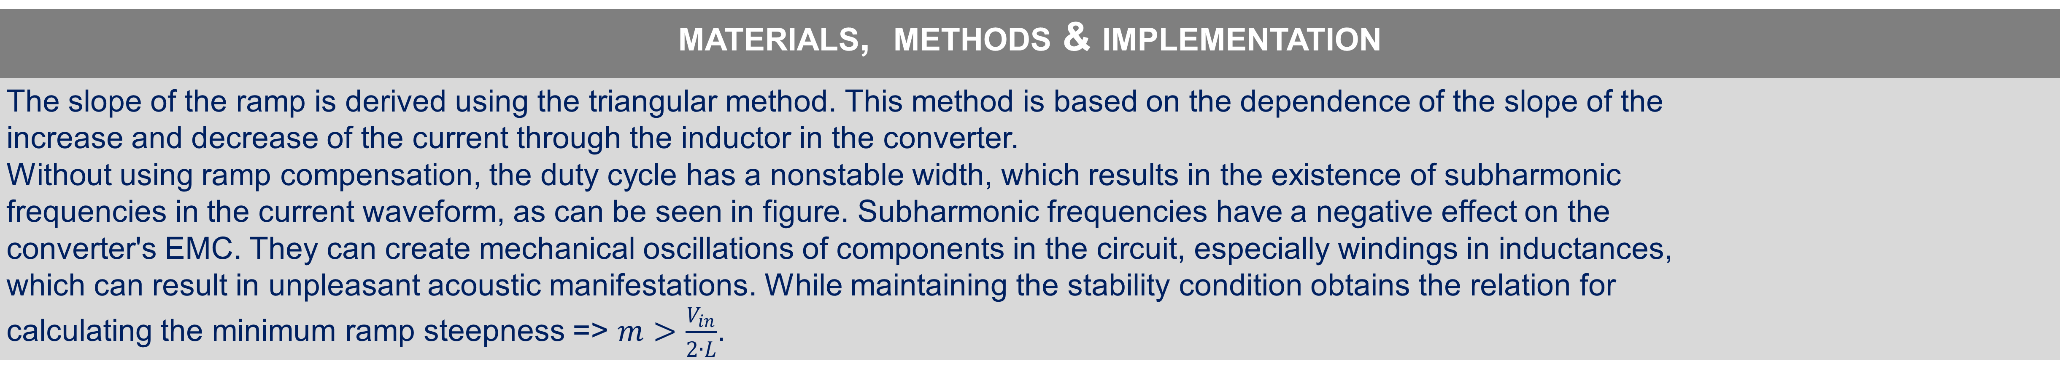
Designing of the Ramp Reference for Buck Converter for Hydrogen production
TRANSCOM 2025: 16th International Scientific Conference on Sustainable, Modern and Safe Transport
Tomáš Paulec¹, Pavol Špánik², Juraj Tvarožek³, Michal Praženica⁴
1 University of Žilina, Žilina, Slovakia
2 University of Žilina, Žilina, Slovakia
3 University of Žilina, Žilina, Slovakia
4 University of Žilina, Žilina, Slovakia
introduction
The document discusses advancements in hydrogen production for transportation applications, focusing on improving power converters used in electrolysis. Hydrogen is increasingly considered a sustainable energy alternative for fuel-cell electric vehicles and combustion engines. | The transportation sector is shifting to hydrogen energy, but power converter instability in electrolysis hinders efficiency and scalability. This study optimizes ramp reference compensation in buck converters to enhance stability and energy conversion for reliable hydrogen production. | This research enhances power converter stability by optimizing ramp reference compensation to eliminate subharmonic oscillations. It improves electrolysis efficiency, reduces energy losses, and lowers costs. By ensuring reliable power conversion, it supports large-scale hydrogen adoption.
materials, methods & implementation
The slope of the ramp is derived using the triangular method. This method is based on the dependence of the slope of the increase and decrease of the current through the inductor in the converter. Without using ramp compensation, the duty cycle has a nonstable width, which results in the existence of subharmonic frequencies in the current waveform, as can be seen in figure. Subharmonic frequencies have a negative effect on the converter's EMC. They can create mechanical oscillations of components in the circuit, especially windings in inductances, which can result in unpleasant acoustic manifestations. While maintaining the stability condition obtains the relation for calculating the minimum ramp steepness => $m>\frac{V_{in}}{2∙L}$.
results
After applying ramp compensation, Fig.1, the converter's efficiency improved by 1.99 %, from 66.24 % to 68.23 %. The output current ripple was reduced by 26.3 %, from 190 mA to 140 mA, leading to a more stable power supply to the electrolyzer. Unlike conventional peak current mode control without compensation, which suffers from instability above 50% duty cycle, our method ensures stable operation under a wide range of operating conditions. Without using the ramp compensation Fig. 2. subharmonic frequencies appear in the output current, which can be observed in the slight ripple of the output current. The control signal alters its value in each period with a periodically repeating pattern. Fig.1 Output current and PWM waveform of the converter, using ramp compensation Fig.2 Output current and PWM waveform of the converter, without using ramp compensation
conclusion & implementation path
This study demonstrates the effectiveness of ramp compensation in improving the stability and efficiency of a peak current mode-controlled buck converter used for hydrogen electrolysis. Our experimental validation confirms that implementing an optimal ramp reference eliminates subharmonic oscillations and enhances overall system performance. By improving hydrogen production efficiency, the work supports the transition to green energy that replaces fossil fuels in transport and industry. Better efficiency means lower energy requirements and fewer emissions from electricity production, especially if the electricity is from renewable sources. More stable hydrogen production has a direct impact on the quality and availability of fuel for fuel cell vehicles. The converter will be used for experimental testing of the influence of current pulses on electrolysis properties. The results will be the basis for designing a more advanced converter. Therefore, in future designs, we would like to consider all the knowledge collected and implement it in designing a more complex converter after performing measurements on electrolyzers. Future work will explore advanced adaptive ramp compensation techniques to enhance efficiency and stability further, making hydrogen production systems more reliable and scalable for industrial applications.
acknowledgements
This work was supported by projects: APVV-22-0330 “Research of a system for active and optimal management of electrical energy using battery storage system“ and VEGA 1/0314/24 “Research of a system for active management of electrical energy using the battery storage system.” Liu, Y., & Chen, Q., 2011, "High-frequency switching behavior and modeling of power converters." IEEE Transactions on Industrial Electronics, 58(1) D. Zhao, M. Zhou, J. Wang, T. Zhang, G. Li and H. Zhang, 2023, "Dispatching Fuel-cell Hybrid Electric Vehicles Toward Transportation and Energy Systems Integration," in CSEE Journal of Power and Energy Systems, vol. 9, no. 4, pp. 1540-1550, July 2023, doi: 10.17775/CSEEJPES.2020.03640. M. U. Ahmed A., U. Raximov, M. Sayidvalieva and A. Pradeep, 2023, "Comparative Analysis of the Advancement of Hydrogen Vehicles and Electric Vehicles: A Critical Review," 2023 International Conference on Computational Intelligence and Knowledge Economy (ICCIKE), Dubai, United Arab Emirates, pp. 151-155, doi: 10.1109/ICCIKE58312.2023.10131877. Demir, Nesrin & Kaya, Mehmet Fatih & Albawabiji, M.. (2018). Effect of pulse potential on alkaline water electrolysis perfor-mance. International Journal of Hydrogen Energy. 43. 10.1016/j.ijhydene.2018.07.105

