Slide 1


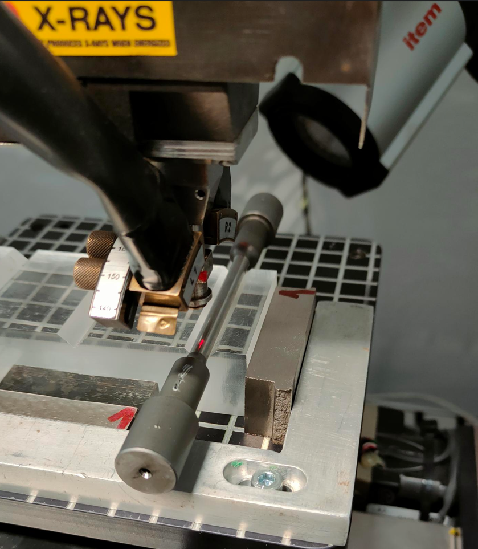
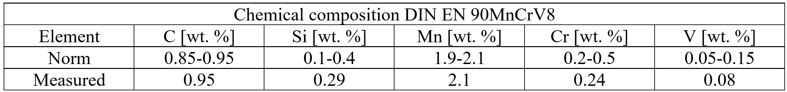
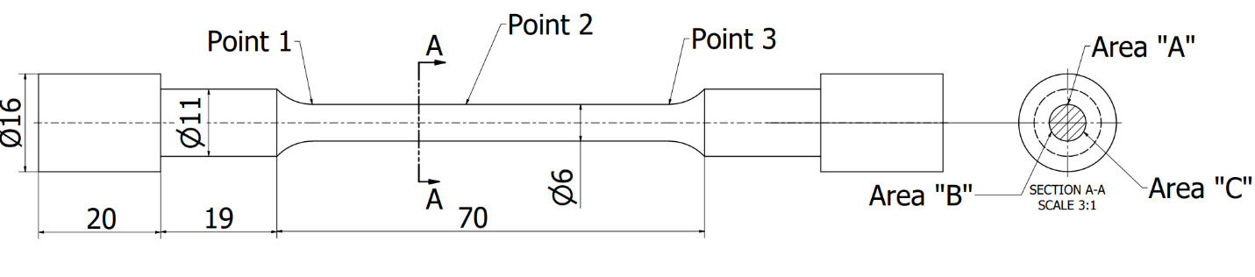
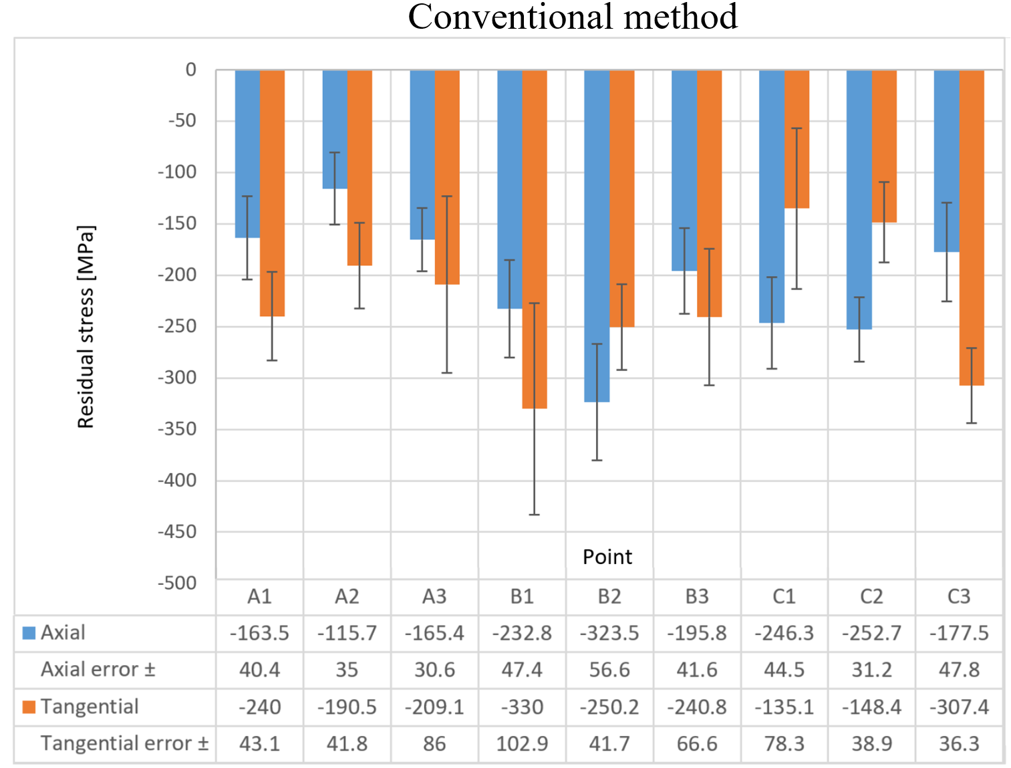
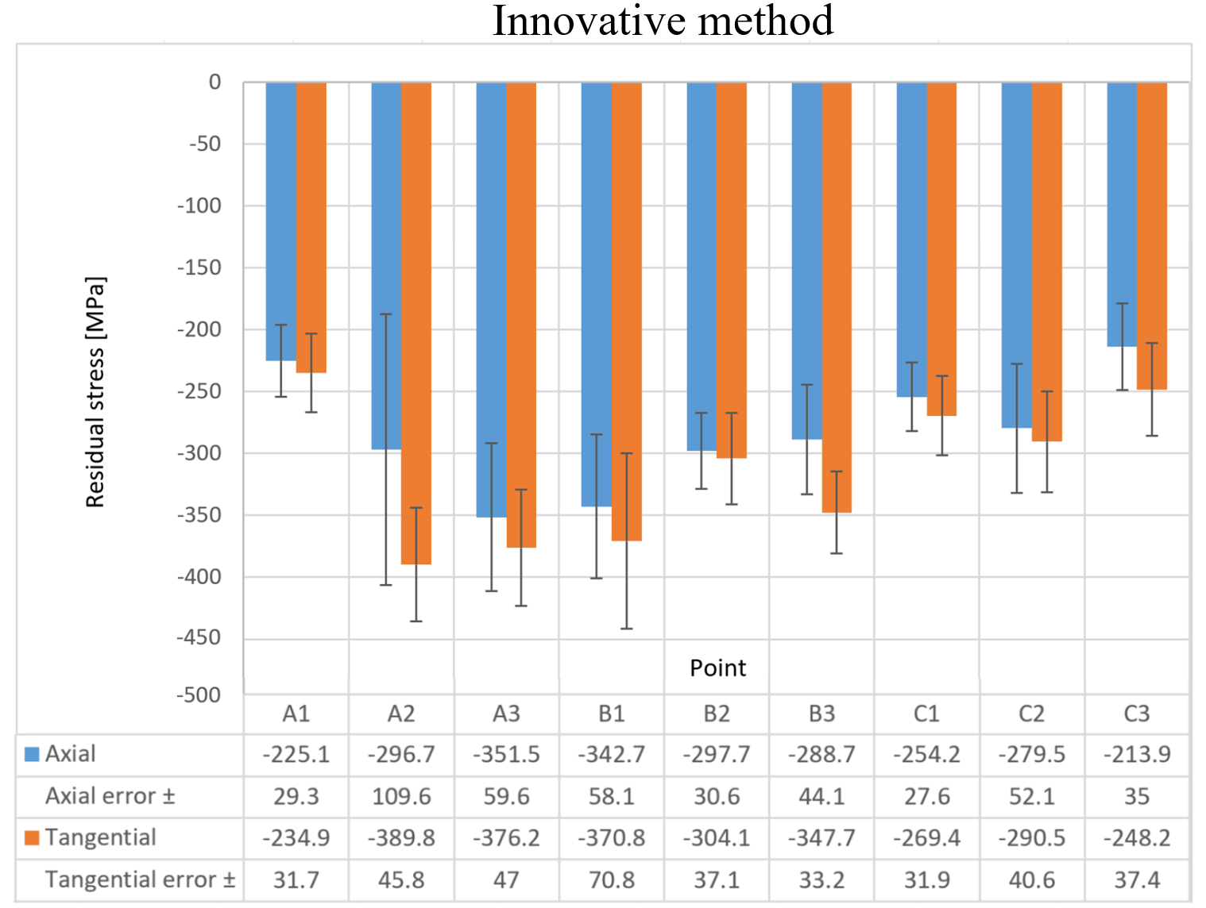
Comparison of Residual Stresses in Tools Used in the Automotive Industry: Conventional vs. Innovative
Heat Treatment for Cost-Effectiveness and Efficiency
TRANSCOM 2025: 16th International Scientific Conference on Sustainable, Modern and Safe Transport
Peter Spuro¹*, Michal Sajgalik¹, Jozef Mrazik¹, Andrej Czan¹, Richard Joch¹, Mario Drbul¹, Jaromir Markovic¹
1 University of Žilina, Žilina, Slovakia
introduction
Background information & Market Context Currently, there is a trend towards reducing energy consumption in manufacturing processes. It is crucial to find ways to optimize processes and achieve higher profitability. The primary focus is on reducing energy intensity in heat treatment, where energy consumption is particularly high. Tool steels must be tempered after hardening. Tempering also results in high energy consumption, which is why it is necessary to find ways to optimize this process. | Problem Statement & Stakeholders Residual stresses are formed in the material after hardening and tempering. These residual stresses can be either compressive, denoted as (-), or tensile, denoted as (+). Compressive residual stresses enhance the fatigue limit of steel by impeding crack initiation. In contrast, tensile residual stresses facilitate crack initiation by creating favourable conditions for fatigue failure. | Research Objectives & Expected Impact This study evaluates two distinct heat treatment approaches. The first is a conventional regime involving quenching, tempering, and a final tempering step in the coating chamber. The second is an innovative regime that combines quenching with direct tempering in the coating chamber, omitting the intermediate tempering step. The aim of this study is to compare the residual stresses in tool steel processed by conventional and innovative methods.
materials, methods & implementation
The material used in the experiment was 90MnCrV8 steel, which is suitable for coldwork.
The samples were quenched in an induction dual-chamber vacuum furnace RDVA–8.10.6/13G. Following tempering, the steel was placed in the coating chamber of the Staton PD 300 on a heated rotating holder. Residual stress measurements were conducted using the ProtoiXRD device. The radiation type was CrKα, and the irradiated area size was 1 mm². Residual stresses were measured in both the axial and tangential directions. The diffraction signal from the {222} plane was collected at an angle of 156.9°.
results
In both methods, compressive residual stresses predominated on the surface. The innovative heat treatment method demonstrated slightly higher surface compressive residual stress values, which is considered a beneficial outcome. Moreover, the residual stress distribution in both methods exhibited a consistent trend in both the axial and tangential directions, indicating comparable stress behavior across the samples.
conclusion & implementation path
The study demonstrates the significant advantages of the innovative heat treatment method in influencing residual stress distribution. The following key conclusions can be drawn: Both the innovative and conventional methods predominantly induce compressive residual stresses on the surface, which are crucial for enhancing resistance to crack initiation and propagation. The innovative method proves to be more efficient and cost-effective compared to conventional techniques. Higher compressive residual stress values were achieved with the innovative method, further improving the material's performance and durability. The martensitic phase transformation during quenching plays a vital role in generating compressive stresses near austenite crystals and stabilizing the retained austenite phase, contributing to enhanced mechanical properties. Residual stress patterns were consistent in both axial and tangential directions, irrespective of the heat treatment method employed. Overall, the innovative method emerges as a superior choice for the heat treatment of automotive components, offering improved residual stress characteristics and extended fatigue life, thus making it a more sustainable solution.
acknowledgements
This research was funded by the University of Žilina project APVV-20-0216: “Research on the Implementation of High-Impact Surface Technologies for Precision Automotive Structural Components“, APVV 20-0561 - “Research on the implementation of new measurement methods for calibrating measurement systems in industrial metrological practice“, KEGA 025STU-4/2024 "Development of Soft Skills in University Students in Technically-Oriented Subjects".

