Slide 1


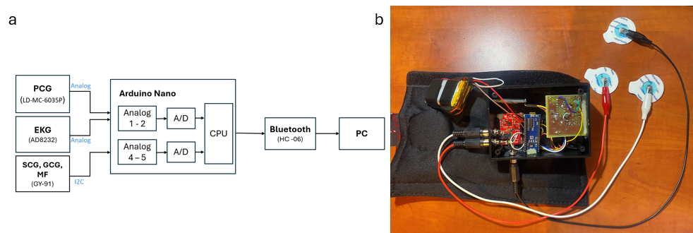
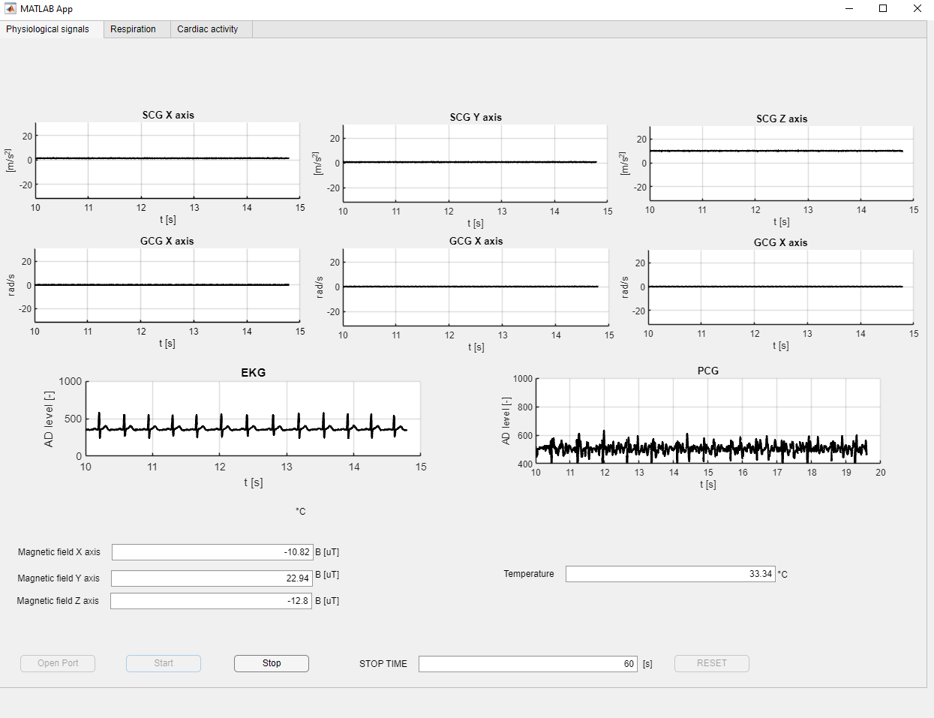
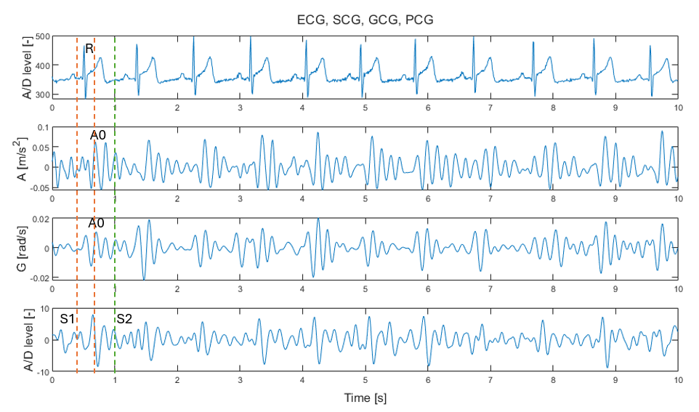
Seat Belt Cover for Monitoring the Driver's Physiological Functions – Laboratory Prototype
TRANSCOM 2025: 16th International Scientific Conference on Sustainable, Modern and Safe Transport
Veronika Wohlmuthova, Michal Labuda, Maros Smondrk, Lubomir Trpis, Branko Babusiak
University of Zilina, Faculty of Electrical Engineering and Information Technology, Department of Electromagnetic and Biomedical Engineering,
Univerzitna 8215/1, Zilina 010 26, Slovakia
introduction
Circulatory diseases are rising, harming life expectancy, quality of life, and economic stability. In Slovakia, they caused 35.9% of deaths in 2021. Truck drivers are especially at risk, facing health issues, reduced performance, higher accident risks, and economic consequences. | Cardiovascular diseases are a leading cause of death in Slovakia, especially among drivers. Our device monitors drivers' health in real time—tracking cardiac activity, temperature, and respiration—to enable early diagnosis and prevention. | This poster introduces a multifunctional device for professional drivers, combining cardiac monitoring with static magnetic field detection. By using a multiparametric approach, it enhances physiological assessment, reduces cardiovascular risks, and improves road safety through early hazard detection.
materials, methods & implementation
Our device (Fig. 1a) integrates readily available components. The ECG is recorded using the AD8232, while SCG and GCG are monitored via the GY-91 module, which includes BMP280 and MPU9250 sensors. The MPU9250 features a 9-axis sensor, and BMP280 provides pressure and temperature data.
PCG monitoring is enabled by a custom board with an LD-MC-6035P microphone, an acoustic tube, and a phonendoscope head, with signal processing via an OP484-based analog circuit.
All components are integrated with an Arduino Nano, communicating via Bluetooth (HC-06) and powered by two 3.7 V Lithium Polymer batteries. The GY-91 module along with the phonendoscope head was placed directly in the seatbelt cover, while the Arduino Nano, AD8232 and Bluetooth module HC-06, PCG board and Li-Pol batteries, were placed in a plastic box on top of the seatbelt cover Fig. 1b.
Fig. 1. (a) Block diagram of the device; (b) Realization of the constructed device.
PCG – Phonocardiography
SCG – Seismocardiography
GCG – Gyrocardiography
ECG – Electrocardiography
MF – DC magnetic field measurement
results
Our MATLAB-based application, built with AppDesigner, controls, processes, visualizes, and stores signals. It features three main windows, with the first (Fig. 2) handling real-time recording and visualization. It captures SCG and GCG signals from X, Y, and Z directions, records skin surface temperature, and averages magnetic field values over 10 seconds across all axes.
Fig. 2. Initial window of the application with real-time signals graphs.
Fig. 3. 10 second recording of ECG, SCG, GCG and PCG signals. Key events in the cardiac cycle: R - ventricular depolarization, AO - opening of the aortic valve, S1 - closure of the mitral and tricuspid valves, S2 - closure of the aortic and pulmonary valves.
conclusion & implementation path
Monitoring professional drivers' physiological signals can significantly reduce health risks and enhance road safety. Our multifunctional device continuously tracks cardiac signals (ECG, SCG, GCG, PCG), respiratory activity, body temperature, and static magnetic fields, providing real-time insights to help prevent critical incidents such as microsleep or sudden cardiac failure. Currently a fully functional laboratory prototype, the system is designed for accuracy, practicality, and seamless vehicle integration. A mobile application is also in development to alert drivers through vibrations or ringing when anomalies are detected. Future test measurements will involve in-car monitoring to refine the system and address biosignal artifacts caused by engine activity and vehicle motion. Beyond professional drivers, this device has potential applications in remote healthcare, sports diagnostics, high-risk health monitoring, and environmental assessments of static magnetic fields, making it a versatile tool for broader health and safety applications.
acknowledgements
This research was funded by the Slovak Research and Development Agency, grant number APVV-22-0423 and UNIZA grant system number 20412/2024.

