Slide 1


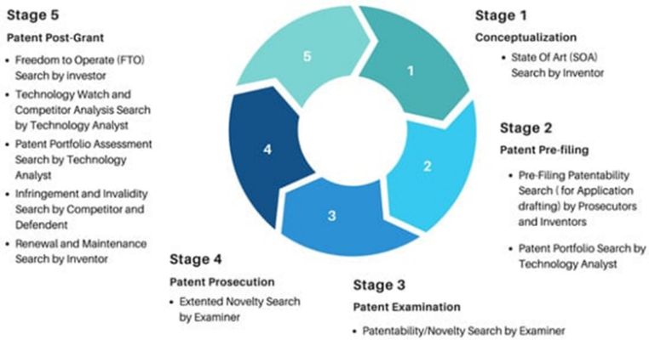
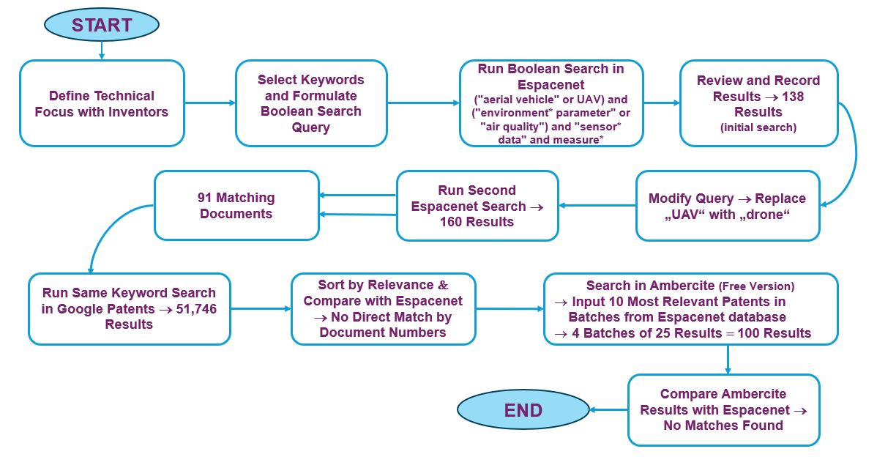
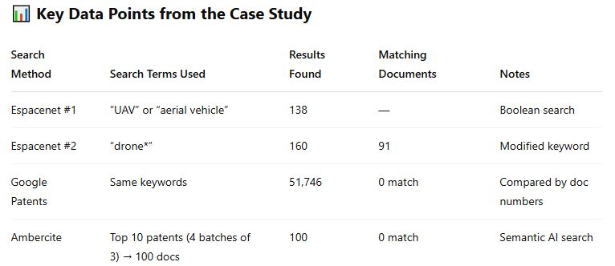
Patent Searches in the University Environment – New Challenges Related to AI
TRANSCOM 2025: 16th International Scientific Conference on Sustainable, Modern and Safe Transport
Mária Tomková¹, Andrea Čorejová², Katarína Hornická³
1 University of Zilina, Zilina, Slovakia
2 University of Zilina, Zilina, Slovakia
3 University of Zilina, Zilina, Slovakia
introduction
Background Information & Market Context patent searching is a key factor for verifying the novelty of a research result patent searches are usually performed by search experts in paid and freely available databases the development of AI tools brings opportunities for lay public, researchers and students to use the search activity and its results | Problem Statement & Stakeholders identification of suitable patent search tools/platforms for researchers, students and searching experts | Research Objectives & Expected Impact description of patent search tools that use semantic search and artificial intelligence (AI) in research compared to traditional methods point out the possibilities and the limits of the different search approaches in the university environment expanding AI patent searching tools in the university environment in the future
materials, methods & implementation
applied searching methods: Boolean Search, Semantic Search, AI Search relevant patent search tools/platforms in the university environment: freely available: Patentscope, Espacenet, Google patents, Patent Quality Artificial Intelligence (PQAI), Derwent Innovation Index – Web of Science search engine paid: Ambercite, Patbase, Quartet, Novelty and LexisNexis the purpose of the search – patent searches to retrieve patent documents at different stages of the patent lifetime (see figure on the right) comparison of patent search methods in the university environment
results
CTT UNIZA realized a state of the art search for a technical solution related to UAVs in order to compare the results of patent searches using various searching methods. The figure on the left shows an overview of the patent search process used in the case study. The figure on the right shows the results of the case study. Overview of the Patent Search Process (authors) Case Study: Key Data Points (Chat GPT) The strength of AI search is efficiency, as it can analyse large amounts of data in a much less time than traditional search methods. It can also categorise and automate many search-related activities and provide comprehensive analysis. AI can also help predict future trends in R&D based on historical data to which it has access to, as well as assist in decision-making processes related to the IP protection strategy. On the other hand, there are risks such as data quality, which affects the quality of the outputs themselves, which is directly dependent on the scale and complexity of the data the AI is trained on. Therefore, a certain level of critical thinking and analytical skills, as well as expertise in the field of research, is always required by the user, to assess and verify the outputs provided by the tool.
conclusion & implementation path
The integration of AI will undoubtedly change the approach and search methods for searching in patent documents as well as other documents. The ability of AI to increase search accuracy and speed up the assessment of patents is obvious. However, from our perspective, databases using AI are not sufficient for creating patent searches. Substantial is still the combination of the use of these AI-driven databases with the expertise of a search expert, which can provide top-notch and relevant results in a short period of time. At the same time, AI-based databases will continue to improve over time, so it is important to exploit their potential and learn how to work with them. Especially with those that are freely available. For researchers, this is a significant ease of work and saves time, but it is important not to forget about the obvious risks. Conclusion: Chat GPT searching is useful for project writing, not for patent application filling patent search requires combination of Boolean search, semantic search and classification search across multiple platforms and databases patent search requires cooperation of researcher and patent searching expert for IP commercialization, the combination of market research and patent search results is important The use of AI for search activities may impact on the researcher's weaker knowledge of working with scientific literature, where he will study only those documents and publications that AI has purposefully selected without a critical assessment of their relevance and quality, or informative value.

