Slide 1


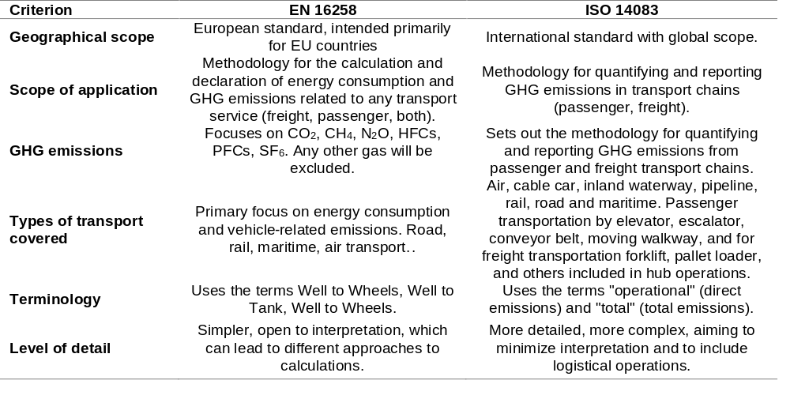
Comparative analysis of GHG emission calculation procedures according to EN 16258 and ISO 14083
TRANSCOM 2025: 16th International Scientific Conference on Sustainable, Modern and Safe Transport
Karolína Ujlacká¹, Vladimír Konečný²
1 Department of Road and Urban Transport, Faculty of Operation and Economics of Transport and Communications, University of Žilina, Univerzitná 8215/1, 010 26 Žilina, Slovakia
introduction
Transport is a major source of greenhouse gas emissions, accounting for up to 40%, mainly due to its reliance on fossil fuels. EN 16258 (2012) offers an EU-based method for calculating emissions. ISO 14083 (2023) provides a globally valid framework for all modes of transport. | ISO14083 is still underused and many companies rely on outdated EN 16258 procedures. This limits consistency in reporting emissions. Key stakeholders include transporters, logistics companies and policy makers. | This study aims to compare EN 16258 and ISO 14083, highlight their methodological differences, and analyze their impact on emission calculation results. The goal is to raise awareness of ISO 14083 and support its implementation for more accurate, transparent, and standardized GHG reporting in the global transport sector.
materials, methods & implementation
The research uses a comparative analytical method to evaluate two standards for calculating greenhouse gas emissions in transport – EN 16258 and ISO 14083. EN 16258 offers a simpler methodology focused on the EU, while ISO 14083 provides a more detailed and globally applicable framework, including updated emission factors and a wider range of transport modes. Calculations were carried out to compare emissions reporting. The data is based on actual transport data provided by the transport company, which includes operational records of international and domestic freight movements.
results
A comparative analysis of EN 16258 and ISO 14083 revealed key methodological differences in scope, terminology and level of detail. ISO 14083 represents a more comprehensive and globally applicable framework. These differences influence how emissions are calculated and reported, especially when considering updated emission factors, biogenic carbon content, and logistics operations – which are not addressed in EN 16258.
Using ISO 14083 helps companies produce accurate and reliable emission reports for clients, authorities, and investors.
It also supports carbon footprint reporting
(ISO 14067) and life cycle assessments (ISO 14040).
Clear GHG reporting helps companies meet climate goals and comply with EU regulations
conclusion & implementation path
The study confirmed that ISO 14083 provides a more detailed and internationally applicable method for calculating greenhouse gas emissions compared to EN 16258. While both standards are still in use, ISO 14083 ensures greater accuracy, consistency, and transparency, particularly in complex and multimodal transport chains. Wider implementation of this standard can support companies in aligning with climate targets, international reporting frameworks, and regulatory requirements. A comparison of emission costs revealed that ISO 14083 reports slightly higher direct emissions (TTW) due to its updated methodology and inclusion of broader emission sources. In contrast, total emissions (WTW) are slightly lower under ISO 14083, reflecting its life cycle-based approach and accounting for biogenic carbon. These differences highlight how the choice of standard can directly influence calculated emission values and their economic interpretation—an essential factor in environmental and strategic decision-making. Future research should focus on the readiness of transport companies to adopt ISO 14083, the development of supporting tools and calculators, deeper life cycle assessments for alternative drive systems, and the integration of cost-benefit analysis into GHG calculations. This direction supports informed business planning and effective policy-making for a more sustainable transport sector.
acknowledgements
This publication was created as part of the research project KEGA: 025ŽU-4/2023 Identification of the impact of driver fatigue on road safety.

