Slide 1


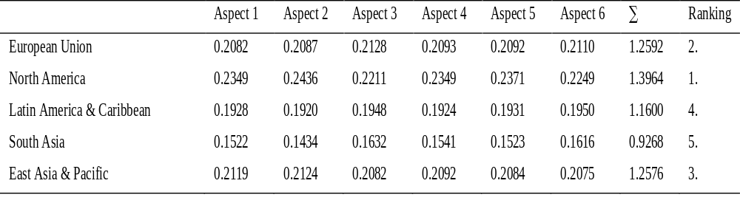
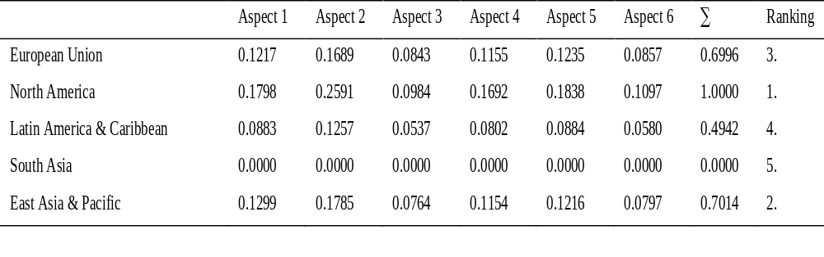
Assessing logistics performance in global regions using selected multi-criteria assessment methods
TRANSCOM 2025: 16th International Scientific Conference on Sustainable, Modern and Safe Transport
Dominika Jonasíková¹, Vladimír Konečný¹
1 Department of Road and Urban Transport, Faculty of Operation and Economics of Transport and Communications, University of Žilina, Univerzitná 8215/1, 010 26 Žilina, Slovakia
introduction
Logistics is a key driver of globalization, optimizing the movement of goods, information, and finance across supply chains. Its efficiency directly impacts economic growth, competitiveness, and value creation. As customer expectations for speed and quality rise, logistics plays a critical role in business success. | Measuring logistics performance is complex due to regional differences in infrastructure, governance, and supply chain conditions. The Logistics Performance Index (LPI) evaluates factors like customs efficiency, infrastructure, and shipment reliability. Inefficiencies increase costs and disrupt supply chains, affecting governments, businesses, and consumers. | This study analyzes global logistics performance using multi-criteria methods to identify strengths and weaknesses. The findings will offer insights to improve efficiency, reduce bottlenecks, and boost supply chain resilience, informing policies that support economic growth and global trade competitiveness.
materials, methods & implementation
The assessment of logistics performance in global regions was conducted using the entropy method and the Multi-Attribute Utility Theory (MAUT) method. The entropy method is applied to determine the objective importance of logistics performance indicators by measuring data uncertainty. Indicators with higher variability receive greater weights, ensuring a more data-driven evaluation. The MAUT method is then used to rank global regions based on multiple criteria by assigning preference weights and calculating overall scores, allowing for a comprehensive comparison of logistics efficiency. The study relies on data from the Logistics Performance Index (LPI) provided by the World Bank. The LPI evaluates six key aspects of logistics performance: efficiency of customs clearance, quality of trade and transport-related infrastructure, ease of arranging shipments, competence of logistics services, ability to track and trace consignments, and timeliness of deliveries. By combining these methodologies, the research provides a structured and quantitative approach to assessing logistics performance across different global regions.
results
The research analyzed the logistics performance of five global regions using the Logistics Performance Index (LPI) and applied entropy and MAUT multi-criteria assessment methods. These methods provided both objective weights for the LPI aspects and a final ranking of the regions based on normalized performance data. The entropy method determined that infrastructure quality (Aspect 2) has the greatest impact on overall logistics performance. According to both methods, North America consistently ranked first, demonstrating the strongest logistics systems, while South Asia ranked lowest, highlighting areas for improvement. The combination of these methodologies provides a robust academic framework for logistics performance evaluation, supporting further research and comparative studies across regions and time.
The results of this study offer valuable insights for policy makers, logistics companies, and economic strategists. By identifying the most influential aspects of logistics performance—particularly the quality of infrastructure and service competence—stakeholders can prioritize investment in the most impactful areas. For example, countries in South Asia or Latin America can use this analysis to guide logistics reforms and infrastructure development. Moreover, the LPI-based ranking provides a benchmark for evaluating regional progress, informing future decisions in trade, transport planning, and supply chain management. This approach can also be adopted by organizations to assess and optimize their logistics networks internationally.
Table 1. Normalized entropy method matrix of average values of LPI aspects. | Table 2. MAUT decision matrix for individual LPI aspects.
conclusion & implementation path
The study assessed the logistics performance of five global regions by applying two multi-criteria decision-making methods: the entropy method and the MAUT (Multi-Attribute Utility Theory) method. These methods were used to analyze six key aspects of the Logistics Performance Index (LPI), including customs efficiency, infrastructure quality, and logistics service competence. The findings confirmed that North America consistently achieves the highest logistics performance across all evaluated aspects, followed closely by East Asia and the Pacific. In contrast, South Asia ranked the lowest, suggesting significant room for improvement in its logistics systems. The entropy method identified the quality of trade and transport-related infrastructure (Aspect 2) as the most influential factor in overall logistics performance, while ease of arranging competitively priced shipments (Aspect 3) had the least impact. Both methods provided consistent and meaningful rankings that reflect the real logistics capabilities of each region. These insights can support decision-makers in identifying key investment priorities, especially in regions with underdeveloped logistics infrastructure or inefficient customs procedures. The EU's position is also affected by differences between countries within the region. Some countries lower their overall level by underperforming in key aspects such as customs clearance efficiency or the quality of transport infrastructure. The internal structure of the logistics market in the EU at country level will be the subject of further follow-up research, and the trend of LPI development and aspects of LPI in EU countries will also be investigated.
acknowledgements
This publication was created as part of the research project KEGA: 025ŽU-4/2023 Identification of the impact of driver fatigue on road safety.

