Slide 1


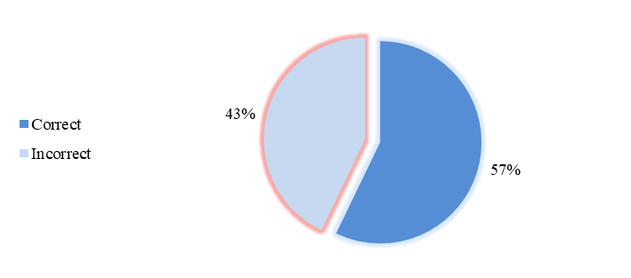
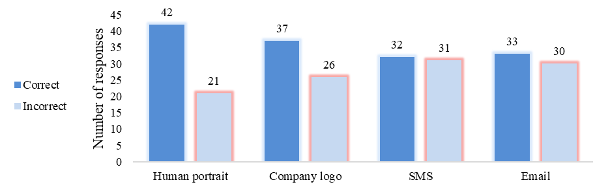
Title of the TRANSCOM 2025 paper
TRANSCOM 2025: 16th International Scientific Conference on Sustainable, Modern and Safe Transport
Matúš Madleňák ¹, Samuel Hubočan²
1 Faculty of Security Engineering, University of Žilina, 01026, Žilina, Slovakia
2 Faculty of Security Engineering, University of Žilina, 01026, Žilina, Slovakia
introduction
The rapid development of artificial intelligence is fundamentally affecting cybersecurity and leading to a new generation of phishing attacks - Phishing 2.0. These attacks are personalized, visually convincing and difficult to distinguish from legitimate communications. Sectors such as transport, energy, healthcare and public administration can be affected. | AI enables the creation of synthetic media (text, voices, portraits, logos), which makes fraud detection by ordinary users difficult. Stakeholders are experts in critical infrastructure protection and security management. | The aim is to investigate human ability to identify AI-generated content, with results that may inform strategies in cybersecurity and user education.
materials, methods & implementation
The methodology used consisted of a 12-question questionnaire, with each question containing a pair of content - one human-generated and one AI-generated. Various types of media were tested including portraits, emails, SMS messages and company logos. The research was carried out on a sample of 21 respondents working in the fields of critical infrastructure protection, transportation and crisis management. Subsequently, an analysis of the accuracy of responses both overall and by media type was conducted to identify those areas where detection of AI-generated content is most challenging.
results
Twenty-one respondents took part in the survey and answered the 12 questions in the questionnaire. The results revealed that the respondents were able to correctly detect a total of 145 content cases, representing a rounded 57 % of the total number of responses. In contrast, 107 responses were incorrect, corresponding to 42 %. This result suggests that respondents have some ability to detect AI-generated content, but a significant proportion of responses are still incorrect, which highlights the need to improve their skills in this area. The overall results are shown in Figure 1.
Figure 1.
Twenty-one respondents took part in the survey and answered the 12 questions in the questionnaire. The results revealed that the respondents were able to correctly detect a total of 145 content cases, representing a rounded 57 % of the total number of responses. In contrast, 107 responses were incorrect, corresponding to 42 %. This result suggests that respondents have some ability to detect AI-generated content, but a significant proportion of responses are still incorrect, which highlights the need to improve their skills in this area. The overall results are shown in Figure 2.
Figure 2.
conclusion & implementation path
The findings show that although respondents were able to correctly identify AI-generated content in more than half of the cases (57.5%), the significant proportion of incorrect responses (42.5%) indicates a limited ability to distinguish between human and artificially generated content. Particularly problematic were text formats (SMS and emails), where success rates were lowest, while visual stimuli (portraits, logos) were more recognizable. This disproportion confirms that modern generative AI tools can produce linguistically and stylistically plausible content that is difficult for humans to distinguish. To improve detection reliability, it will be necessary to engage larger samples, investigate user interactions with AI content including through technologies such as eye-tracking, and focus on the effectiveness of phishing 2.0 training and education.
acknowledgements
The article was supported by The Ministry of Education, Research, Development and Youth of the Slovak Republic grant number VEGA1/0257/23 Cyber risk assessment as an essential tool for increasing cyber security in public administration. Funded by the EU NextGenerationEU through the Recovery and Resilience Plan for Slovakia under the project No.17R05-04-V01-00005.

