Slide 1


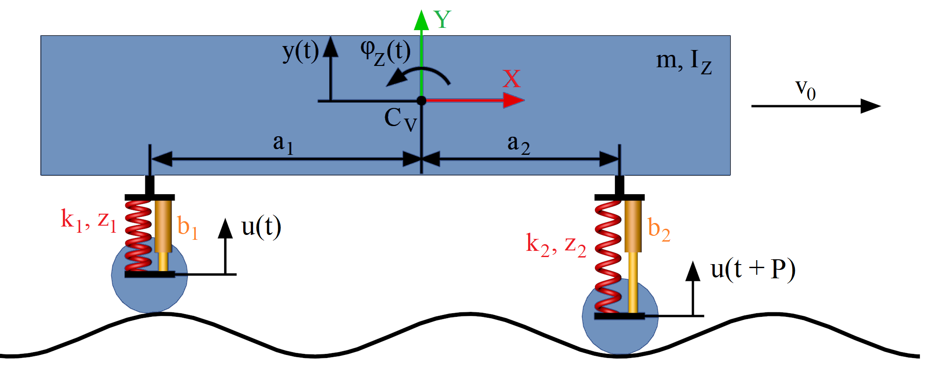
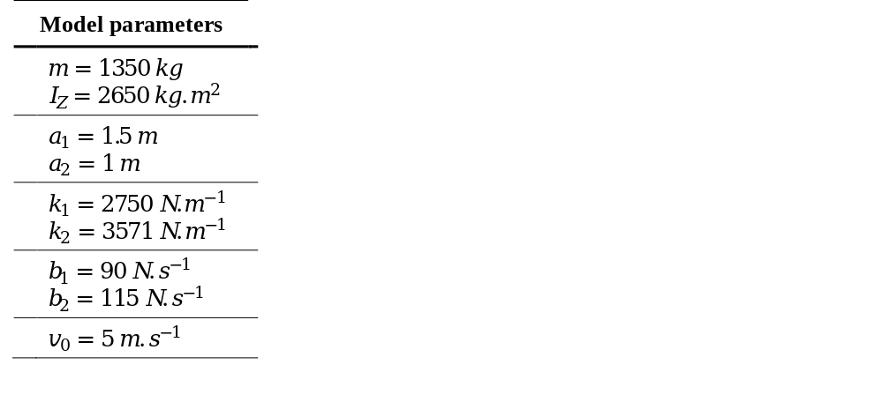

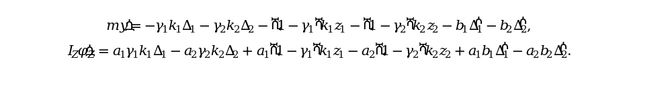

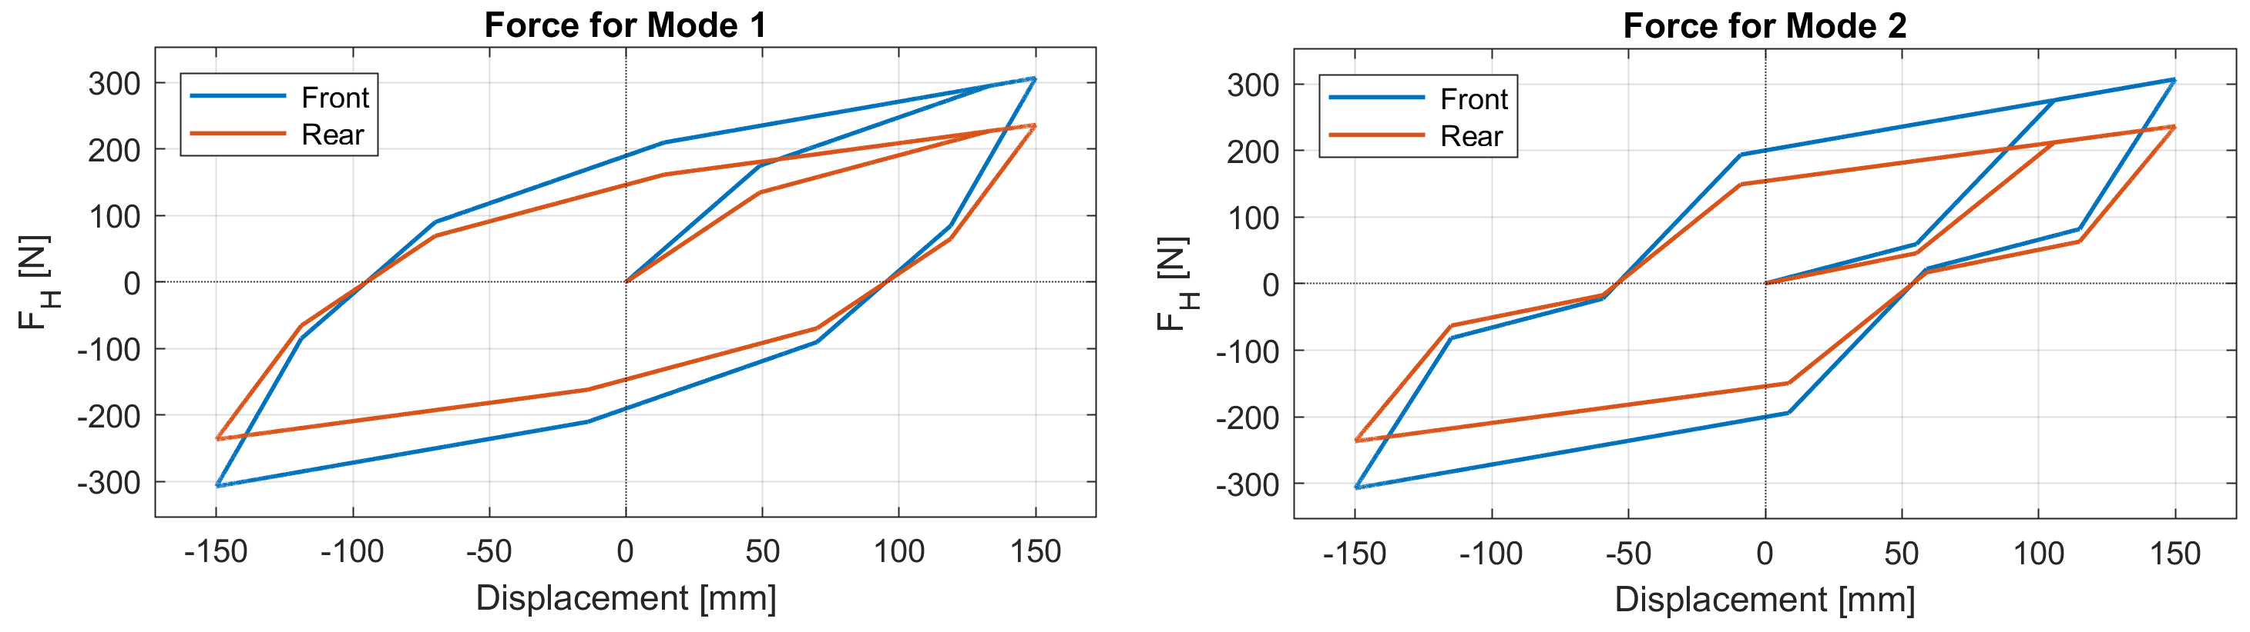
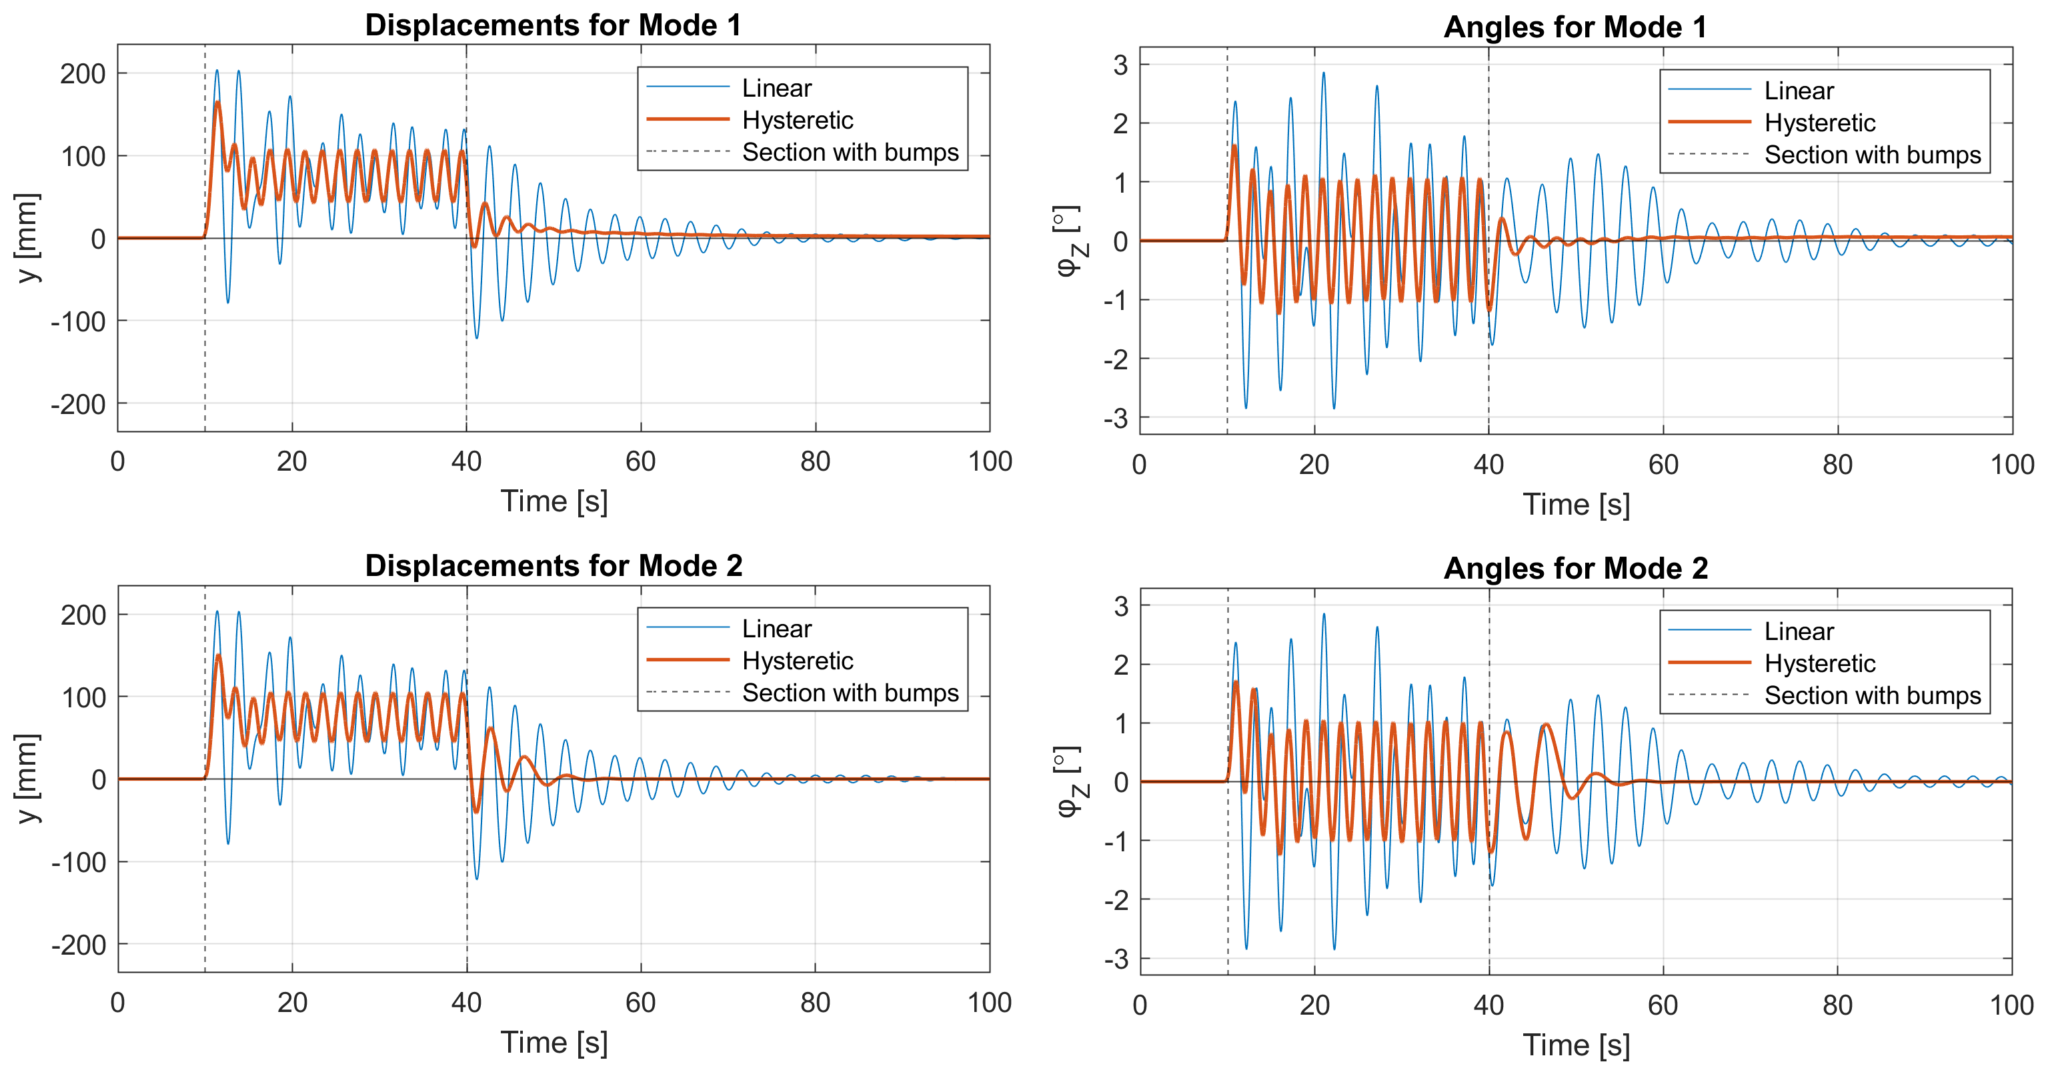
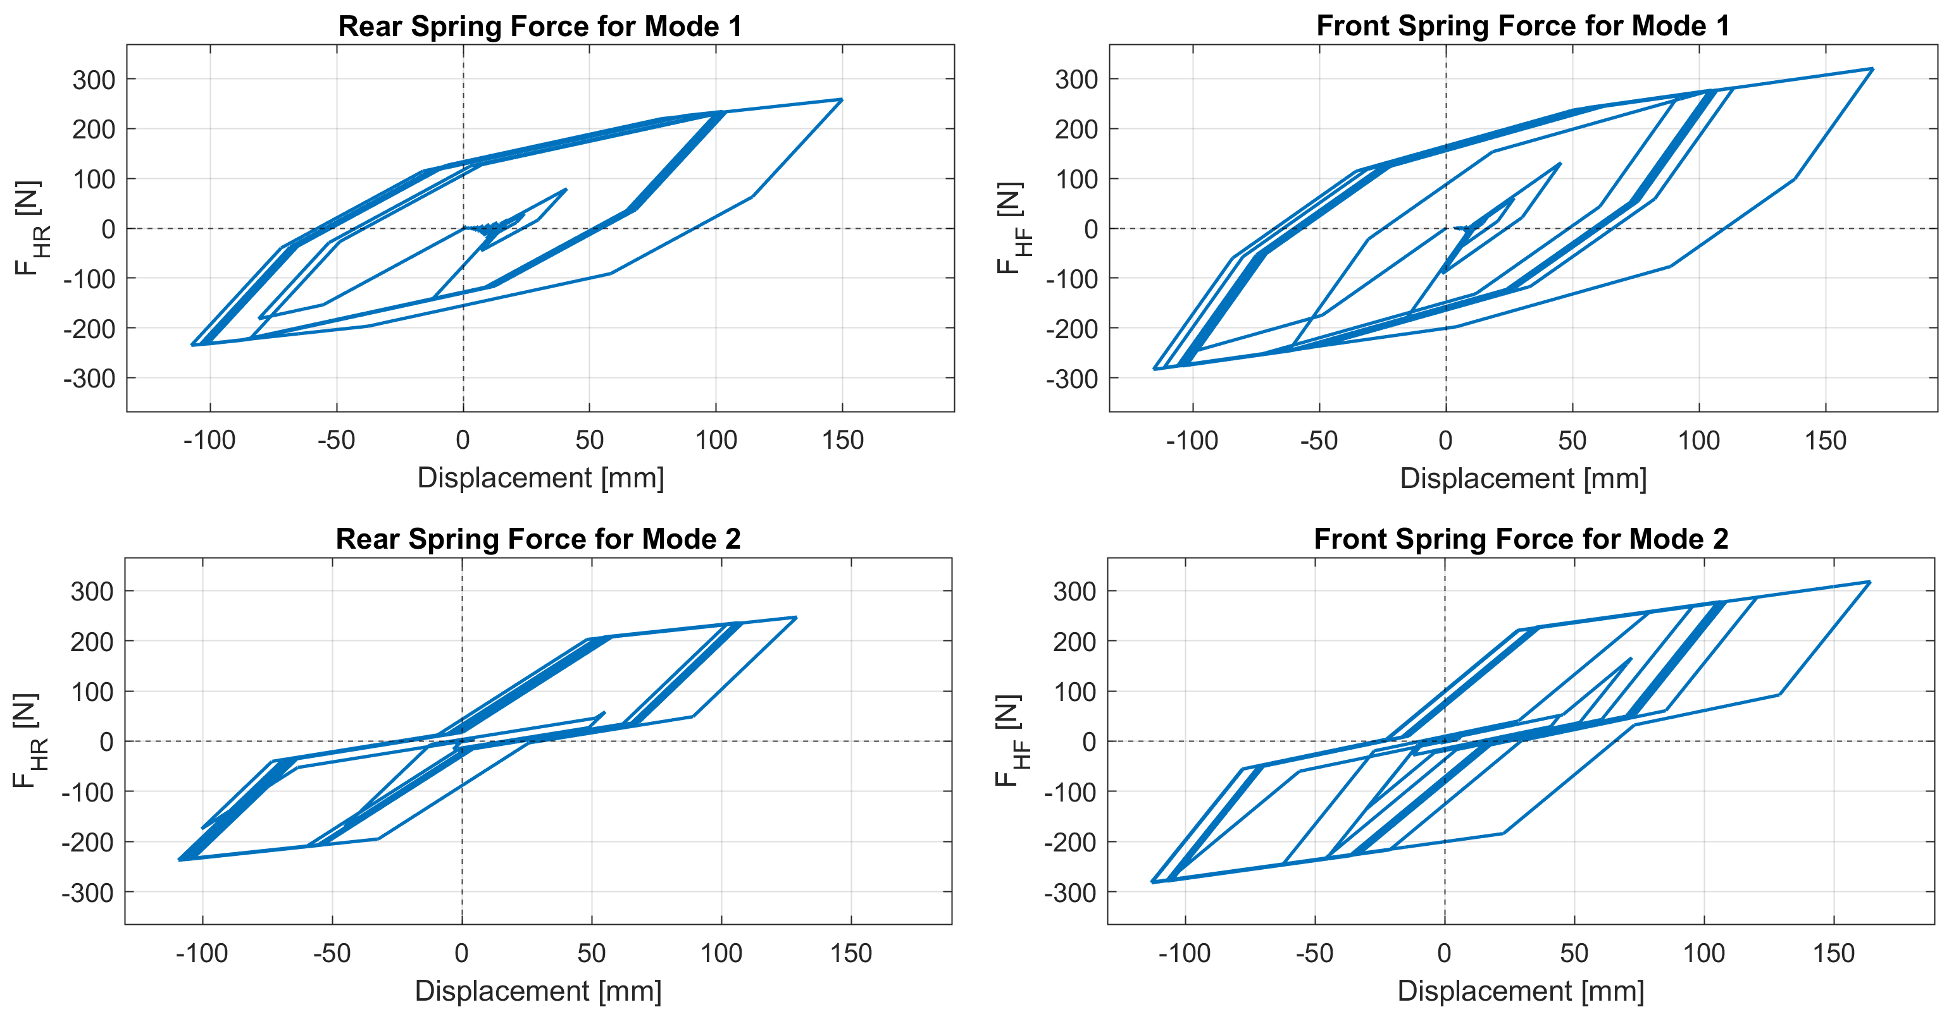
Road vehicle model with hysteretic suspension
TRANSCOM 2025: 16th International Scientific Conference on Sustainable, Modern and Safe Transport
Ján Minárik ¹, Milan Sága ¹, Milan Vaško¹, Branislav Ftorek¹
1 University of Žilina, Žilina, Slovakia
introduction
The vehicle suspension represents one of its most important parts, significantly influencing the safety, handling and comfort. Real springs and dampers, comprising the suspension, often possess hysteretic behavior. The hysteresis represents a nonlinear relationship between deformation and stiffness of the material. | In this paper, we carried out the dynamical analysis of a simplified half-vehicle model with a suspension comprising viscous dampers and springs with stiffness modeled by a multilinear hysteresis. Vehicle oscillation is induced by a kinematic excitation function describing the irregularities of the road with respect to time. | The main objective was to investigate the impact of hysteretic effects on the vertical motion of the vehicle, while considering two distinct shapes of hysteretic loops. The results were compared with the solution of the linear model. The study expects to enhance the understanding of how the hysteresis influences the vehicle dynamics.
materials, methods & implementation
Physical model
Hysteretic force of the springs:
Mathematical model
Springs displacements $∆$ and their time derivatives $\dot{∆}$:
System of equations of motion:
Additional equations for hysteresis control functions:
results
The hysteretic loops (top right) represent the restoring forces during one loading cycle. Two different loop shapes, denoted as Mode 1 and Mode 2, were utilized. The bottom left section shows the time courses of the vertical displacements and the pitch angles of the vehicle during its motion, for both modes. Hysteretic restoring forces for both axles and modes, during the whole motion, are shown in the bottom right section.
conclusion & implementation path
The study aimed to investigate how hysteretic stiffness influences the motion of a road vehicle moving on an uneven track. We used the simplified half car model, incorporating a suspension system with hysteretic stiffness represented by a multilinear model. The results were obtained numerically in MATLAB and compared with the solution of the corresponding linear model. The hysteretic systems provided rather comparable results. Despite that, the shape of the hysteretic loop is an important factor. In the presence of driving forces, the selected loop shapes seem to have no significant impact on the obtained solutions. Nonetheless, the systems behave differently during the phase of unforced oscillation. After the comparison with the linear system, it can be seen that the hysteresis affects the model behavior considerably. The hysteretic systems oscillate with increased energy dissipation, resulting in likewise increased damping. Therefore, this motion is more steady, with lower amplitudes and it is damped at a higher rate, compared to the linear system. This might be beneficial mainly for the passenger comfort.
acknowledgements
This research was supported by the projects KEGA, with project No. 005ZU-4/2024 and VEGA, with project No. 1/0423/23. References
Barethiye, V., Pohit, G., Mitra, A.: A combined nonlinear and hysteresis model of shock absorber for quarter car simulation on the basis of experimental data, Engineering Science and Technology, an International Journal, 20(6), 1610-1622, 2017. https://doi.org/10.1016/j.jestch.2017.12.003.
Bartošák, M., Horváth, J., Španiel, M.: Multiaxial low-cycle thermo-mechanical fatigue of a low-alloy martensitic steel: Cyclic mechanical behaviour, damage mechanisms and life prediction, International Journal of Fatigue, 151:106383, 2021. https://doi.org/10.1016/j.ijfatigue.2021.106383.
Halama, R., Fusek, M., Poruba, Z.: Influence of mean stress and stress amplitude on uniaxial and biaxial ratcheting of ST52 steel and its prediction by the AbdelKarim–Ohno model, International Journal of Fatigue, 91, 313-321, 2016. https://doi.org/10.1016/j.ijfatigue.2016.04.033.
Hua, C., Zhao, Y., Lu, Z., Ouyang, H.: Random vibration of vehicle with hysteretic nonlinear suspension under road roughness excitation, Advances in Mechanical Engineering, 10(1), 2018. doi: 10.1177/1687814017751222.
Ismail, M., Ikhouane, F., Rodellar, J.: The Hysteresis Bouc-Wen Model, a Survey, Archives of Computational Methods in Engineering, 16, 161-188, 2009. doi: 10.1007/s11831-009-9031-8.
Jiregna, I., Sirata, G.: A review of the vehicle suspension system, Journal of Mechanical and Energy Engineering, 4(2), 109-114, 2020.
doi: 10.30464/jmee.2020.4.2.109.
Kalmár-Nagy, T., Shekhawat, A.: Nonlinear dynamics of oscillators with bilinear hysteresis and sinusoidal excitation, Physica D: Nonlinear Phenomena, 238(17), 1768-1786, 2009. https://doi.org/10.1016/j.physd.2009.06.016.
Mohite, A. G., Mitra, A. C.: Development of Linear and Non-linear Vehicle Suspension Model, Materials Today: Proceedings, 5(2),
4317-4326, 2018. https://doi.org/10.1016/j.matpr.2017.11.697.
Xin, G., He, R., Guo, R.: Hysteresis Characteristic Model of Suspension for Vehicle Dynamics Simulation, Advanced Materials Research, vol. 706-708, pp. 1385-1388, 2013. doi: 10.4028/www.scientific.net/AMR.706-708.1385.
Zhu, X., Lu, X.: Parametric Identification of Bouc-Wen Model and Its Application in Mild Steel Damper Modeling, Procedia Engineering, 14, 318-324, 2011. https://doi.org/10.1016/j.proeng.2011.07.039.
https://www.mathworks.com/products/matlab.html

