Slide 1


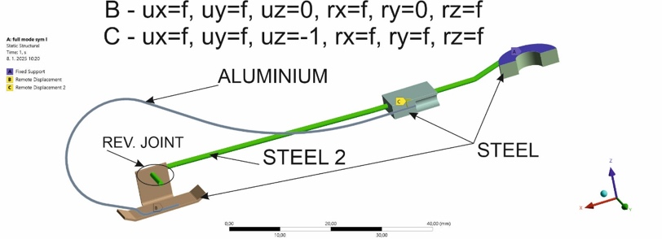
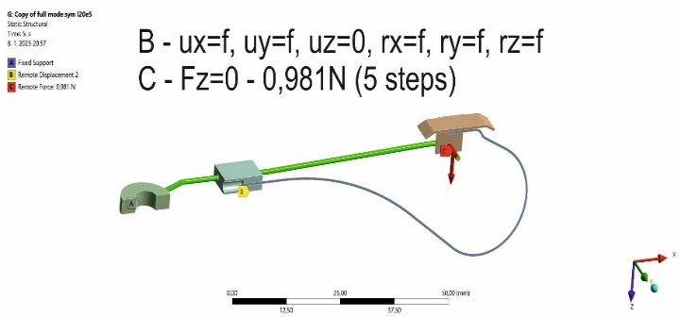
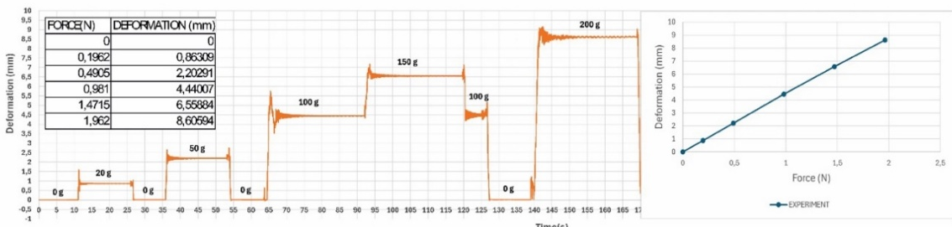
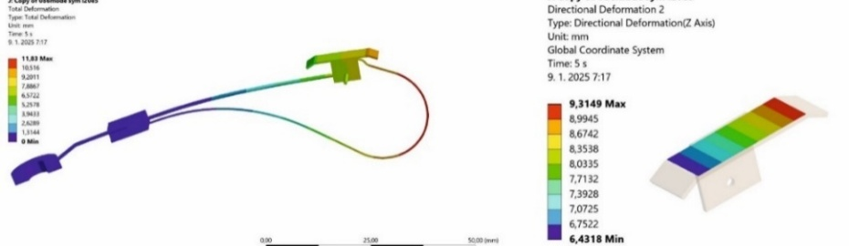
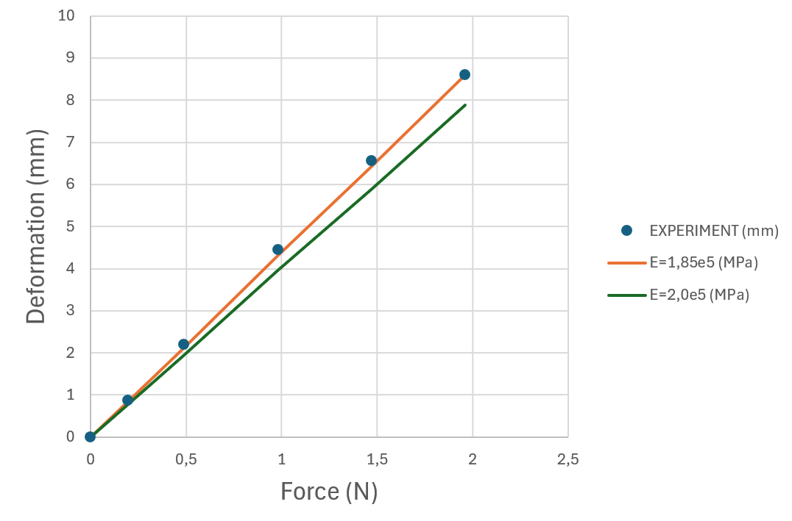
Validation of a virtual model of a contact thermocouple with real measurements
TRANSCOM 2025: 16th International Scientific Conference on Sustainable, Modern and Safe Transport
Jozef Harušinec¹, Kristína Kozáková¹, Andrej Suchánek¹
1 University of Žilina, Univerzitná 8215, Žilina 010 26, Slovakia
introduction
Accurate brake temperature measurement is essential for the safety, durability, and environmental performance of modern railway vehicles. Advancements in vehicle design require more precise and reliable testing methods. | Clamping force affects the accuracy of thermocouple readings, leading to potential errors in brake system evaluations. This impacts engineers, manufacturers, and safety authorities who depend on reliable data. | The study uses FEM simulations and experiments to assess the influence of clamping force and improve measurement accuracy. Findings aim to enhance testing practices and increase safety in railway operations.
materials, methods & implementation
The research combines finite element modelling and experimental validation to assess how clamping force influences thermocouple-based temperature measurements on brake discs. A CAD model of the HTA1001 thermocouple was created based on real dimensions, then simplified for FEM simulation in ANSYS (Figures 1 and 2). Material properties were adjusted, particularly the Young’s modulus of the support wire, to match experimental stiffness results. Experimental testing used a laser displacement sensor (ILD 1700 – 50) and a load-based setup to record slider deflections under various forces.
Figure 1. Thermocouple model boundary conditions
Figure 2. The boundary conditions of the verification model
results
The study confirmed that clamping force causes measurable deformation of the thermocouple slider, directly impacting the accuracy of temperature readings. Finite element simulations initially overestimated stiffness; to match experimental results, the Young’s modulus of the support wire had to be adjusted to 1.85·10⁵ Mpa. This calibration brought the simulation results in line with physical measurements, demonstrating that small changes in material assumptions significantly affect model precision. Figure 3 shows the measured deflection of the thermocouple slider under various applied loads. The data was obtained using a laser displacement sensor and calibrated weights, providing a reference curve for validating FEM simulation results. Figure 4 shows the resulting slider deflection across different applied forces, highlighting the discrepancy between uncorrected simulations and experimental measurements. The main innovation lies in the integration of experimental data into FEM modeling to refine the mechanical behavior of contact thermocouples. This enables a more realistic representation of preload effects during measurement. Practically, this leads to more reliable brake temperature readings, supports the development of accurate testing methodologies, and contributes to safer, data-driven design and evaluation of railway brake systems.
Figure 3. Thermocouple body deflection measurement result
Figure 4. Resulting deflection values on the slider
conclusion & implementation path
The research confirmed that preload affects thermocouple readings and must be accounted for during brake testing. With calibrated material properties, the FEM model now accurately predicts slider deformation under load (Figure 5).
This improves the reliability of brake disc temperature testing in railway applications, supporting higher safety and performance standards.
Future research could investigate the integration into real-time onboard monitoring systems.
Figure 5. Evaluation of the comparison between the thermocouple model and the real thermocouple
acknowledgements
This publication was supported by the Cultural and Educational Grant Agency of the Ministry of Education of the Slovak Republic under the project KEGA 024ZU-4/2024: Deepening the knowledge of university students in the field of construction of means of transport by carrying out professional and scientific research activities in the field. It was also supported by the Slovak Research and Development Agency of the Ministry of Education, Science, Research, and Sport under the project VEGA 1/0513/22: Investigation of the properties of railway brake components in simulated operating conditions on a flywheel brake bench. Funded by the EU NextGenerationEU through the Recovery and Resilience Plan for Slovakia under the project No. 09I03-03-V05-00002.

