Slide 1


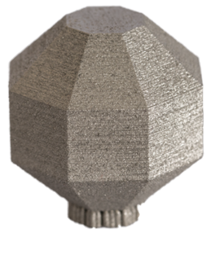
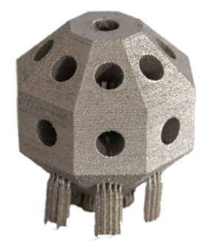
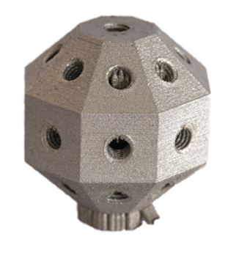
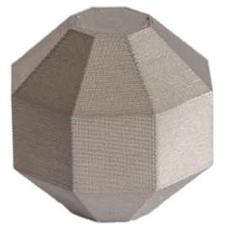
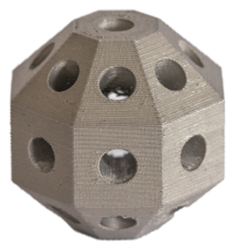
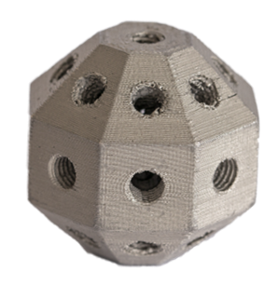
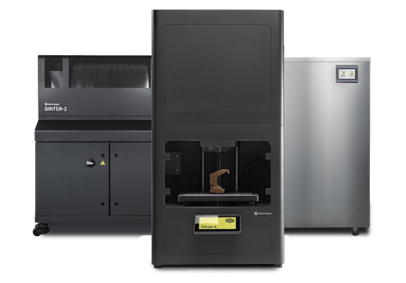
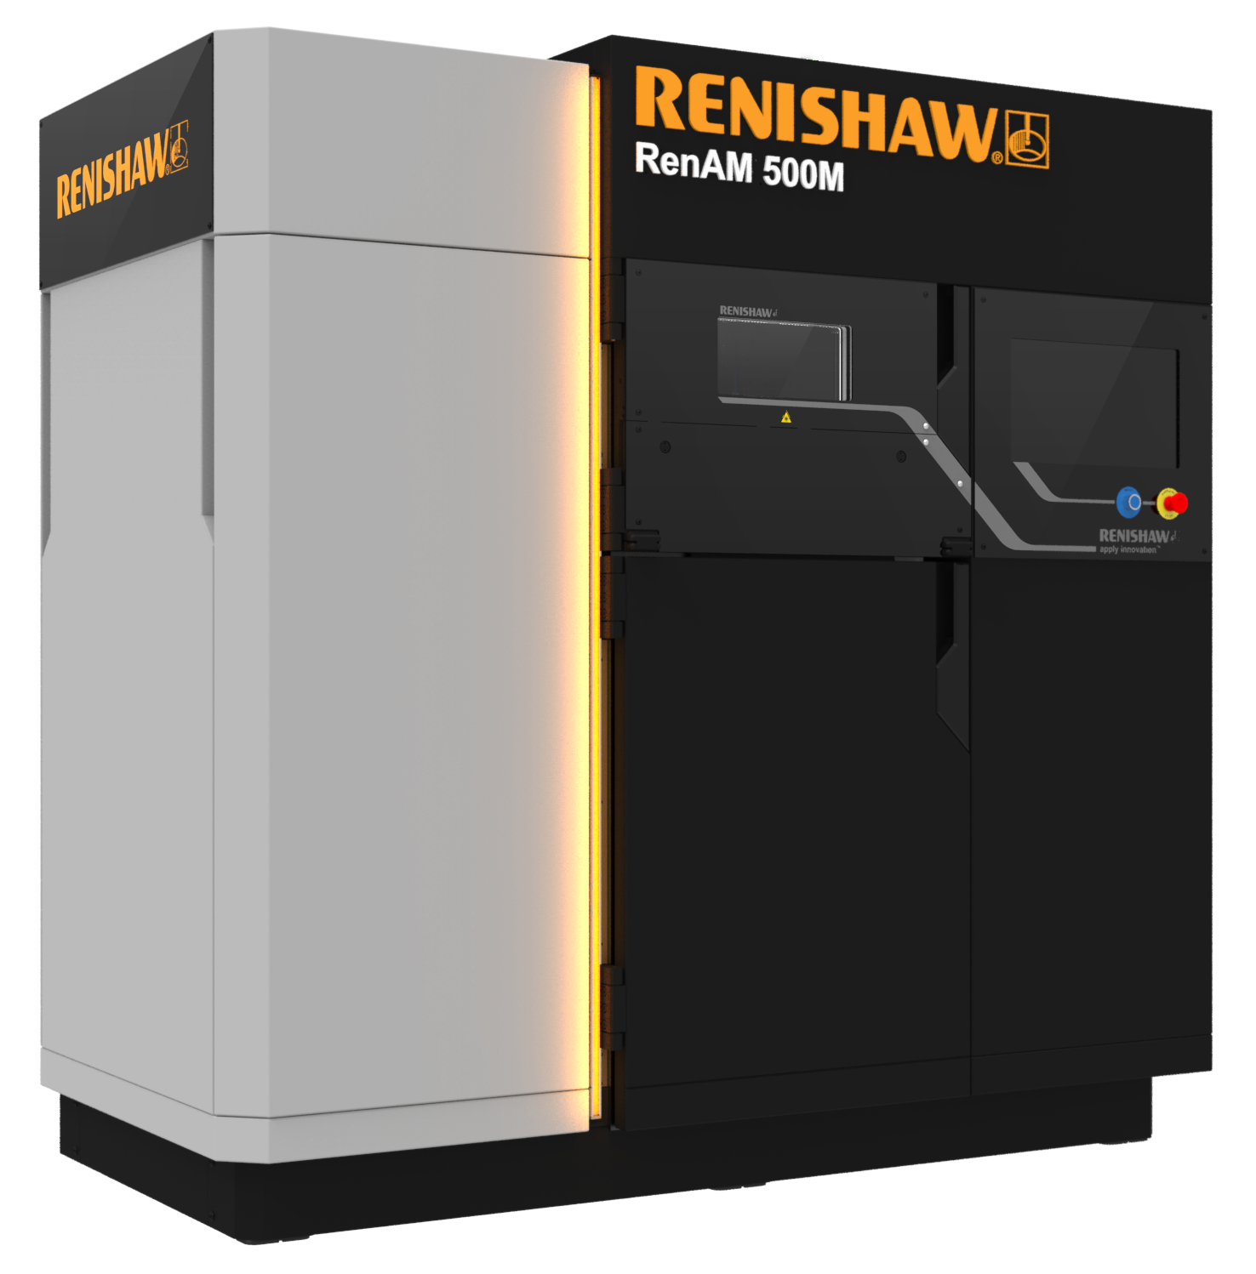
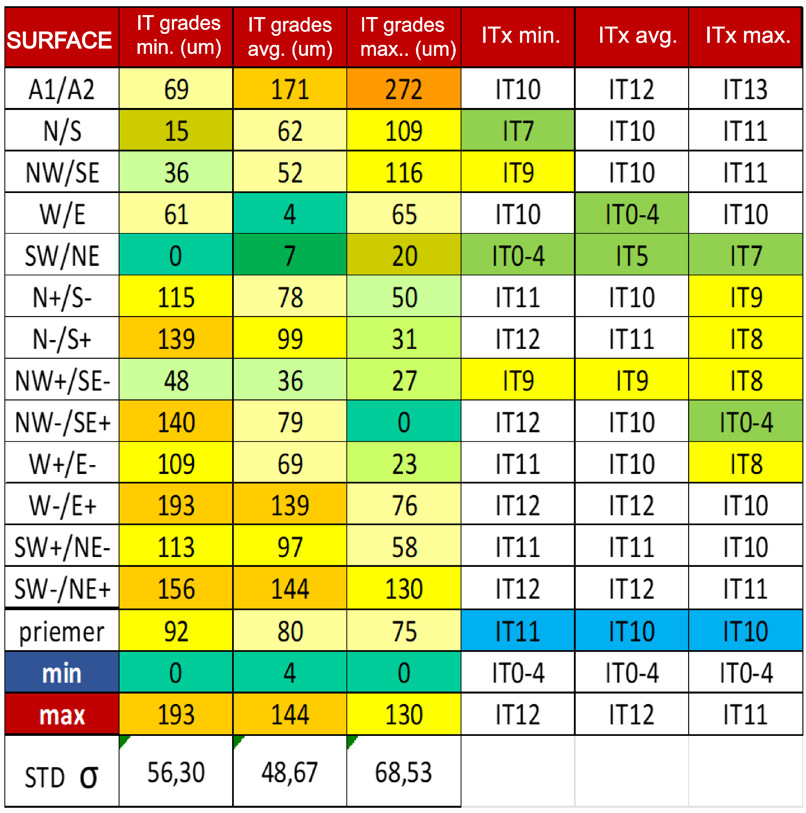
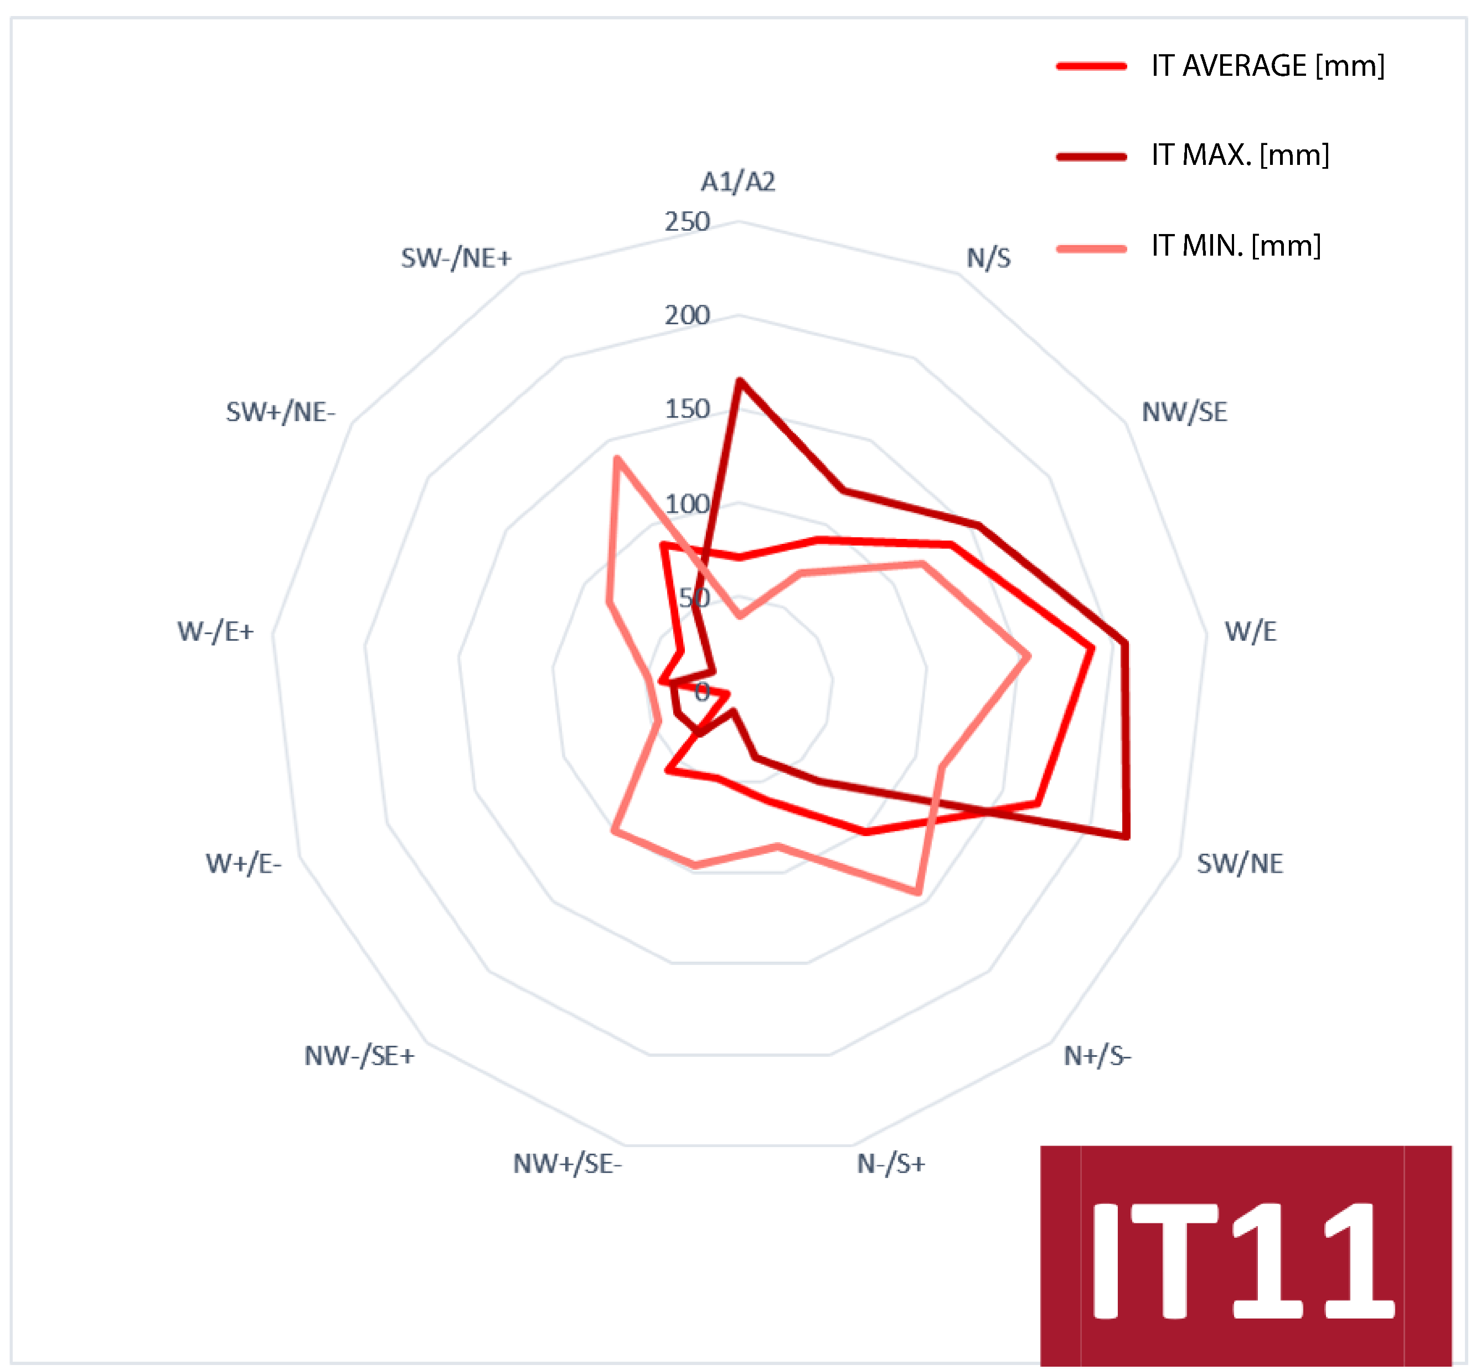
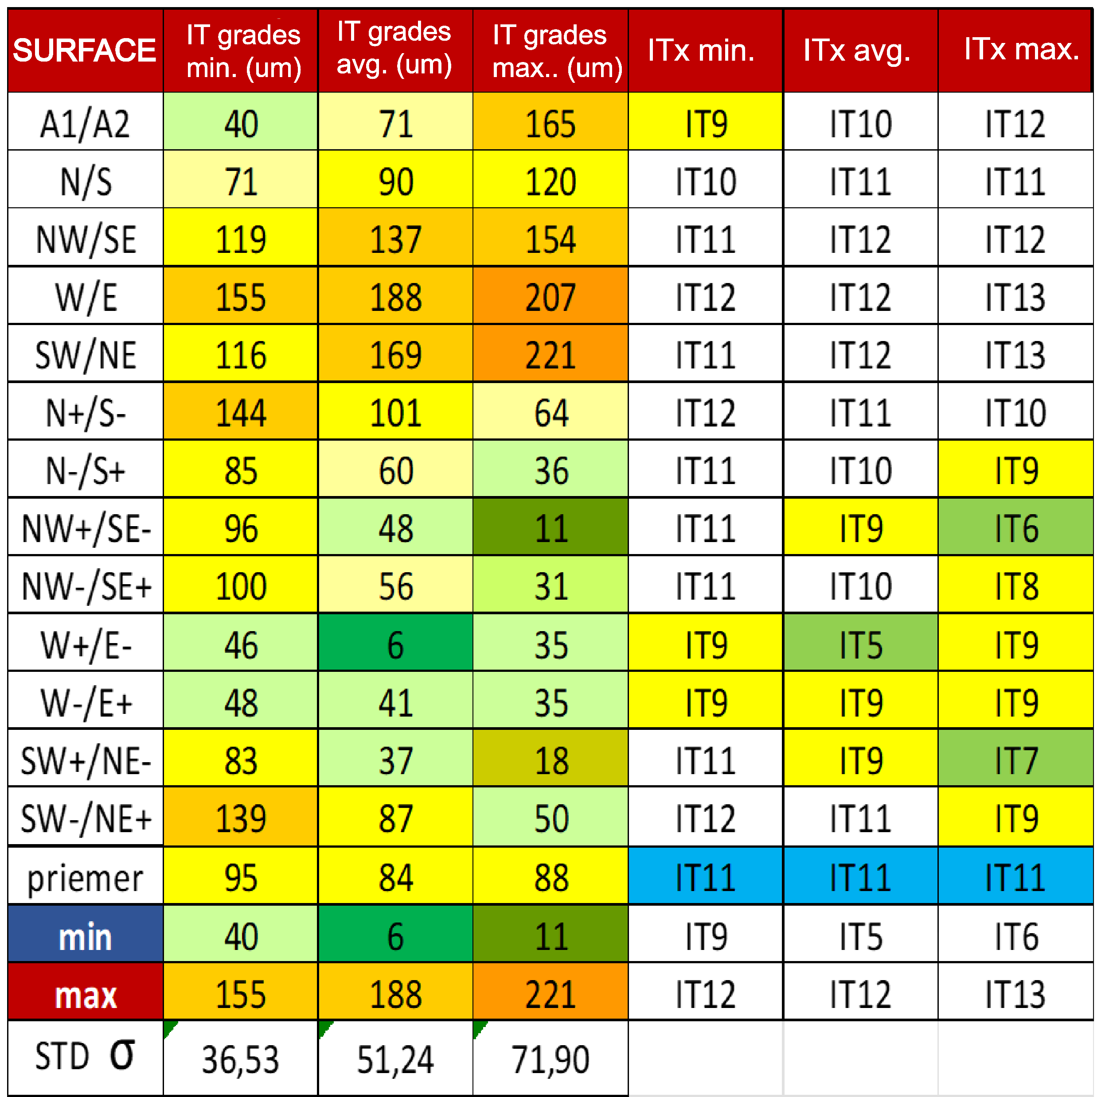
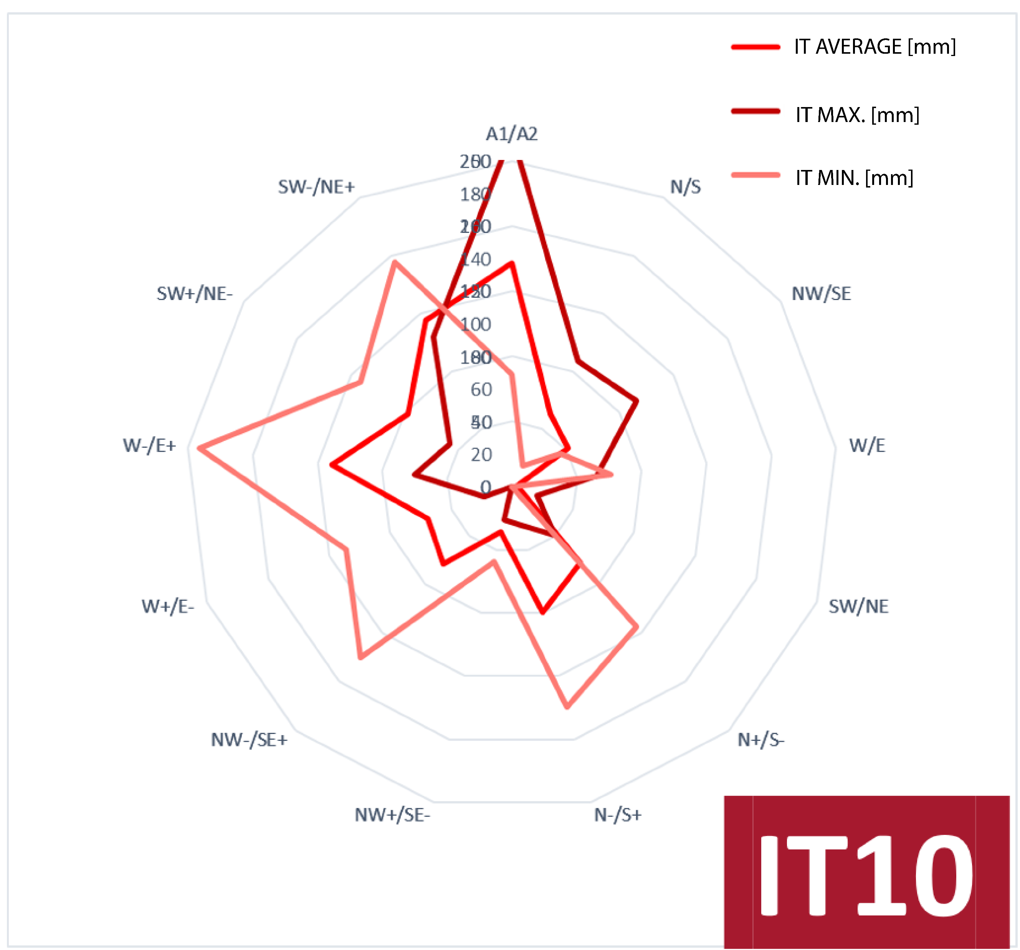
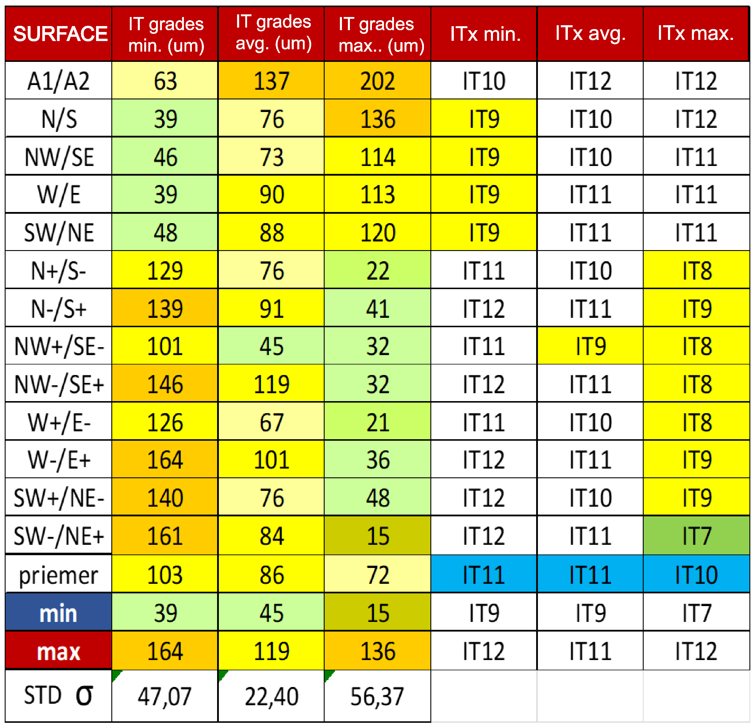
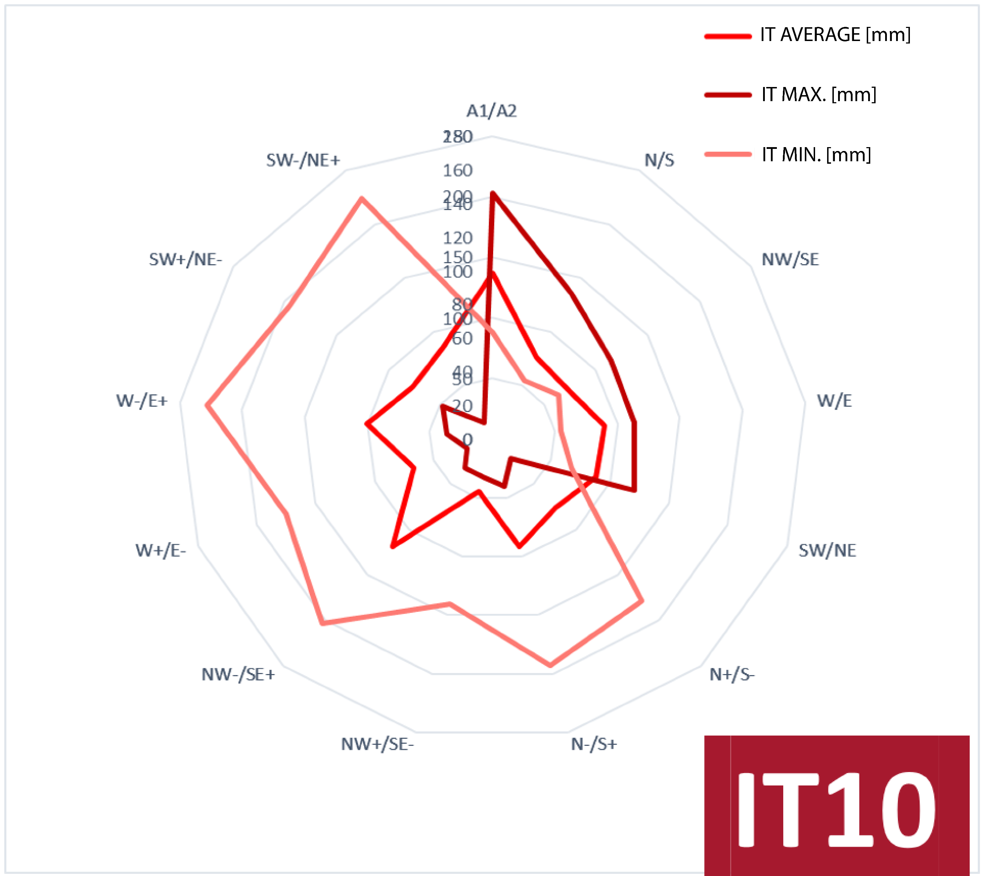
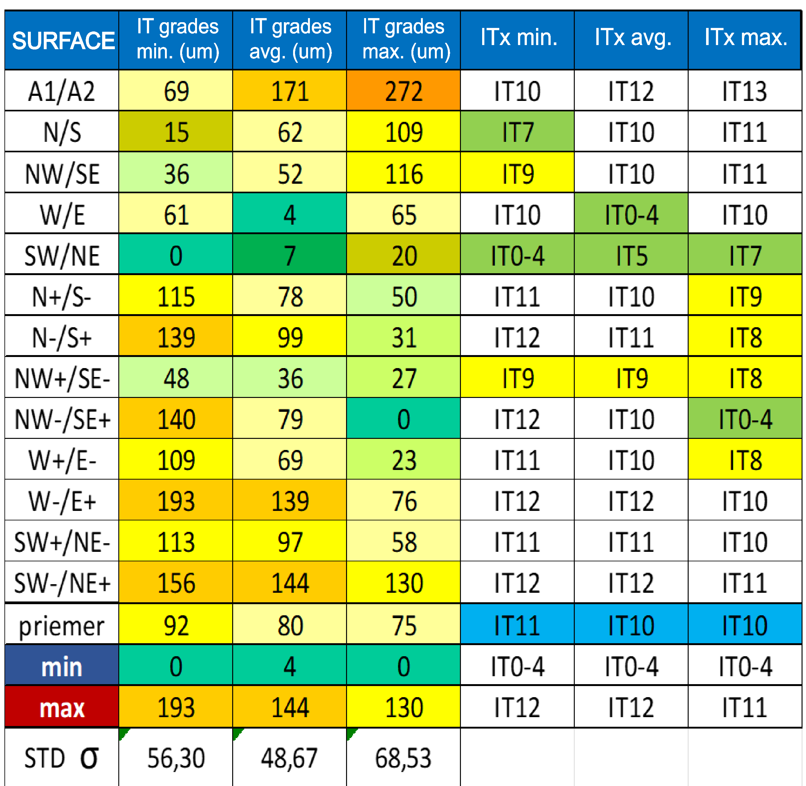
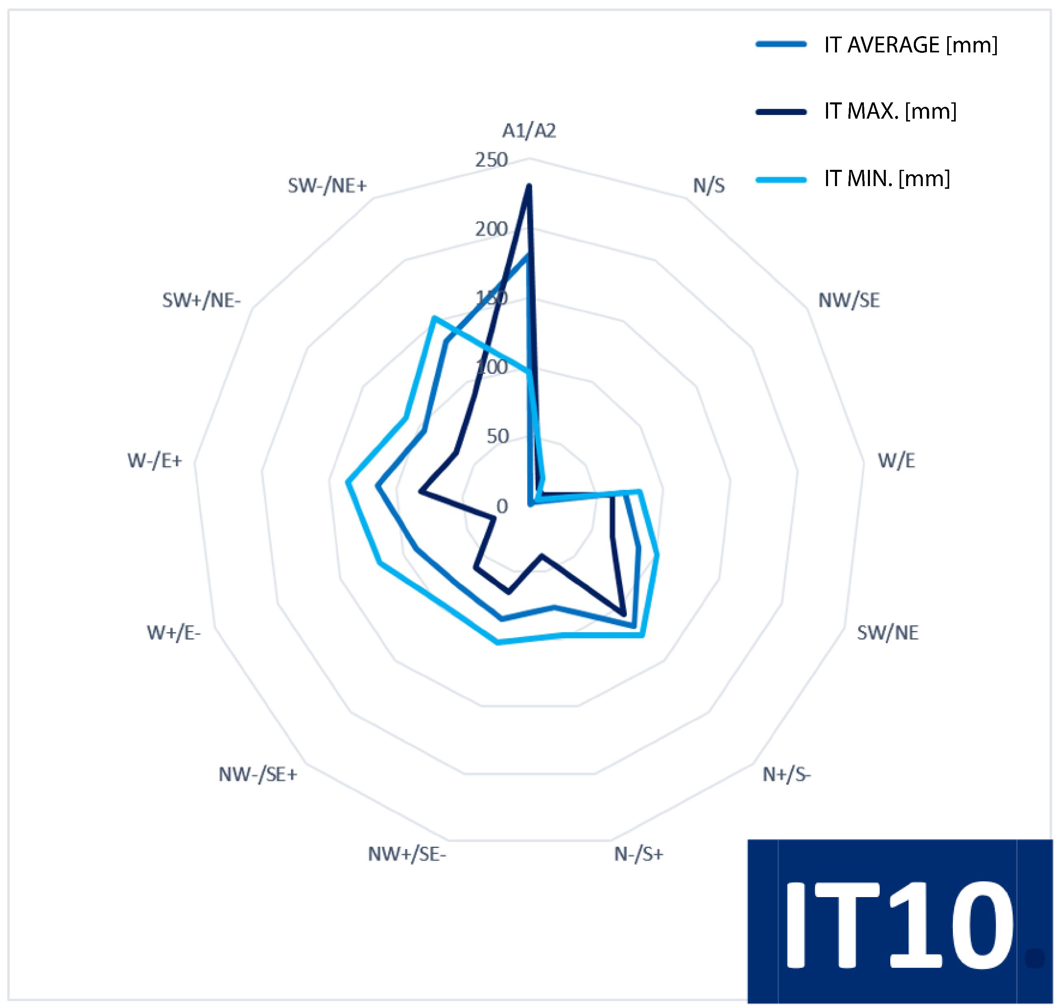
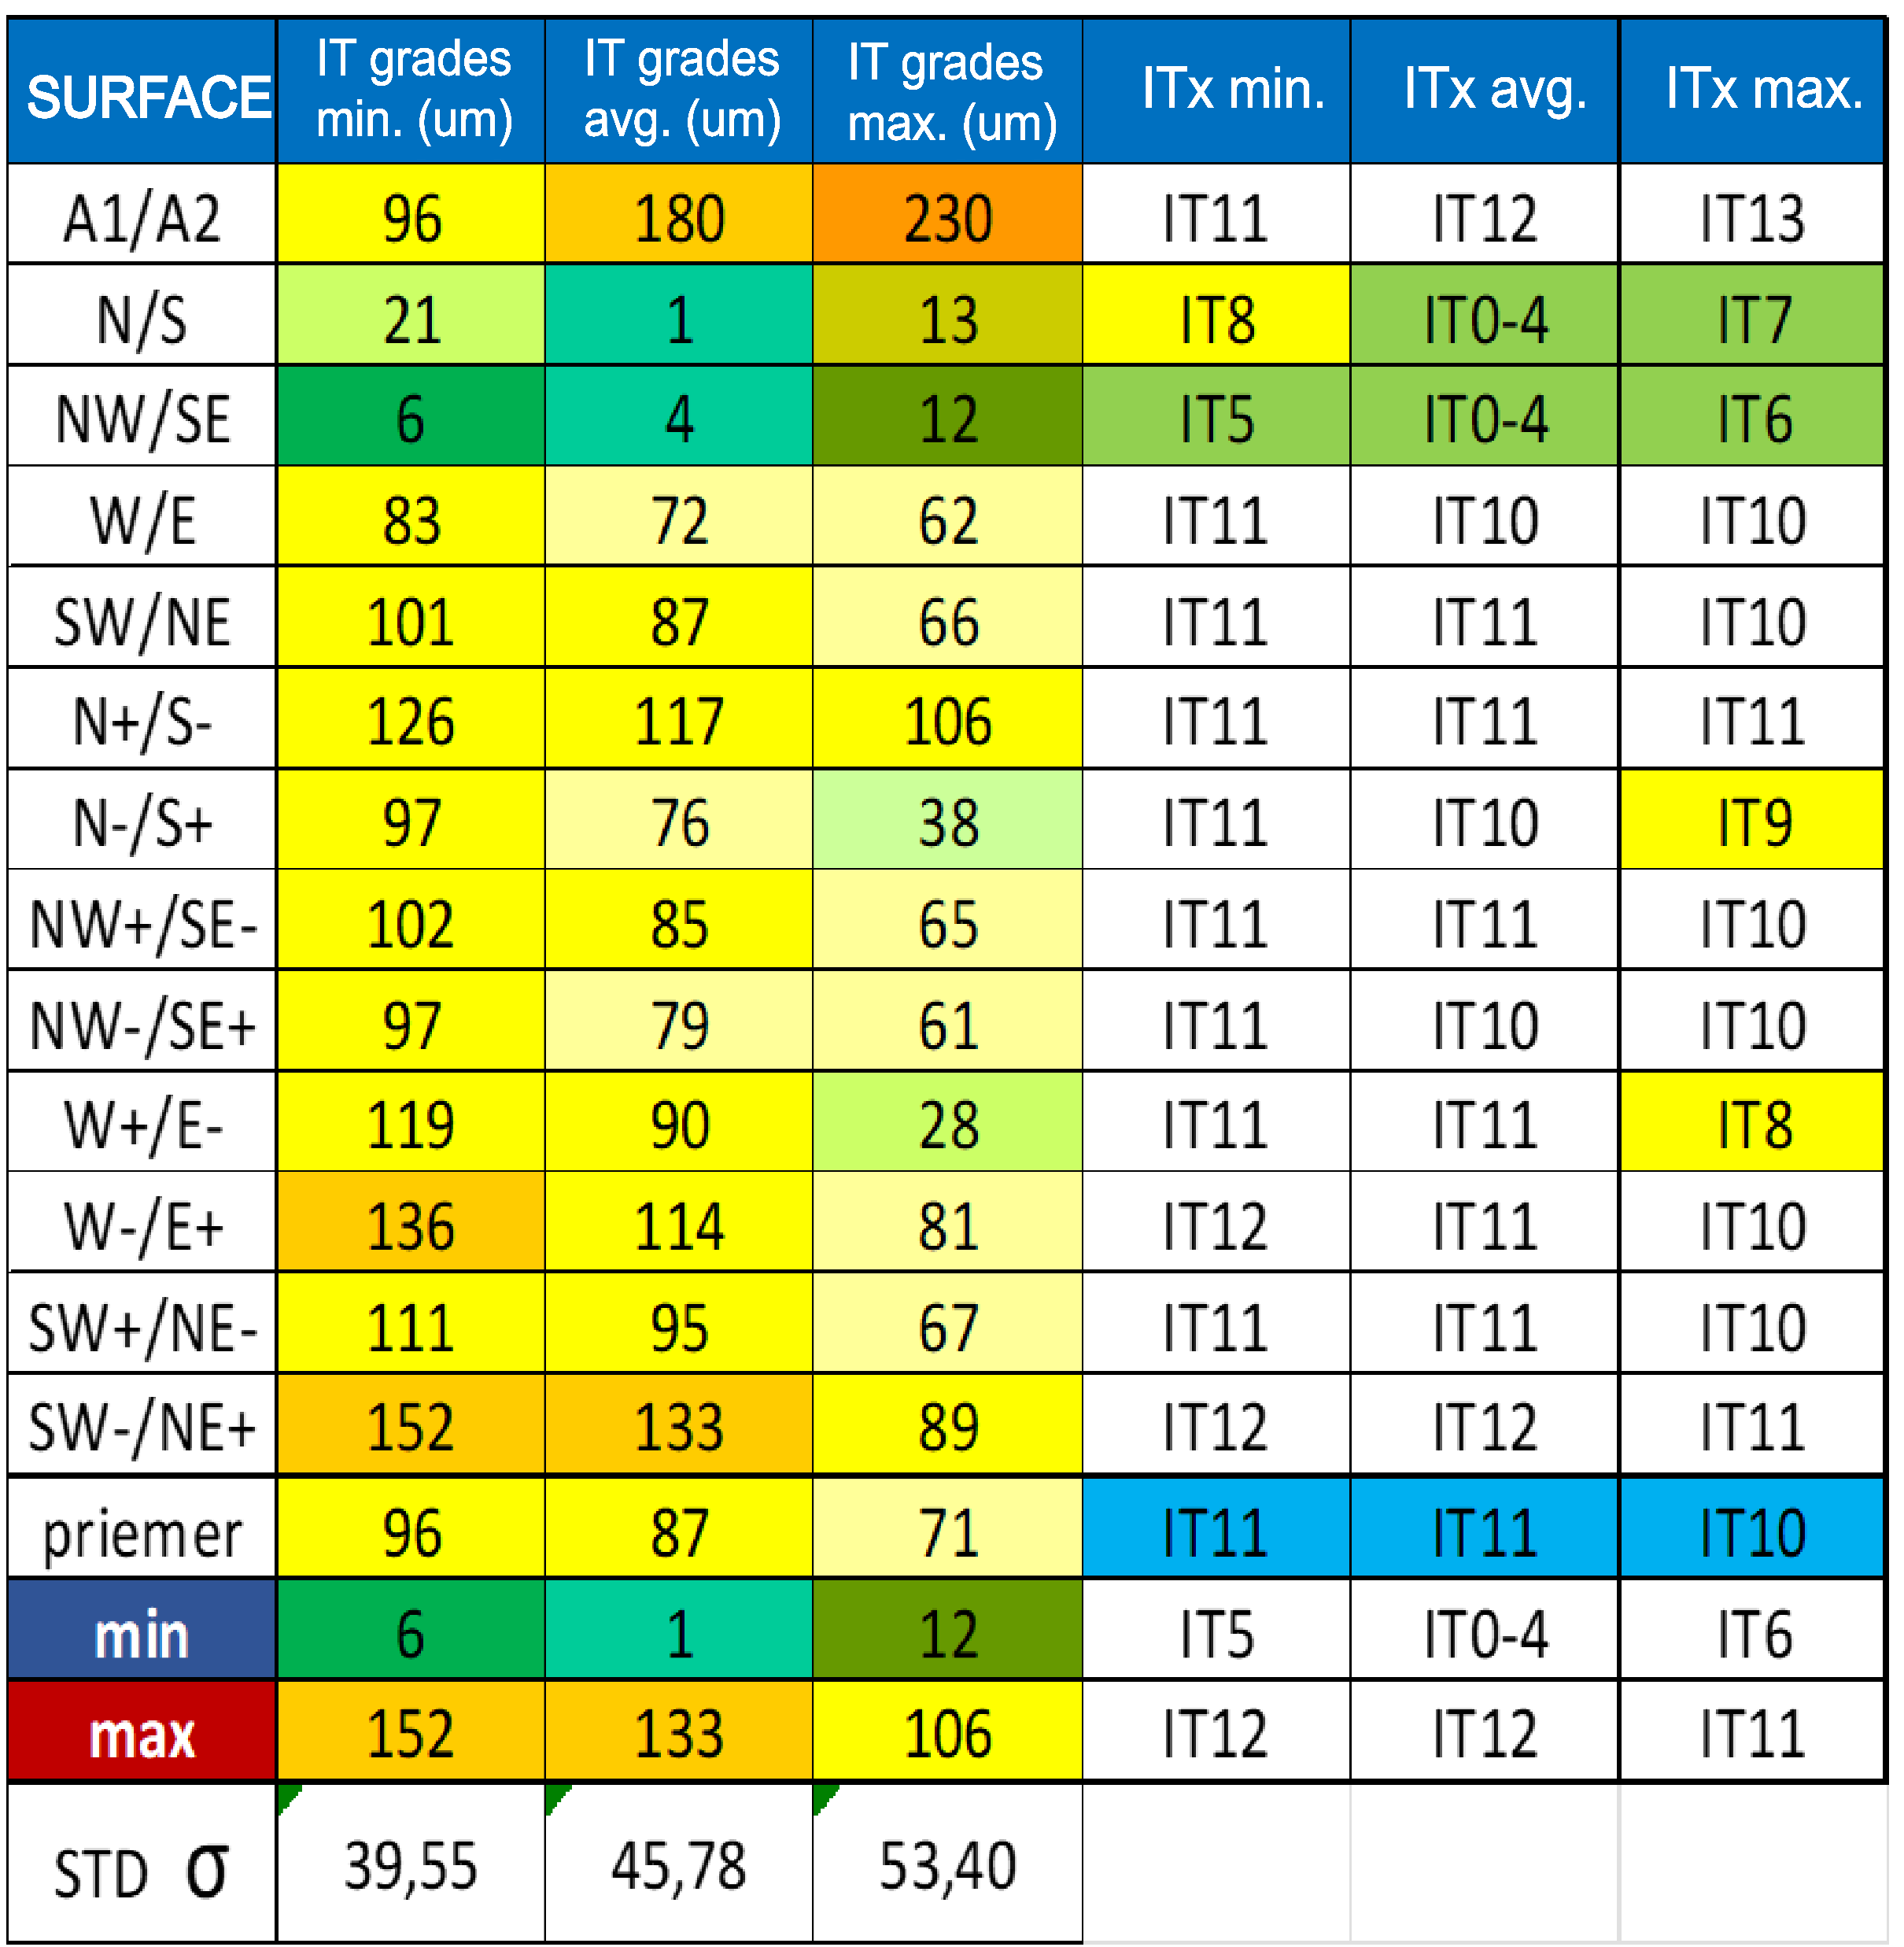
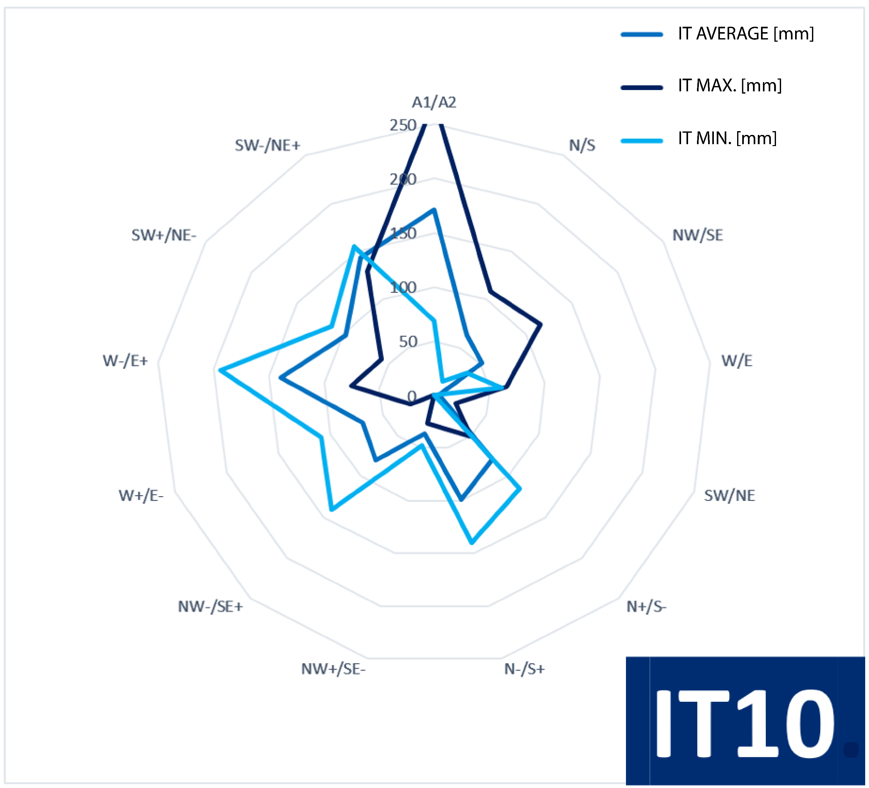
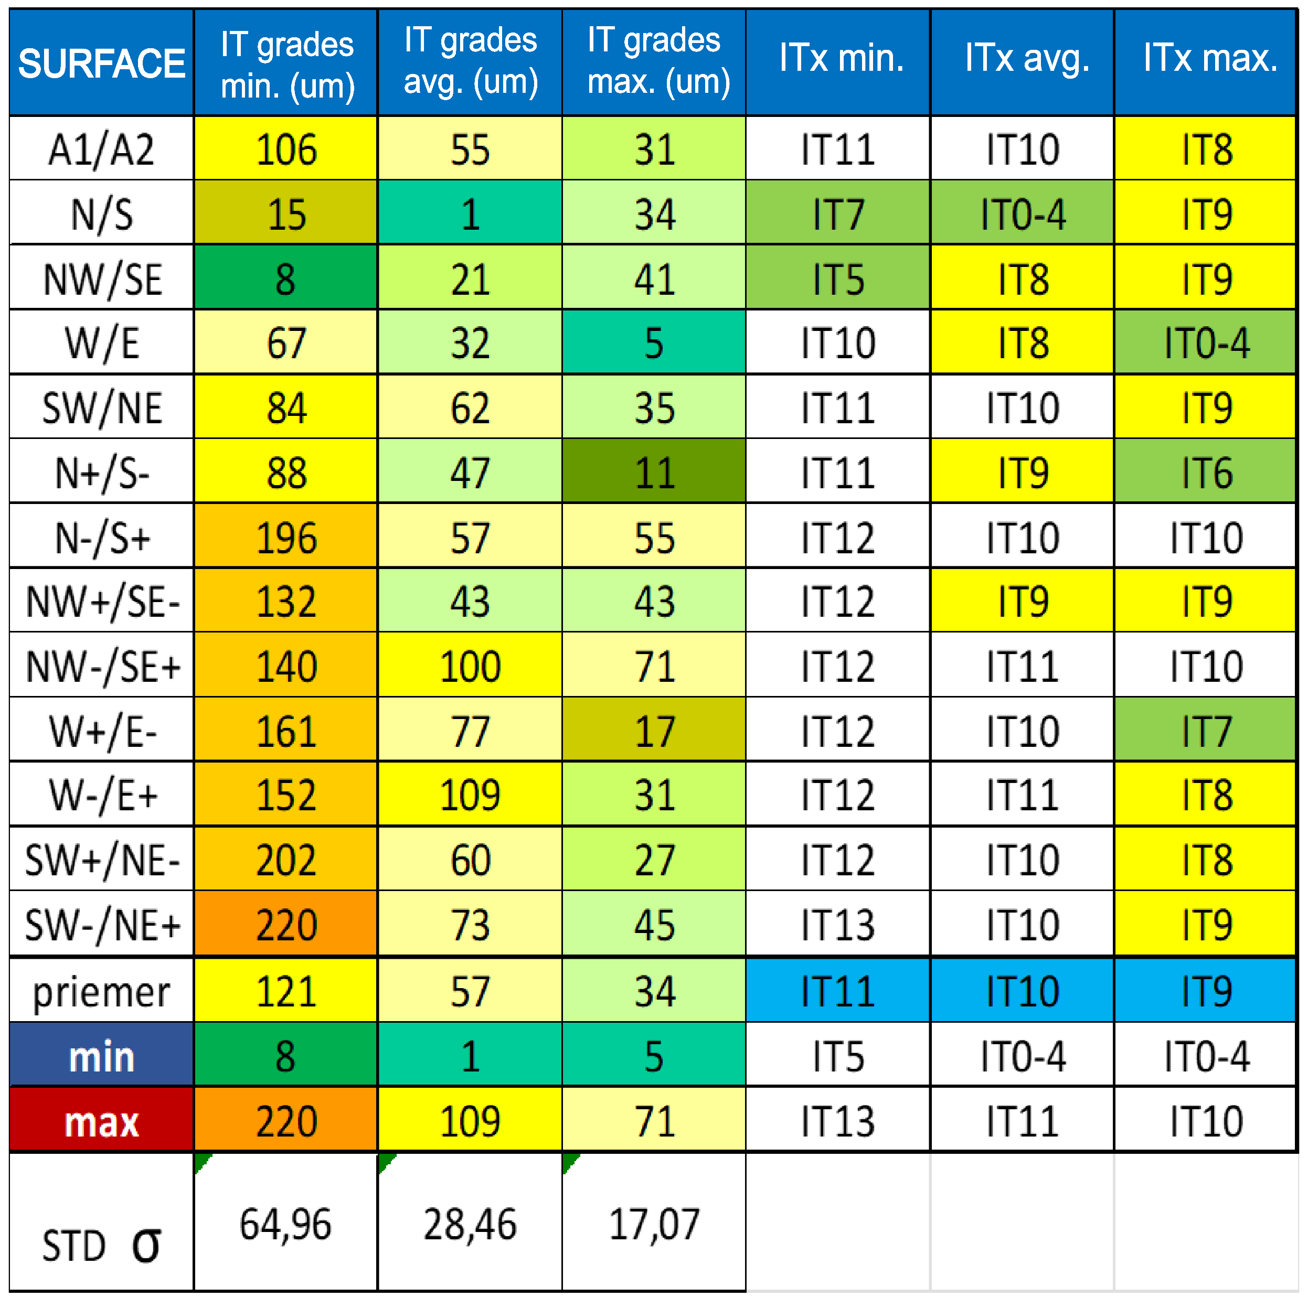
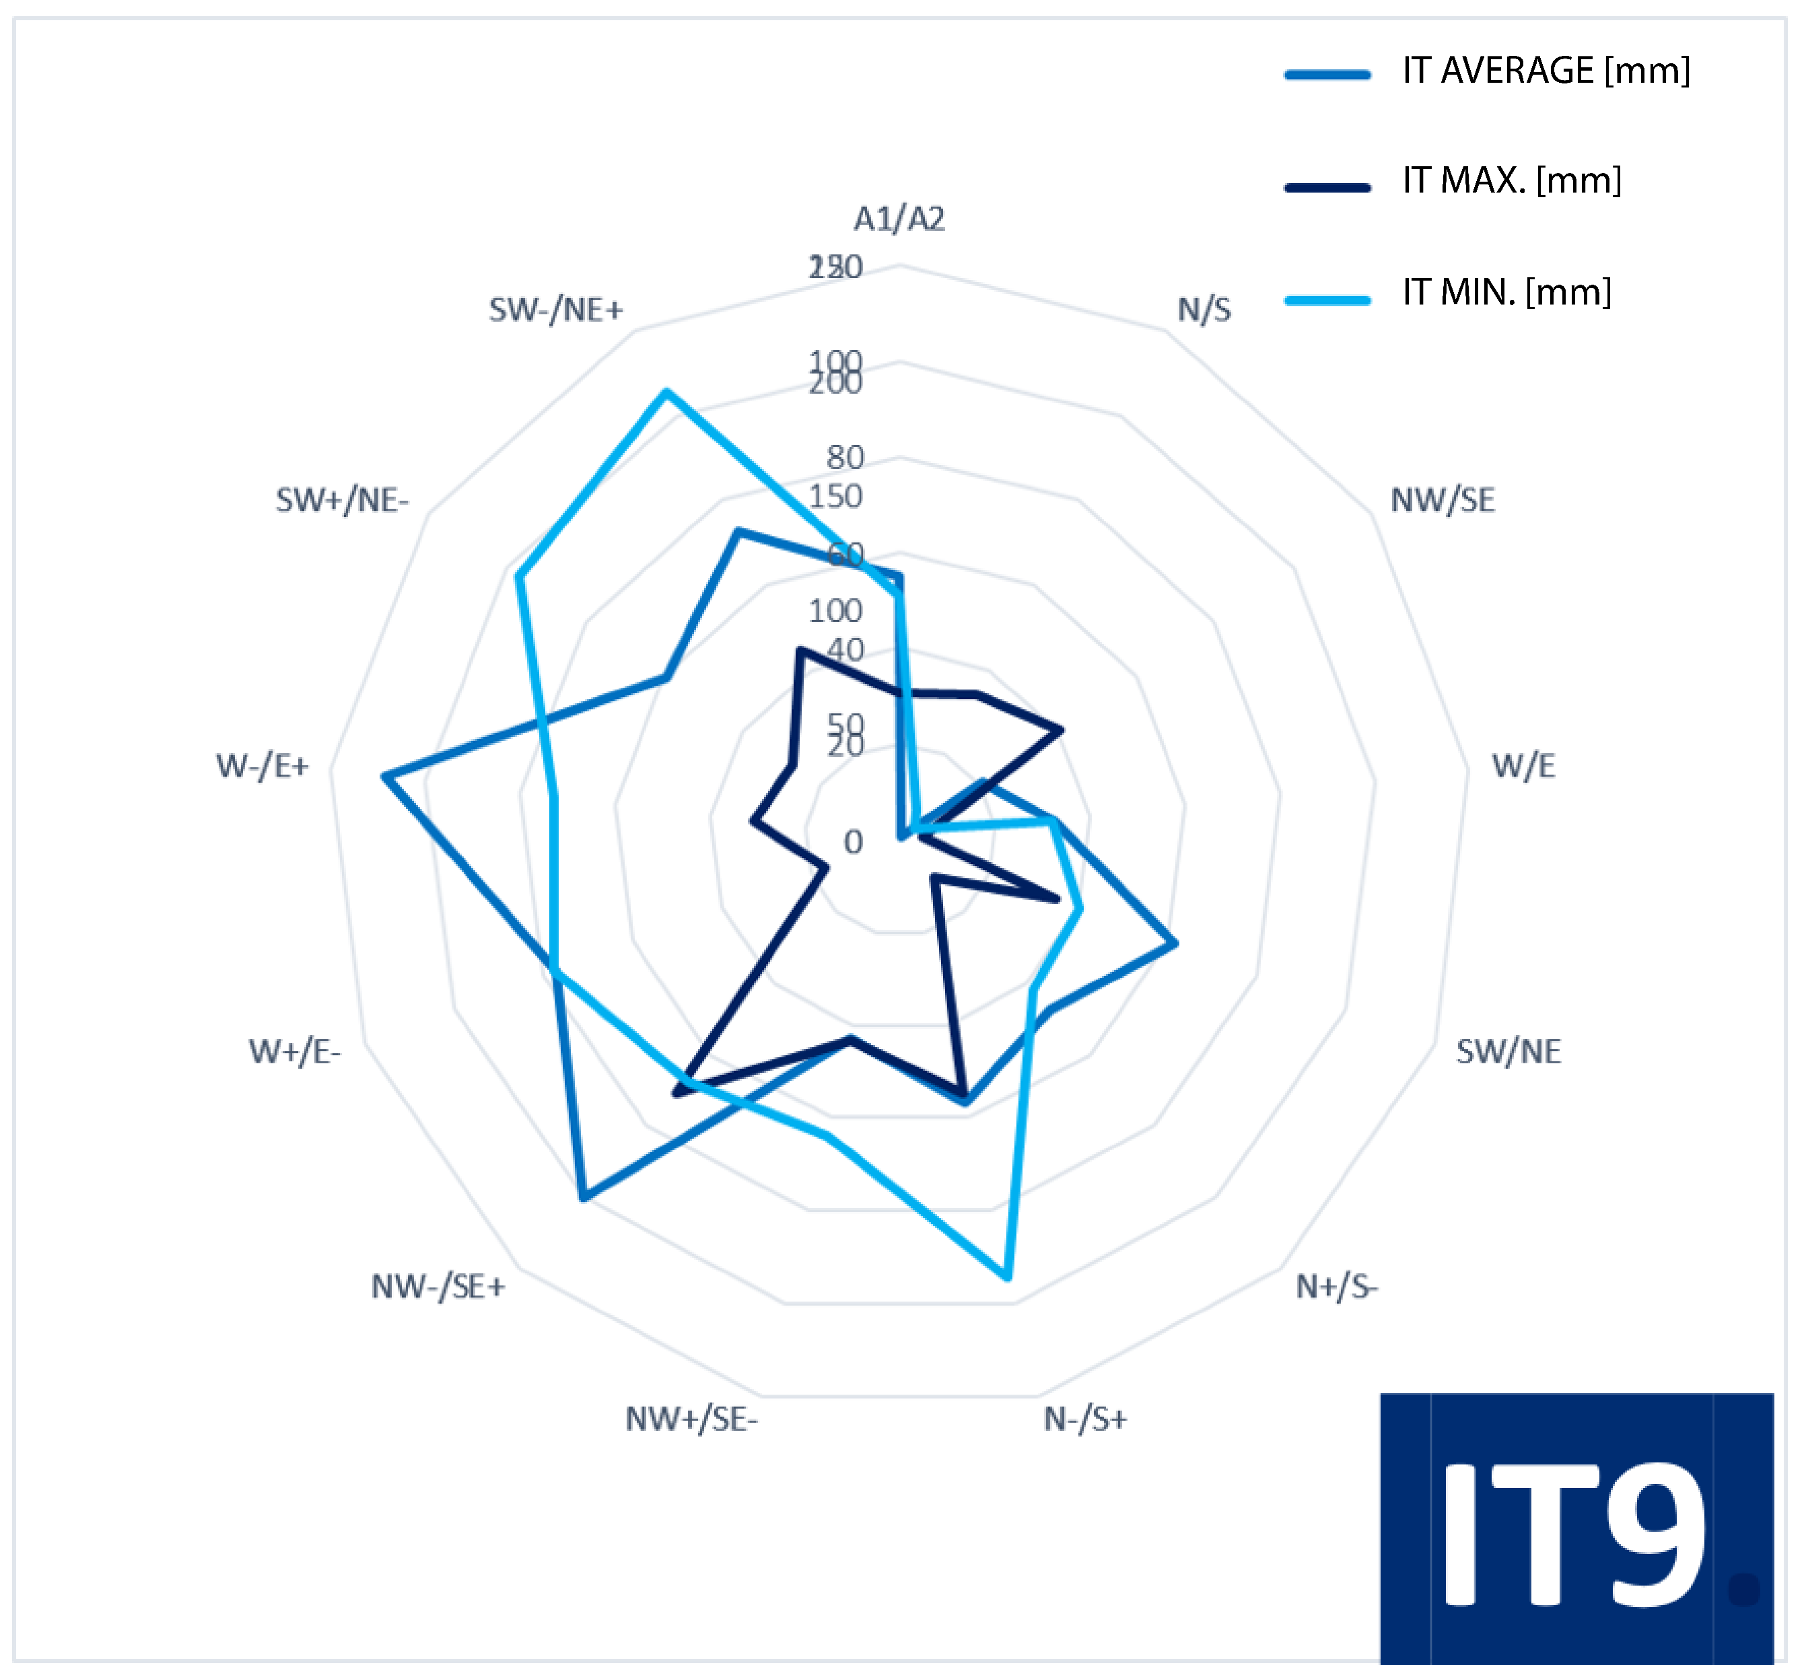
Title of the TRANSCOM 2025 paper
TRANSCOM 2025: 16th International Scientific Conference on Sustainable, Modern and Safe Transport
Andrej Czán¹, Natália Czánová2, Jozef Holubjákr³, Dominik Krišák⁴
1 University of Žilina UNIZA, Žilina, Slovakia
introduction
Backround information & Market Context SLM and ADAM are key AM technologies for stainless steel parts—SLM offers precision and strength, while ADAM is more cost-efficient. The Wohlers Report 2022 notes strong market growth driven by rising industrial use, emphasizing smart method selection. | Problem Statement & Stakeholders Problem Statement: Choosing between SLM and ADAM is challenging due to trade-offs in precision, cost, and performance for stainless steel AM parts. Stakeholders: Manufacturers, engineers, designers, cost analysts, R&D teams, and end users. | Research Objectives & Expected Impact Research Objectives: Compare SLM and ADAM to define best use cases and selection guidelines. Expected Impact: Better AM decisions, improved part quality, and increased industrial adoption.
materials, methods & implementation
Description of research methods and materials
This study investigates the performance of stainless steel 17-4 PH parts produced using two additive manufacturing technologies: Selective Laser Melting (SLM) and Atomic Diffusion Additive Manufacturing (ADAM). The powdered stainless steel 17-4 PH material was sourced from Markforged and processed using both methods to compare the hardness, accuracy, and mechanical properties of the resulting samples.
The experimental sample design considers all orientations (X, Y, Z axes) and both positive and negative Z angles to assess geometric accuracy. The 3D design includes octagonal areas spaced 30 mm apart, with hole samples (5 mm diameter) and M5 threaded samples. These samples are analyzed for dimensional accuracy and mechanical properties, including hardness, to provide a comprehensive comparison of the two additive manufacturing methods.
SLM Process: The SLM process was performed using the Renishaw RenAM 500 printer, which utilizes a high-powered laset to selectively melt metal powder layers with a precision of 50um.
ADAM Process: The ADAM process was carried out using the Markforged Metal X printer. This method uses a composite material consisting of metal powder bound in a polymet matrice. The material is printed in lyer by lyer, with a lyer thickness of 125um
SLM
ADAM
results
Academic Findings & Innovation Practical Applications
Key Findings:
1.Mechanical Properties:
  SLM parts made from stainless steel17-4PH exhibit higher hardness and tensile strenght due to fully dense structures.
  ADAM parts, while strong, show slightly lower hardness due to the polymet matrice, though sintering can improve properties.
2. Geometric accuracy:
  SLM offers high precision, especialy for complex geometries and tight tolerances.
  ADAM, with its larger layer height, is less accurate, especialy for negative angles or overhangs
3. Post-processing:
  SLM requires more extensive post-processing to address surface roughness and thermal distortion.
  ADAM is simpler, needing only sintering, making it more cost-effective and faster for certain parts
Practical Applications:
ADAM:
    Ideal for automotive, consumer goods, and industrial applications where cost efficiency, reduced waste, and moderate mechanical strenght are prioritized. Suitable for producting functional prototypes and non.critical parts.
SLM:
    Best for aerospace and medical industries where precision and strenght are crucial, such as lightweight and structural components custom implantats, and complex functional parts.
ADAM is more advanced method than SLM due to better material efficiency, lower costs and a simpler post processing process, making it an ideal choice for a wider range of application
conclusion & implementation path
Summary of research conclusions, impact and potential areas of further research in this field
CONCLUSION
This study compared two metal PBF methods, SLM and ADAM, by evaluating the raw materials' thermophysical properties and technological characteristics. It focused on production quality, efficiency, and precision. While SLM showed good production quality, it presented challenges, whereas ADAM demonstrated superior mechanical properties, shape accuracy, and stability. A key contribution was the development of 3D sample designs that enhance the evaluation of AM technologies. The data from this study will support future research and expand theoretical knowledge in additive manufacturing.
acknowledgements
Identify applicable funding agency here, put sponsor acknowledgments and references.
This research was supported by the University of Zilina through the following projects: KEGA 028ŽU-4/2024
"Implementation of Innovative Approaches in Education for Students in the Field of 3D Metrology" APVV-20-0561 "Research on implementing new measurement methods for calibrating measurement systems in industrial metrology practice," APVV-15-0405 "Comprehensive use of X-ray diffractometry for identifying and quantifying the functional properties of dynamically stressed structural elements made from key technical materials," and APVV-22-0328 "Development and verification of a methodology for measuring specific parameters of Ti implants during the production process."

