Slide 1


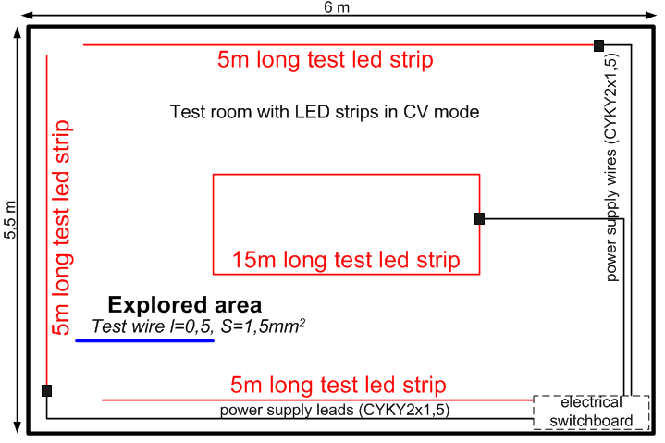
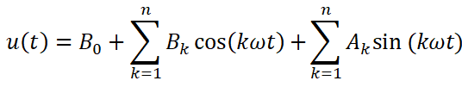
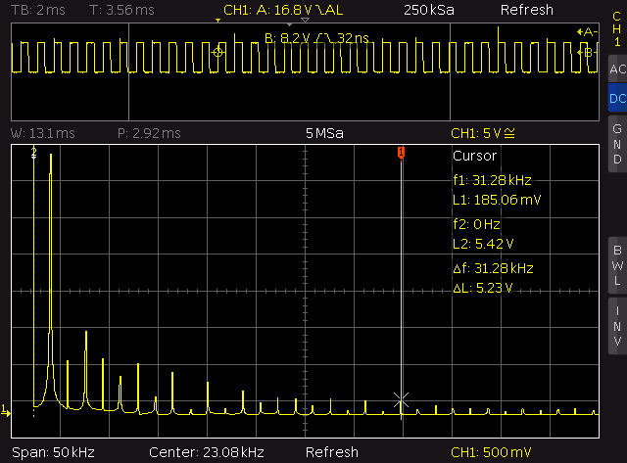
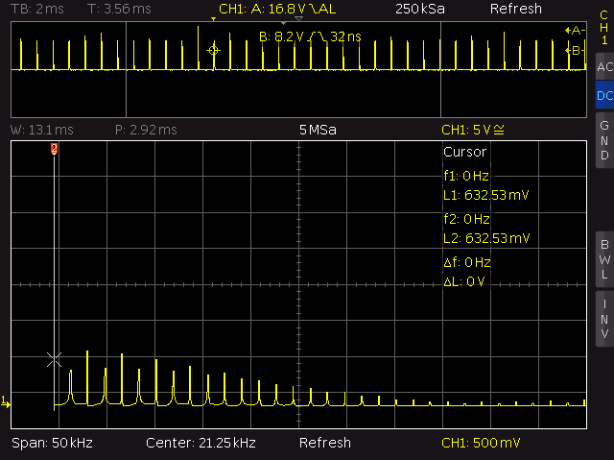
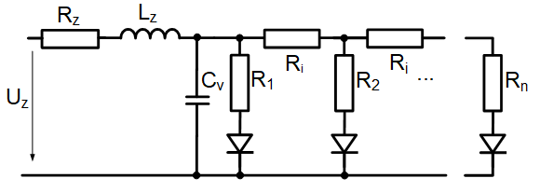

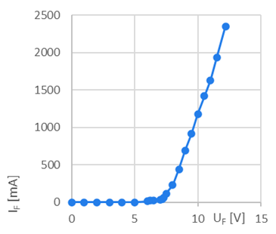
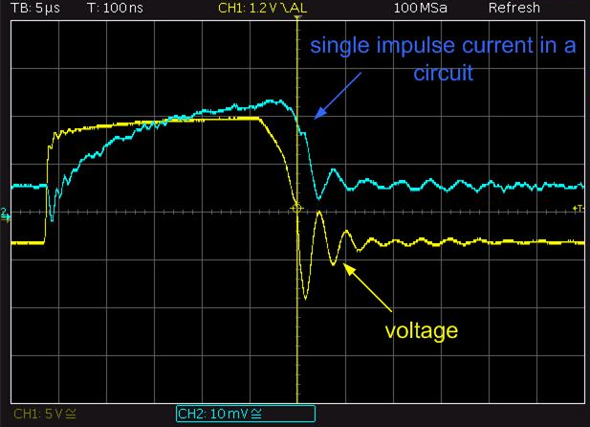
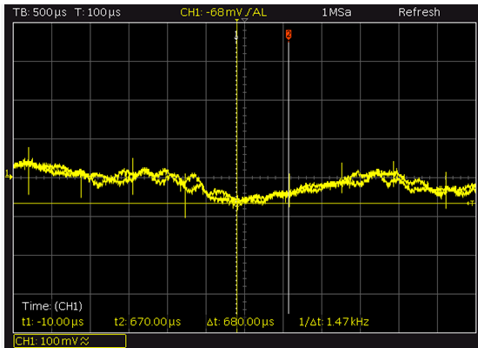
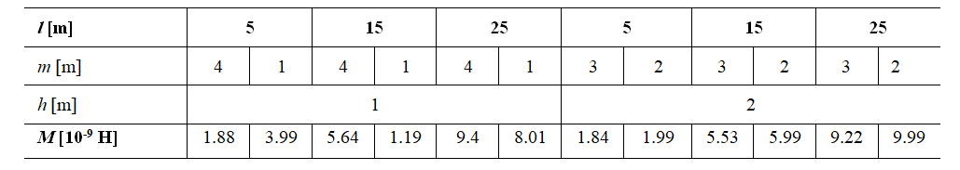
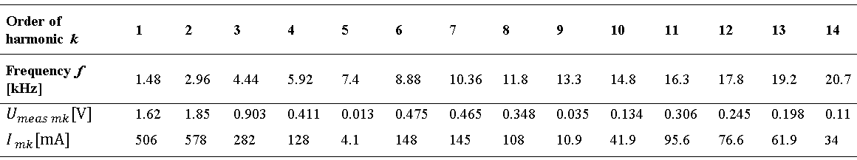
Analysis of electromagnetic field values in real space with multiple non-harmonic supplies
TRANSCOM 2025: 16th International Scientific Conference on Sustainable, Modern and Safe Transport
Alek Tropp, Mariana Benova
University of Žilina, Faculty of Electrical Engineering, Žilina, Slovakia
introduction
The subject of false influence can be sensitive electronic equipment in medicine, in professional industrial measurement as reported but effects specifically on cardiac pacemakers | The influence of low-frequency electromagnetic fields from the public power grid, but also from installations powered by low voltage from 12 to 60V using a controlled pulse source or other actuator in the sense of ICNIRP. | First, for clarity, one circuit and one source. Are shows the calculated and informative measured values ​​for the defined standard and controlled lighting in a room or office. For the practical significance of this article, a theoretical calculation of the mutual inductance between the EMF source and the test conductor located in the space of the investigated room is supplemented and supported by the measurement and analysis of the induced voltage.
materials, methods & implementation
Analyze of the current characteristics in the power supply electrical circuit and visualize by FFT
Equivalent circuit diagram of the CV LED strip
Used spectral analyse of power PWM signal with modulation depth 50% for n=30 harmonic components
Real waveform of the analyzed PWM power supply and display of harmonic components
Investigated area with test wire–for analyze inducted noise
of supply voltage with amplitude of fundamental harmonic component
results
Analysis of the current flow in a circuit with a nonlinear load powered by a switching power supply with PWM output. Waveform of a single pulse.
Induced noise and pulse from non linear circuits in the investigated area in test wire
Measured VA characteristics of non-linear load - led strip with CV chip connection
Induced voltage on the test wire
The measurement of the induced voltage on the test wire located in the analyzed space is shown in figure. Figure shows the voltage waveform due to the electromagnetic noise that was induced into the test wire.
Electromagnetic noise consists of a waveform that shows the noise when the power supply is turned off and of significant induced pulses visible in the form of peaks. The time axis highlights the time interval that represents the basic switching frequency of the power supply of 1.47kHz. The division on the vertical axis represents the real 100mV of induced voltage.
Next, after connecting the nonlinear load described above, the voltage waveform (yellow) is shown in figure. The time base of an oscilloscope is 1000 times shorter, meaning one division represents 100ns. This allows a single peak to be visible. As we can see, the non-harmonic current curve (blue color) is even more distorted and more pronounced higher harmonic components appear.
Results of calculated values of mutual inductance M
The value of the effective values of harmonic components current and voltage
conclusion & implementation path
This study shows that it is certainly important to deal with the properties of EMF and the effects on the human body and sensitive electronic devices even at low frequencies below 10 kHz. After a theoretical analysis of frequently used lighting power circuits in vehicles and in areas where people stay for a longer time, the presence of higher harmonic components of the current is pointed out. According to theoretical calculations, EMF has a very low intensity near lines and appliances powered by non-harmonic current. However, the calculations do not consider other influences, the existence of other objects in the room, reflections and other real conditions of EMF propagation. By measuring in the monitored area, in the first step, an induced voltage on the test wire of several mV was detected. The measurement result was a consequence of the long-term presence of EM noise. In the next step, after switching on a nonlinear load powered by a non-harmonic low-frequency voltage, the presence of undesirable induced voltage peaks of the order of tens of mV was detected. This area provides scope for further investigation of induced voltage and its frequency analysis.

