Slide 1


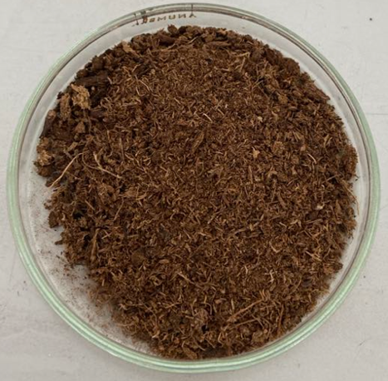
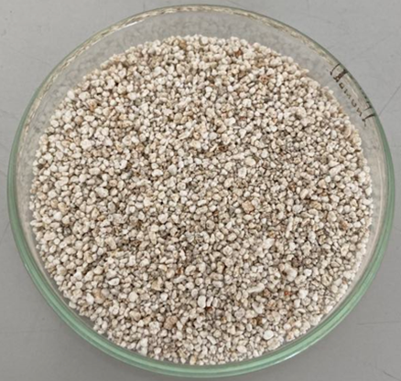
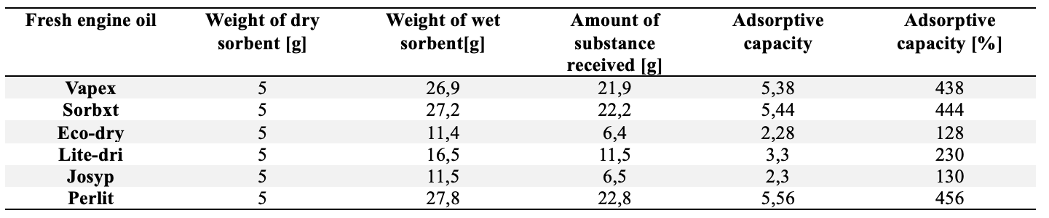
Title of the TRANSCOM 2025 paper
TRANSCOM 2025: 16th International Scientific Conference on Sustainable, Modern and Safe Transport
Dušan Bóna¹, Iveta Marková¹, Jozef Svetlík¹
1 Žilinská univerzita v Žiline, Žilina, Slovensko
introduction
Sorptive materials are an essential part of the equipment of members of the fire and rescue service of the Slovak Republic. They are used in most cases such as traffic accidents or traffic accidents with vehicles transporting dangerous substances. Currently, road transport is at a very high level and the number of cars is still growing. For this reason, the number of traffic accidents is also increasing, and thus many extraordinary events arise, in which it is necessary to use sorption materials
materials, methods & implementation
A total of 6 samples were used for the experiment, which were tested on two types of oil. Specifically on fresh engine oil and on used engine oil. We used procedure from the standard ASTM F726-17.
results
In Figure, we can see a comparison of the adsorption capacities for fresh and used motor oil. An interesting observation in this figure is that all sorbent materials have lower adsorption capacity for used motor oil. However, Sorbxt behaves quite the opposite. While it did not perform the best with fresh oil, it shows the best results with used motor oil.
conclusion & implementation path
From the values in Table, we can say that Perlite has the best adsorption capacity for oil absorption. The weakest values are observed for the Eco-dry.
acknowledgements

