Slide 1


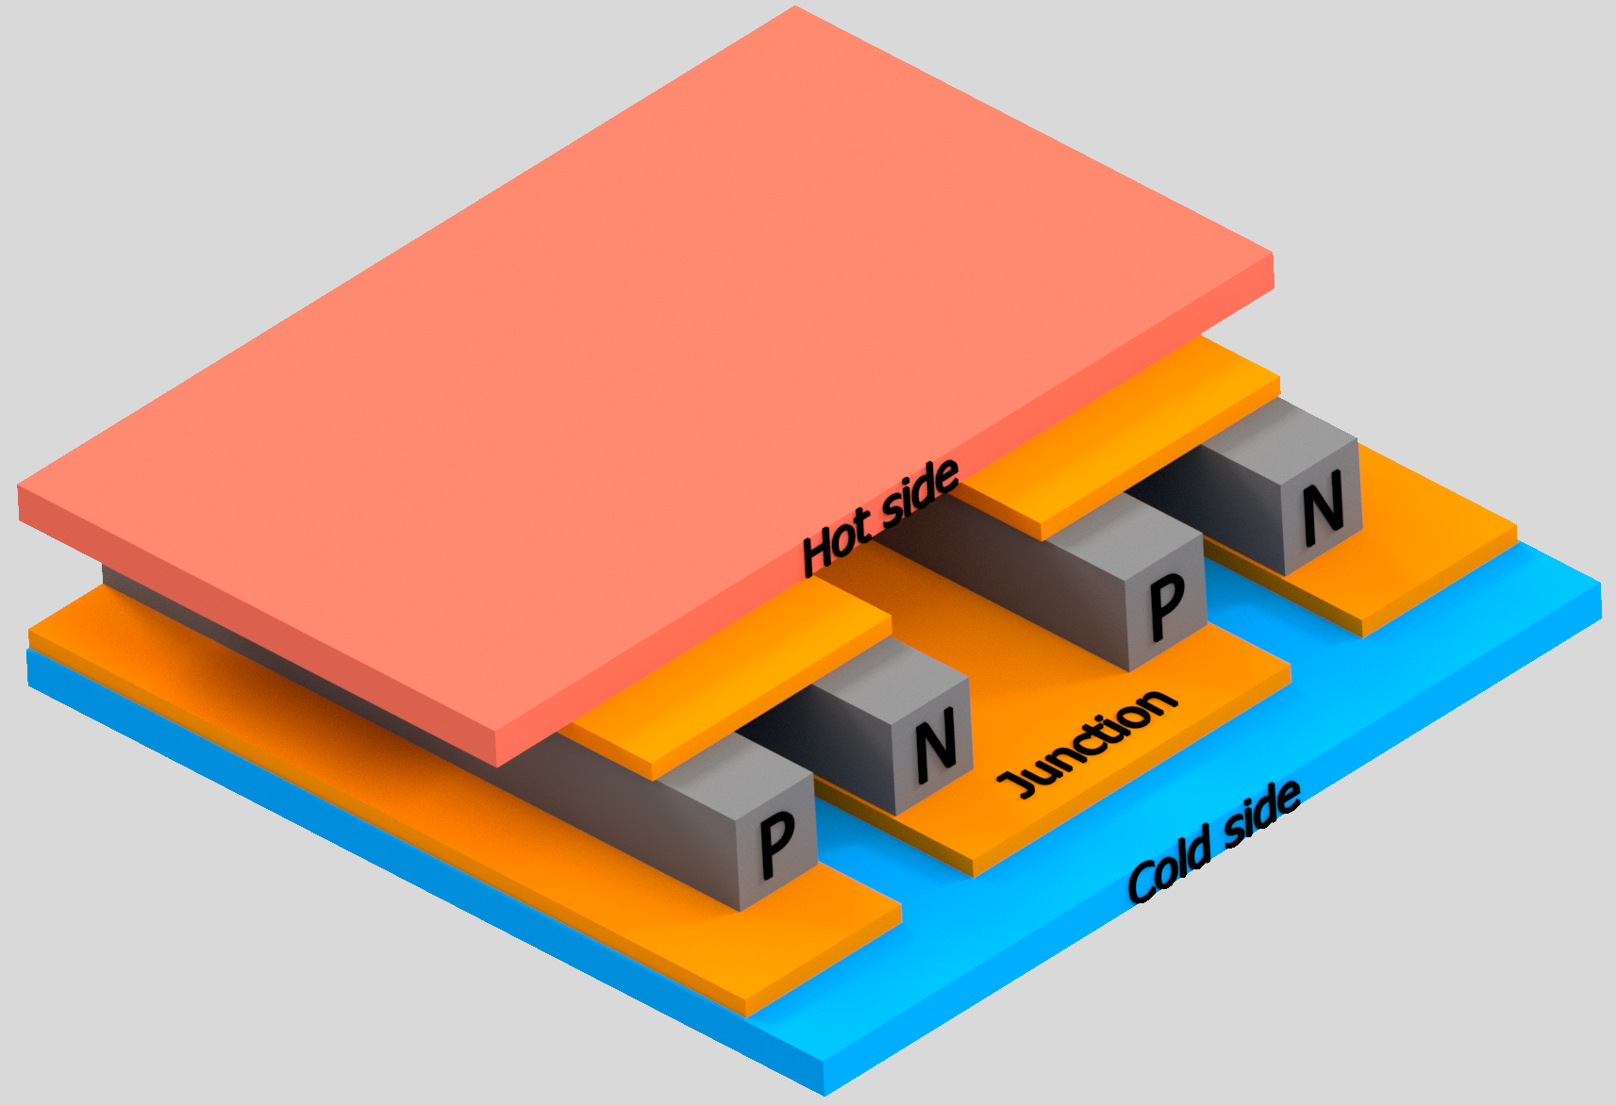
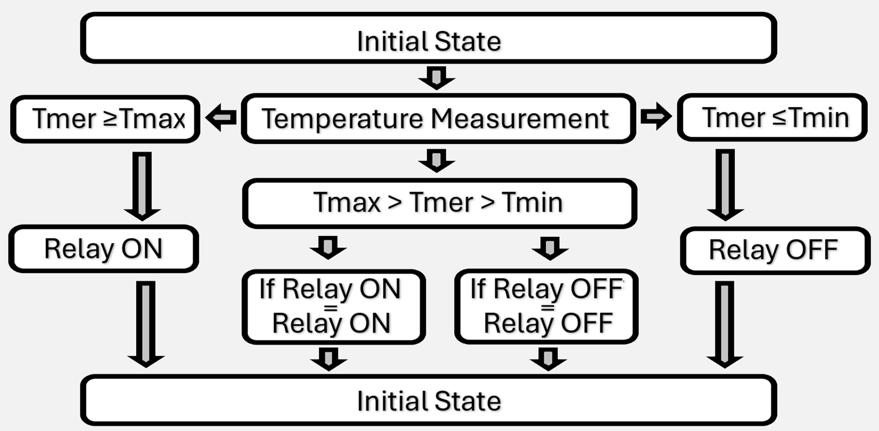
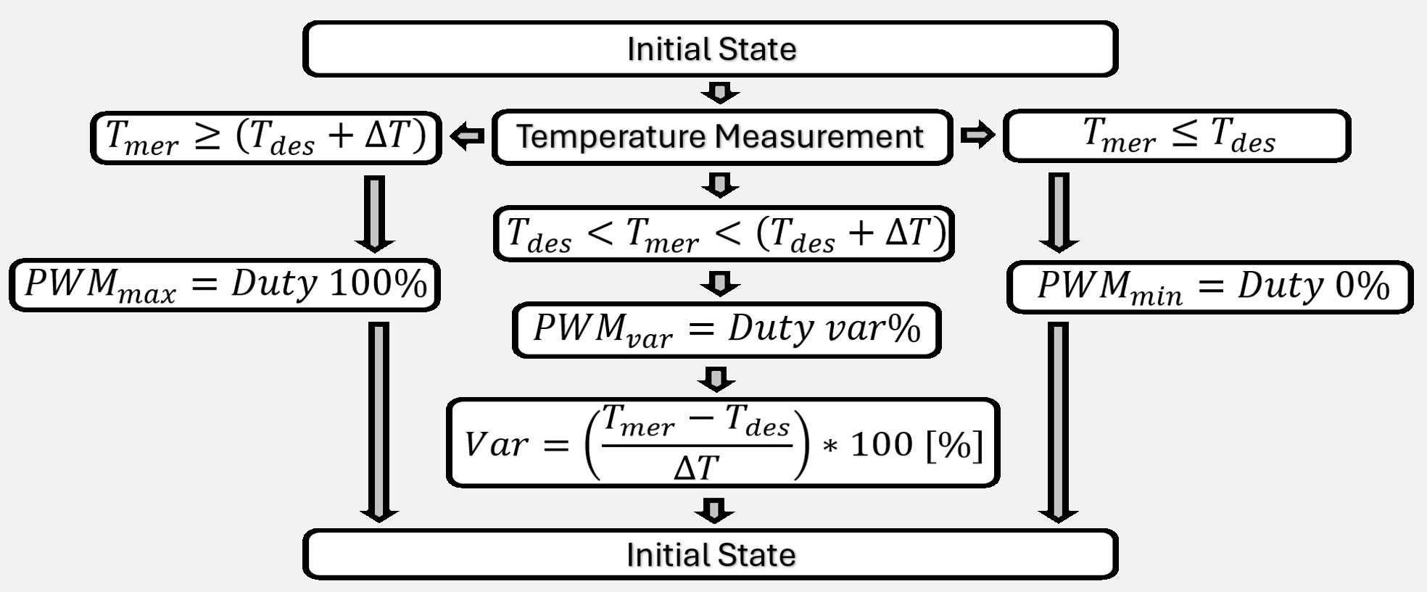
Electronic Regulation of Thermoelectric Modules in a Flow Cooler
TRANSCOM 2025: 16th International Scientific Conference on Sustainable, Modern and Safe Transport
V. Samaš¹, J. Gerlici¹
1 University of Zilina, Zilina, Slovak Republic
introduction
Rail vehicles typically use braking systems, which can be either friction block brakes or disc brakes. During their development and optimization, it is necessary to test the brake lining materials under various conditions, for which a brake inertia test stand is used. | In brake lining testing, the aim is to replicate real-world conditions as accurately as possible. One of the tests for brake lining is the wet condition test. As the name suggests, this test evaluates the performance of the lining under wet conditions. | For wet condition testing, it is essential to regulate the temperature within the range specified by the UIC standard. A flow-based cooler utilizing thermoelectric modules can be used for this purpose. This article presents various methods of TEC regulation.
materials, methods & implementation
The regulation system for thermoelectric modules (TEC) can be based on either a relay circuit or a transistor circuit. The first variant uses relay circuits, which are simple to design and manufacture, but their disadvantage lies in lower precision and slower response due to the lower operating frequency. Despite this, the approach is attractive for applications with less stringent dynamic regulation requirements. On the other hand, transistor circuits allow for electronic switching at high frequencies, eliminating issues with mechanical wear. The high switching frequency ensures smooth temperature regulation with minimal fluctuations, achieving significantly higher accuracy compared to relay control. The transistor solution represents a more modern and efficient approach. The lower resistance of the N-type leads to higher efficiency and less energy loss, making this type of transistor more suitable for applications requiring high performance. Each topology requires a different regulation and control method.
results
The first design variant of the control system uses a hysteresis loop to maintain the temperature within a defined range. This control method was chosen due to its simple implementation and its ability to reduce the number of switching cycles, which is well-suited for relay circuits. In this variant, the range of the hysteresis loop is defined by two limits – the minimum temperature (T_min) and the maximum temperature (T_max). These values are calculated based on the desired temperature (T_des) and the set width of the hysteresis loop (ΔT), which determines the regulation range. The width of the hysteresis loop ΔT, defines the range between the minimum and maximum temperature values. A smaller ΔT value results in higher precision and more switching cycles, while a larger ΔT value reduces the number of switching but leads to greater temperature fluctuations.
Pulse Width Modulation (PWM) control offers several advantages, including the ability to precisely adjust power and high-frequency regulation, which minimizes temperature fluctuations. This ensures the system operates efficiently and dynamically. However, its main disadvantages are higher costs and more complex implementation compared to the relay system. PWM regulation is based on controlling the duty cycle, which is directly proportional to the difference between the measured temperature and the desired water temperature. This method allows for precise control of the thermoelectric modules (TEC) to achieve the desired temperature range.
conclusion & implementation path
This study presented two technological solutions for regulating water temperature using thermoelectric modules (TECs). The first solution is a relay-based system controlled by a hysteresis loop, which is characterized by simple implementation and the ability to minimize the number of switching cycles, thereby significantly extending the relay's lifespan. The second, more advanced variant utilizes an N-channel transistor for PWM regulation. This method allows for high-frequency control, ensuring accuracy and dynamic adjustment of the system's performance. Both variants provide relevant solutions to the addressed problem, each having its specific advantages and limitations. The implementation, fabrication, and thorough experimental validation of the proposed control strategies would provide a comprehensive assessment of their practical functionality, reliability, and overall efficiency. By systematically analyzing their performance under real operating conditions, it would be possible to identify potential limitations, optimize system parameters, and refine the control approach. This process would ultimately lead to the determination of the most effective and efficient system configuration tailored to the specific requirements of the intended application. This would fulfill the main goal of this study, to provide scientific and technical contributions to the field of thermoelectric system control. One possible alternative to traditional relay circuits is the use of Solid-State Relays (SSRs). These relays enable the implementation of PWM control, offering the precise regulation typical of transistor-based circuits. he deployment of SSRs could effectively combine the advantages of both approaches simplicity of relay circuits, along with the high regulation accuracy characteristic of transistor systems.
acknowledgements
This publication was supported by the Cultural and Educational Grant Agency of the Ministry of Education of the Slovak Republic under the project KEGA 024ZU-4/2024: Deepening the knowledge of university students in the field of construction of means of transport by carrying out professional and scientific research activities in the field. It was also supported by the Slovak Research and Development Agency of the Ministry of Education, Science, Research, and Sport under the project VEGA 1/0513/22: Investigation of the properties of railway brake components in simulated operating conditions on a flywheel brake stand.

