Slide 1


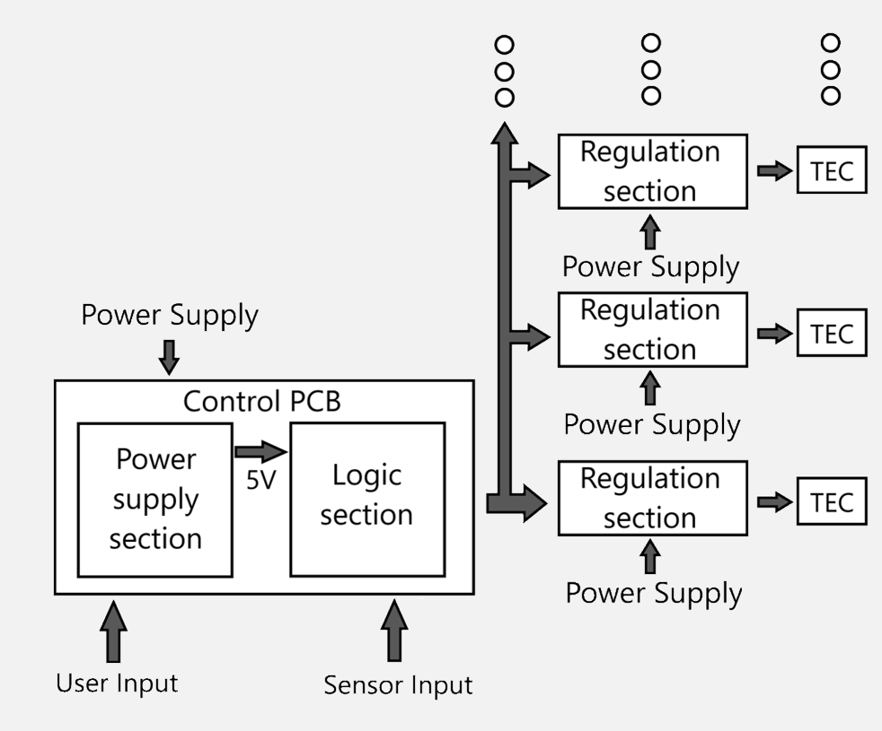
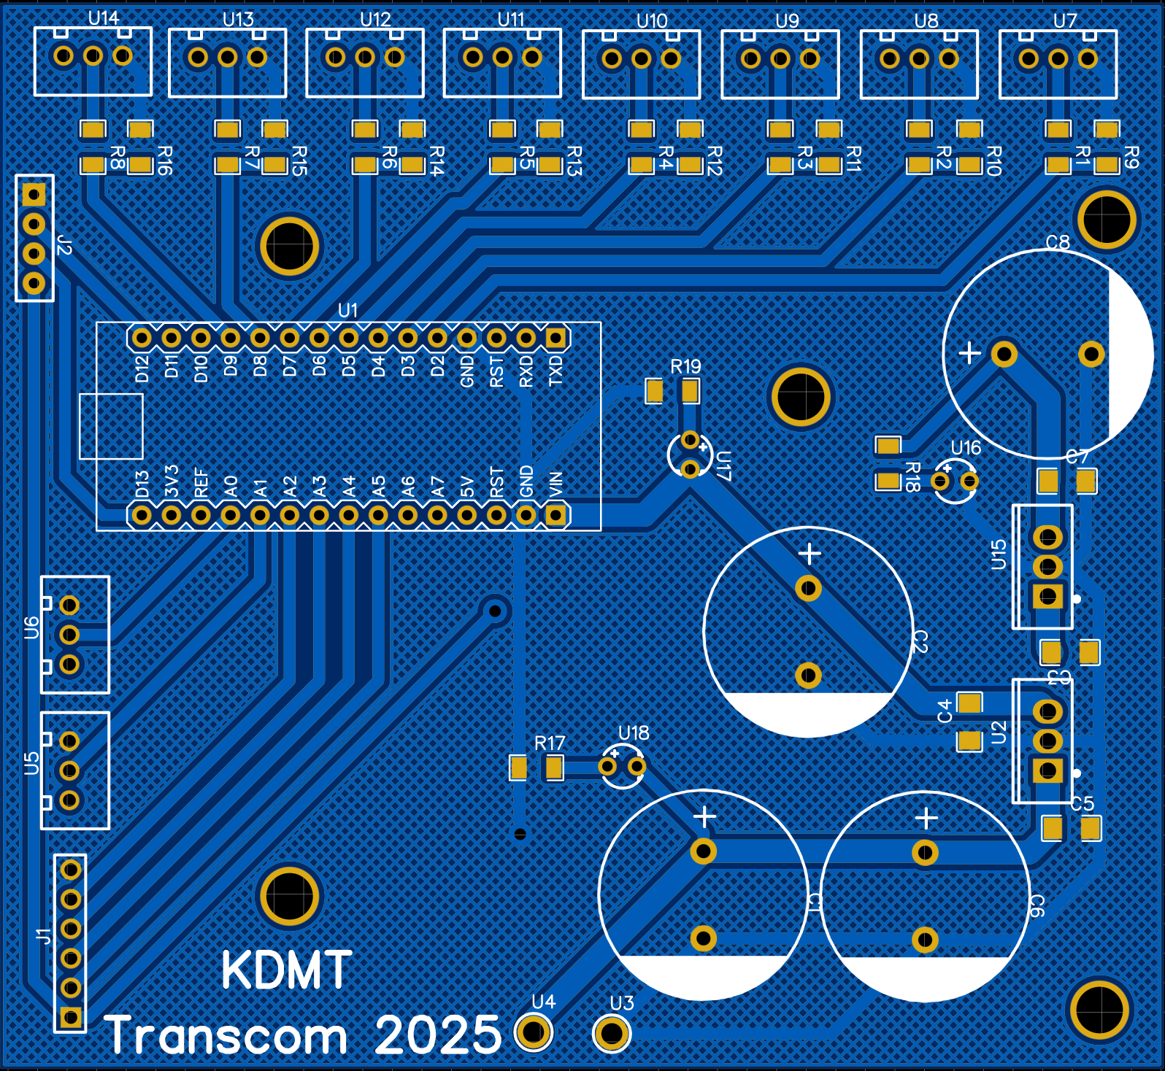
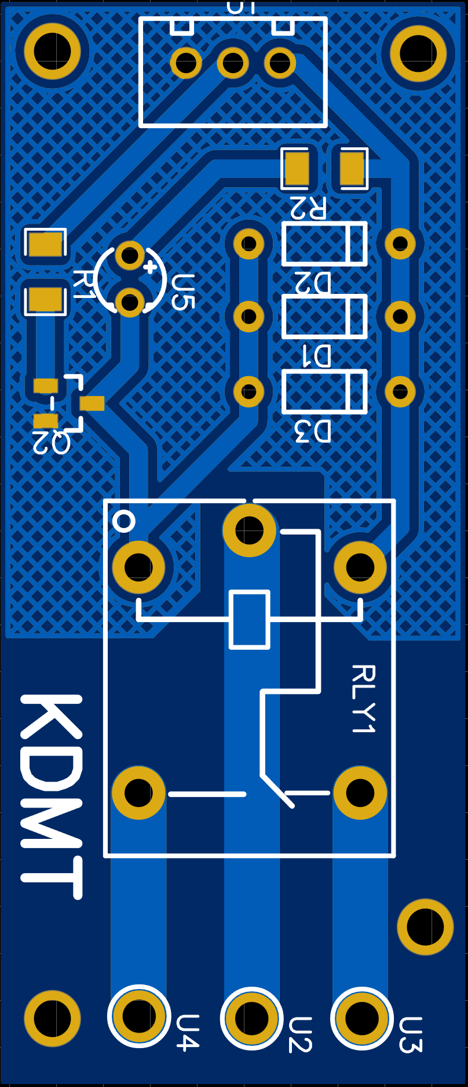
Design of an Electronic Control PCB for Thermoelectric Modules Using Relay Circuits and Hysteresis Loop Regulation in Railway Braking Systems
TRANSCOM 2025: 16th International Scientific Conference on Sustainable, Modern and Safe Transport
V. Samaš¹, J. Harušinec¹, A. Suchánek¹
1 University of Zilina, Zilina, Slovak Republic
introduction
Railway breaking is a crucial aspect of the operation and safety of rail vehicles, ensuring efficient speed control and stopping performance. This is why it is essential to conduct rigorous tests on the materials used for brake discs to assess their durability, thermal resistance, and wear characteristics. For this purpose, a UIC brake test stand is used, allowing for standardized and reliable evaluation under controlled conditions. | To conduct railway brake tests under rainy conditions, wet braking is employed. Wet braking is a specialized braking method that simulates the effects of rain on braking performance, ensuring the reliability and efficiency of the braking system in adverse weather conditions. This type of braking is distinct because it necessitates the application of water at a controlled flow rate. According to the UIC standards. | To conduct tests under wet conditions, the water used must be within a predefined temperature range. This temperature range must be maintained, as the water temperature tends to exceed the maximum threshold. For this purpose, a cooler is required, which in our case uses Peltier modules. It is necessary to regulate the power of these Peltier modules to adjust the cooling power.
materials, methods & implementation
One possible method of regulation of the power is the use of relay circuits, which allow the connection or disconnection of the power supply to the thermoelectric modules based on the real-time requirements of the cooling system. However, relay circuits have inherent limitations, particularly regarding the maximum number of switching cycles and frequency. Frequent switching can reduce the lifespan of the relays and compromise the overall reliability of the system (Camargo, 2024).To mitigate these drawbacks and extend the lifespan of the relays, a control system based on a hysteresis loop is implemented. A key design requirement is the ability to connect multiple thermoelectric modules to dynamically adjust cooling performance according to real-time needs. This approach enhances system flexibility, leading to a modular design. The logic and power supply sections are integrated into a single control PCB, ensuring a compact overall design and simplifying system assembly.
results
Each regulation PCB contains the necessary relay circuits for controlling thermoelectric modules and is dimensioned to withstand elevated thermal and electrical loads. The modular PCB design facilitates easy system scalability, making it particularly advantageous for applications demanding flexible cooling performance. This design approach not only meets technical requirements but also considers economic and practical factors, ensuring a balance between performance, cost, and ease of implementation.
conclusion & implementation path
The scientific contribution of this article lies in the design of an electronic control unit for thermoelectric modules, utilizing relay circuits and the principle of a hysteresis loop. This approach was developed to ensure efficient temperature regulation in a flow-based cooling system specifically designed for the braking systems of railway vehicles. The proposed system consists of two interconnected boards: a control board and a regulation board. The control board incorporates both the logic and power supply sections, ensuring the proper operation of the entire system. The regulation board contains relay circuits, with the control board enabling the individual switching of up to eight regulation boards. This modular approach enhances the system's flexibility and adaptability to various temperature regulation requirements. The main advantage of the proposed solution is the simplicity of implementation and the reliability of the relay circuits, which eliminate the need for more complex electronics based on transistor circuits or PWM (Pulse-Width Modulation) regulation. The hysteresis loop in this context ensures stable and adaptive temperature regulation, which is crucial for the optimal performance of thermoelectric modules and the minimization of relay switching cycles. However, the full significance of this design will be realized only after the fabrication of the printed circuit boards (PCBs), the implementation of long-term testing, and a quantitative performance analysis of the system. This analysis will include a comparison with regulation methods such as PWM signals in combination with transistor circuits. The precision of these measurements is paramount to the performance and reliability of the brake systems, underscoring the necessity for rigorous calibration throughout the design and execution of these tests to ensure the highest level of accuracy and consistency.
acknowledgements
This publication was supported by the Cultural and Educational Grant Agency of the Ministry of Education of the Slovak Republic under the project KEGA 024ZU-4/2024: Deepening the knowledge of university students in the field of construction of means of transport by carrying out professional and scientific research activities in the field. It was also supported by the Slovak Research and Development Agency of the Ministry of Education, Science, Research, and Sport under the project VEGA 1/0513/22: Investigation of the properties of railway brake components in simulated operating conditions on a flywheel brake stand.

