Slide 1


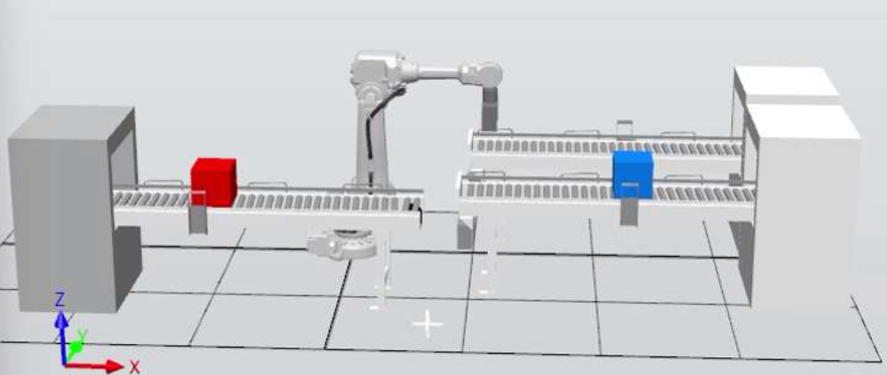
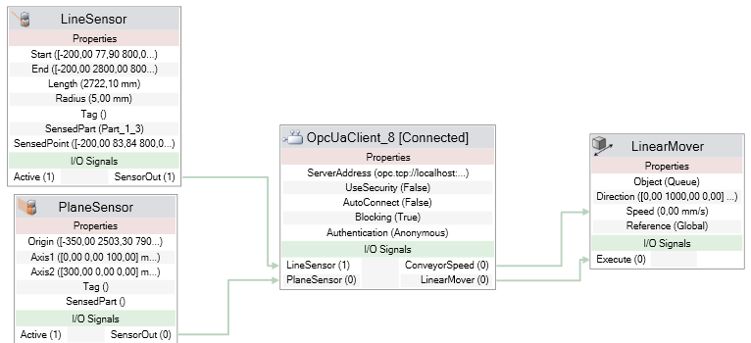
Development of a Digital Twin Controlled by PLC in a Simulation Environment
TRANSCOM 2025: 16th International Scientific Conference on Sustainable, Modern and Safe Transport
Jozef Hrbček¹, Juraj Ždánsky¹, Dávid Macko¹, Emília Bubeníková¹
1 University of Žilina, Žilina, Slovakia
introduction
Digital Twins are an emerging trend in industry and transportation, enabling real-time simulation, process optimization, and data-driven decision-making. In the transportation sector, they play a crucial role in improving efficiency, sustainability, and operational reliability. | Traditional transport modeling lacks the flexibility and accuracy needed to handle dynamic transportation networks effectively. The main challenge is integrating real-time data, optimizing traffic or producing flow, and ensuring seamless coordination between physical and digital infrastructure. | The research aims to develop a Digital Twin for industrial transportation systems that provides more accurate simulations and real-time transportation optimization. The expected impact includes improved traffic flow prediction, increased operational efficiency, reduced congestion, and better-informed decision-making.
materials, methods & implementation
This research utilizes a combination of advanced methodologies, including: Data Collection & Integration: Real-time data is gathered from the digital twin of the box sorting system. Simulation & Modeling: The Digital Twin is built using the RobotStudio software, connected to a PLC environment via OPC UA to ensure an accurate representation of transport processes. The control system is simulated in AutomationStudio. Development of a Digital Twin: A digital twin developed in simulation software can also assist in algorithm development for robotic movement, etc. System Architecture & Implementation: The IRB4600 robot autonomously sorts blue and red boxes onto designated conveyor belts, while a local or remote visualization system facilitates control by displaying conveyor status, sensor data, and real-time robot operations. The implementation phase involves rigorous validation through pilot testing in a controlled environment before large-scale deployment.
results
Academic Contributions: Digital connectivity enhances efficiency, drives innovation, reduces costs, eliminates manual labor, and increases workforce flexibility by enabling smarter systems, real-time data exchange, and seamless automation. Innovative Aspects: The integration of OPC UA for seamless communication between the simulation model and PLCs ensures high accuracy in system behavior replication. The decision-making algorithms enhance adaptability in dynamic traffic scenarios. Practical Applications: The developed Digital Twin can be enhanced to support multiple real-world applications, including: Smart Traffic Management: Real-time optimization of traffic lights and road usage. Public Transport Optimization: Improved scheduling and fleet management for buses and trains. Incident Response: By integrating digital twin technology with industrial controllers, potential failures can be detected early, allowing for predictive maintenance and minimizing downtime.. Logistics & Supply Chain Efficiency: Enhanced coordination in warehousing and transportation hubs.
conclusion & implementation path
This research confirms that Digital Twins (DT) is a key enabler for modern transportation systems. DT enables virtual testing of control algorithms before real-world implementation. The successful implementation of this concept requires: Public-Private Collaboration: Effective cooperation between municipalities, transport operators, and technology providers is essential for the successful implementation of smart transportation solutions. Investment in Data Infrastructure: Ensuring real-time connectivity through industrial communication supporting IoT and cloud-based data platforms is crucial for Digital Twins' effective implementation. Scalability & Adaptability: The model should be adaptable to various environments and transportation scenarios, ensuring seamless integration with different industrial systems, accommodating evolving logistics demands, and supporting future technological advancements. Future research can focus on expanding the Digital Twin framework to include environmental impact predictions, support for autonomous transportation systems, and integration with smart energy systems. Reliable data exchange requires robust network architecture. This study successfully implemented a Digital Twin of a conveyor system integrated with a PLC, demonstrating real-time control through OPC UA communication. The results indicate that Digital Twins provide a robust environment for testing and optimizing control strategies before deployment in real-world scenarios. Additionally, the use of RobotStudio for simulation has proven to be an effective approach in validating industrial automation processes, ensuring improved system performance and reliability. The study also emphasizes the importance of selecting appropriate communication protocols to integrate digital twin models and industrial controllers seamlessly, ensuring interoperability, scalability, and secure data exchange across various automation platforms.
acknowledgement
This work has been supported by the project APVV SK-IL-RD-23-0002: Advanced Localization Sensors and Techniques for Autonomous vehicles and Robots

