Slide 1


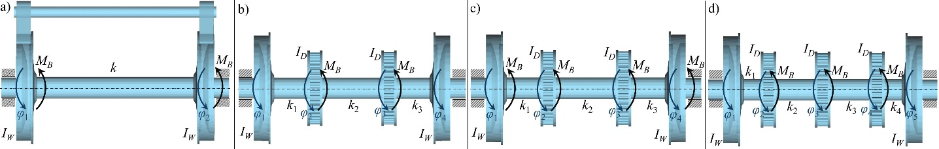
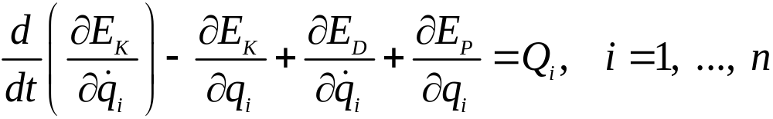
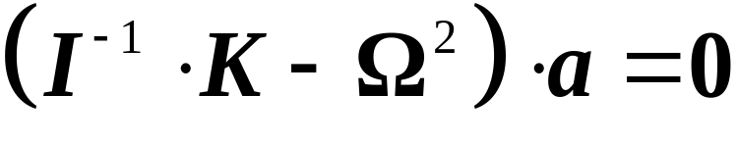
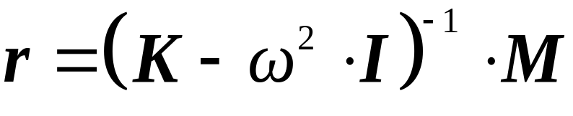
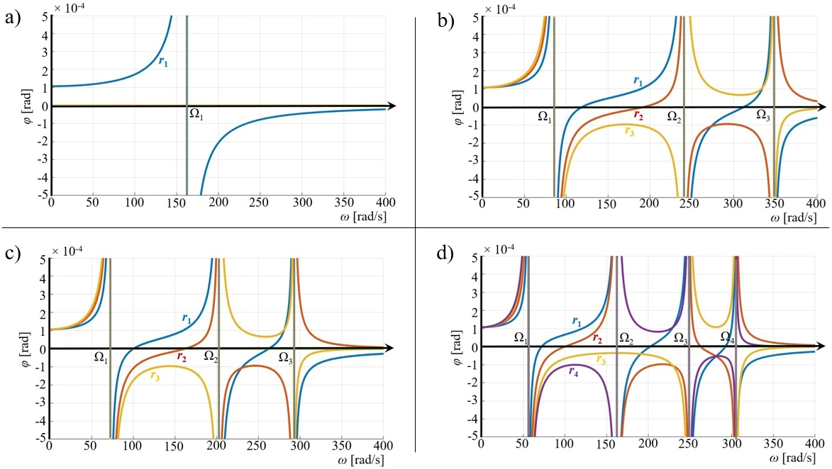
Eigenanalysis of wagon wheelsets based on the rigid body dynamics
TRANSCOM 2025: 16th International Scientific Conference on Sustainable, Modern and Safe Transport
Ján Dižo¹, Miroslav Blatnický¹, Alyona Lovska¹, Martin Bučko¹, Mariusz Kostrzewski², Oleksandr Kravchenko¹
1 University of Žilina, Žilina, Slovak Republic
2 Warsaw University of Technology, Warszawa, Poland
introduction
Railway transport is a widely used kind of transport of people and goods for middle and long distances. This kind of transport must meet strict criteria regarding comfort and safety and, that safety is quite a general term, which can be characterized from more points of view. | Two basic types of friction braked are recognized, namely pad brakes and disc brakes. Pad brakes connects to a friction couple a wheel, more precisely its running surface and a brake pad. Disc brakes includes two or more discs mounted on a wheelset axle and brake pads. | When a wagon wheelset is considered, eigenanalysis is a basic and the most important step from the dynamics point of view. It is possible to recognize based on the eigenanalysis results resonance zones, eigenfrequencies, eigenmodes and others.
materials, methods & implementation
The eigenanalysis of a wagon wheelset in this research is performed based on the rigid body dynamics. It means, that the wheelset is represented as follows: the wheels and brake discs are considered as rigid bodies and individual sections of a wheelset axle are considered as massless.
Fig. 1. Schemes of wheelsets with various brakes configurations
Wheels and brake discs are characterized by the moment of inertia and the massless wheelset axle are defined by torsion stiffness. It is necessary to derive a proper mathematical model of a wheelset in order to find eigencharacteristics. The derivation Lagrange's equations of the second kind were applied. A general form of these equations is known, and it is as follows:
As it is known, the eigenfrequencies are included in the spectral matrix Ω₂:
The resulting vector of the resonance curves are expressed as follows:
results
The results of the performed research is presented in this section.
Fig. 2 depicts the achieved results of the calculations. This figure includes the resonance curves for the analysed wheelsets presented in Fig. 1. The resonance curves were created by means of the Matlab software.
As it can be seen, the resonance curves include the zones, where the amplitude of forced oscillations of the material components of the wheelsets (wheels and brake discs) grow to very high values. These zones are the wanted resonance zones. It is obvious that operation of the wheelset (it means during braking) could lead to such high angular deflections, which would end by destruction of the wheelset.
The wheelset with the pad brake (Fig. 1a) has one resonance zone (Fig. 2a). The torsion oscillation can be caused by uneven braking force on wheelset wheels. The wheelset with two brake discs has three resonance zones, which are shown in Fig. 2b. Resonance zones depicted in Fig. 2c also belong to the wheelset with two brake discs.
Fig. 2. Resonance zone of individual type of wheelsets – the research results
However, it includes additional brake discs mounted in wheels (Fig. 2c). Finally, we can recognize four resonance zones of the wheelset with three brake discs mounted on an axle. Based on the performed research, it possible to conclude, that the wheelset with three brake discs has more resonance zones. Therefore, it should be noted, that more braking components can lead to more unfavourable oscillation behaviour of wheelset during braking.
conclusion & implementation path
The main purpose of the presented research was to perform eigenanalysis of several types of wagon wheelsets. Mathematical models of oscillation of these wheelsets were derived. These models were represented by inhomogeneous equations of motion. Based on the derived equations of motion, resonance curves were shown. Graphical outputs were created by means of the Matlab software. The main objective of resonance curves is to reveal the resonance zones, i.e. dangerous zones, in which, wheelsets should not operate. It was found out, that various types of brakes used on wheelsets lead to different dynamic response. The future research will be focused on a comparison of the achieved results with the FEM approach.
acknowledgements
This research was also supported by the project VEGA 1/0513/22 and the project KEGA 031ŽU-4/2023. “Funded by the EU NextGenerationEU through the Recovery and Resilience Plan for Slovakia under the project No. 09I03-03-V01-00131.” “Funded by the EU NextGenerationEU through the Recovery and Resilience Plan for Slovakia under the project No. 09I03-03-V01-00129.”

