Slide 1


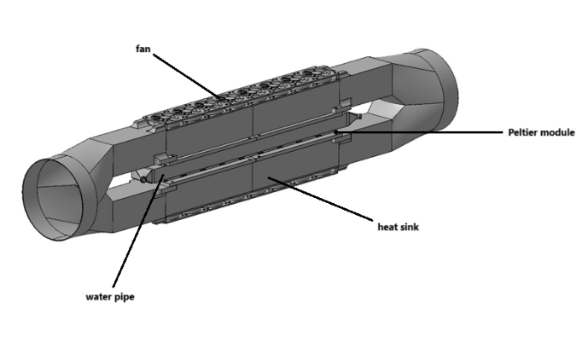
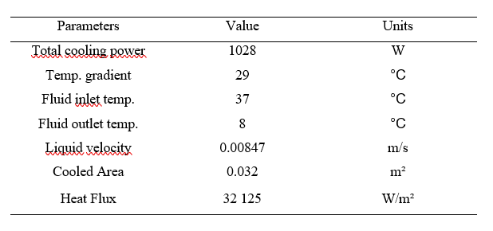
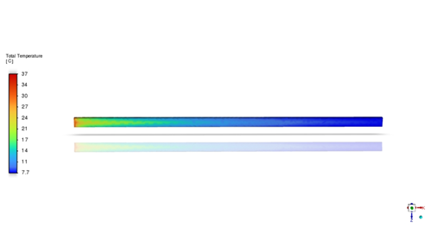
Thermal Regulation of Auxiliary Water for UIC Brake Test Bench
TRANSCOM 2025: 16th International Scientific Conference on Sustainable, Modern and Safe Transport
Matúš Adamkovič¹, Alyona Lovska¹, Andrej Suchánek¹, Jozef Harušinec¹
1 University of Žilina, Žilina 010 26, Slovak Republic
introduction
Heat exchange is a critical component of the thermoregulation systems for the auxiliary fluid used in train brake test benches. The simulation of wet conditions during train brake testing is a crucial for evaluating braking performance and safety. | Brake simulations offer essential feedback to manufacturers, facilitating improvements in brake systems. Techniques for simulating wet conditions during laboratory testing include direct application of water to brake discs or pads, creating humid environments within test chambers. | The primary objective of designing a cooling device with Peltier modules is to provide precise temperature control of the fluid, allowing for accurate regulation in accordance with customer specifications during the testing of specific brake discs or pads
materials, methods & implementation
Peltier modules, often referred to as thermoelectric coolers (TECs), are semiconductor devices that exploit the thermoelectric effect to generate a temperature difference when an electric current flow is applied. This phenomenon allows the modules to transfer heat from one side to the other, providing efficient cooling or heating depending on the direction of current flow. When a direct current (DC) is applied to the Peltier module, electrons in the n-type material and holes in the p-type material are driven toward their respective electrodes. This movement of charge carriers creates a heat transfer process: heat is absorbed on one side of the module, known as the cold side, and is dissipated on the opposite side, referred to as the hot side. By reversing the polarity of the current, the direction of this heat flow can be inverted.
results
Based on the boundary conditions and existing knowledge about Peltier modules, which are characterized by their ability to efficiently and precisely regulate temperature through electric current, a device was designed and constructed to fully leverage these properties. Peltier modules enable precise control of thermal processes, making them optimal components for applications that require accurate cooling or heating. The device is designed to maximize efficiency while minimizing energy consumption, and its design ensures stable, reliable operation, particularly in laboratory environments. The cooling device consists of four heat sinks, each containing four Peltier modules, which are then connected to the pipe. The heat sinks are equipped with a series of fans and air channels to direct the hot air out of the cooling system.
conclusion & implementation path
As can be observed from the simulation results, the temperature initially dropped rapidly from 37 °C to 21°C. However, the cooling process then slowed down, and the time required for the temperature to decrease from 21°C to 8°C was significantly longer. This behavior highlights the limitations of Peltier modules that have a critical role in cooling applications but are limited in their ability to cool liquids flowing through a pipeline, especially as cooling performance decreases with increased thermal load. Radiator coolers, on the other hand, are commonly chosen for general-purpose cooling due to their efficiency. They excel at handling moderate to high thermal loads with minimal energy consumption. In contrast, Peltier modules are used in specialized scenarios where precision is essential. Their ability to regulate temperature within tight tolerances makes them optimal for applications requiring precise thermal regulation, which was the reason for their selection in this research. Ultimately, the choice between these cooling systems depends on specific cooling requirements, such as thermal load, desired precision, budget, and application context. Due to the specific conditions encountered in this study, the use of radiator coolers was not feasible.
acknowledgements
This publication was supported by the Cultural and Educational Grant Agency of the Ministry of Education of the Slovak Republic under the project KEGA 024ZU-4/2024: Deepening the knowledge of university students in the field of construction of means of transport by carrying out professional and scientific research activities in the field. It was also supported by the Slovak Research and Development Agency of the Ministry of Education, Science, Research, and Sport under the project VEGA 1/0513/22: Investigation of the properties of railway brake components in simulated operating conditions on a flywheel brake stand.

