Slide 1


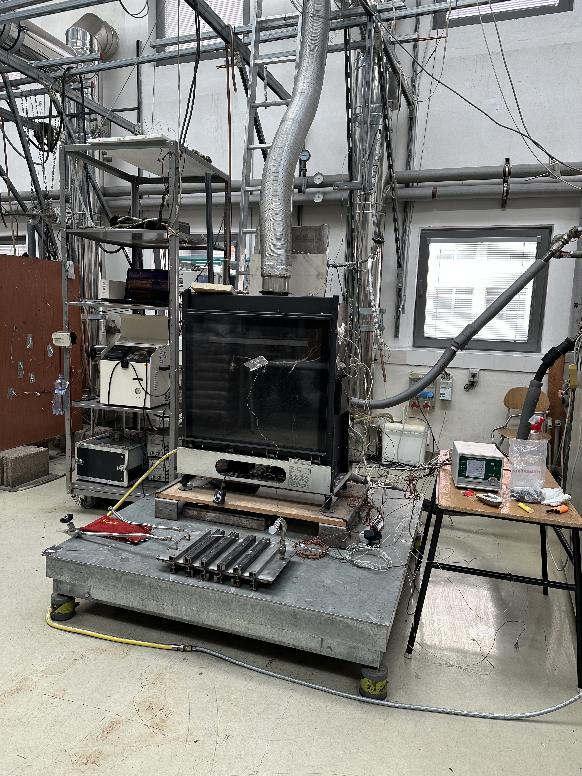
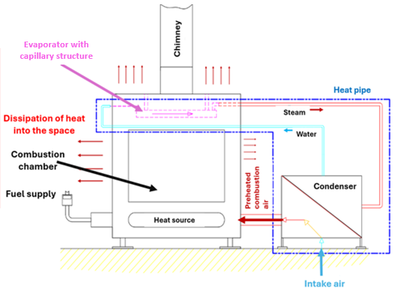
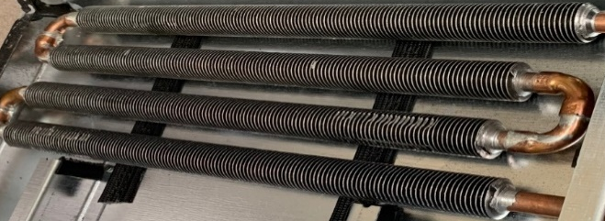
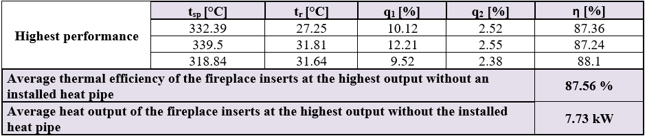
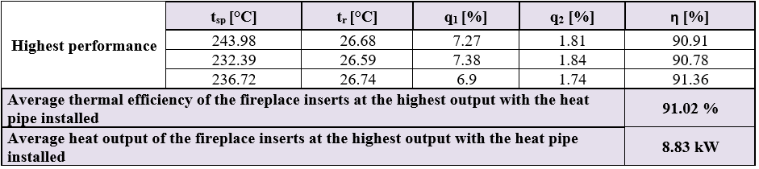
Effective Heat Transfer-Making Use of Waste Heat to Boost Thermal Efficiency of Small Heat Source
TRANSCOM 2025: 16th International Scientific Conference on Sustainable, Modern and Safe Transport
Ľ.Nová¹, P.Nemec¹, J.Jandačka¹, M.Malcho¹
1 University of Žilina, Žilina, Slovakia
introduction
Background information & Market Context In effort to limit global warming and reduce carbon emissions, manufacturers of heat sources try to find an option how to optimize their devices. That can be done through improving their thermal efficiency. Thermal efficiency is directly influenced by several factors as equipment settings, quality of the fuel, chimney loss, and by temperature of the air sucked into the combustion chamber. Use of waste heat from waste flue gas becomes also very important topic as demand for cheaper energy grows worldwide. | Problem Statement & Stakeholders By modifying the heat sources, it is possible to influence these factors and improve thermal efficiency of heat sources. Standard solution is use of heat exchangers, installed in the chimney part of the heat source, but there is need to power them by electricity. On the other hand, when loop heat pipe is installed, the exchange of heat is done without the electricity. Use of this waste heat have many variations, but for maximum improvement of the thermal efficiency it can be used for heating the air sucked into the combustion chamber. | Research Objectives & Expected Impact Design and construction of loop heat pipe for small heat source – gas fireplace Testing measurements before and after installation of the loop heat pipe Calculation of the thermal efficiency based on the measurements results Based on the articles from other authors, improvement of thermal efficiency of gas fireplace was expected.
materials, methods & implementation
Design and construction of loop heat pipe consisted of evaporator with capillary structure and by condenser, which was also used for heating the air on the intake. As first the combustion process of the gas fireplace, in the state as received, was measured and the thermal efficiency was calculated. Then the loop heat pipe with all of its components was installed. Next the combustion process of the gas fireplace with installed loop heat pipe was measured and thermal efficiency was calculated again. The fireplace has 3 power options and during all tests was set to highest power.
results
Measurement record of the gas fireplace as received Measurement of the gas fireplace with installed loop heat pipe The gas fireplace in the state as received had average thermal efficiency η = 87.56%, and its heat output was Pv = 7.73 kW. Following the heat pipe's installation, measurements showed an average thermal efficiency of η = 91.02% and a thermal output of Pv = 8.83 kW. The average thermal efficiency rose by over 3% when the gas fireplace was operating at its power preset set to maximum output.
conclusion & implementation path
By using a heat pipe to warm the air that was given to the combustion chamber, the experiment aimed to improve the efficiency of a tiny heat source. By comparing the fireplace initial state with its modified state, the anticipated outcomes were confirmed. It can be concluded from the experiment of applying the heat pipe to the heat source that the experimental data demonstrated advantages in the form of an increase in heat source output and thermal efficiency. In addition, it does not require electricity to operate, which is advantageous for energy-independent buildings and ensures reliability even during power outages. This technology reduces environmental impacts through reducing gas consumption and decreasing temperature of the waste flue gas. Potential applications include homes, commercial and industrial systems, with a focus on energy independence. Further experiments could focus on optimizing materials, configurations and heat exchangers to improve the efficiency of the heat pipe.
acknowledgements
This work was supported by the Slovak Research and Development Agency [grant number APVV-21-0452]; and by VEGA agency [grant number VEGA 1/0680/23].

