Slide 1


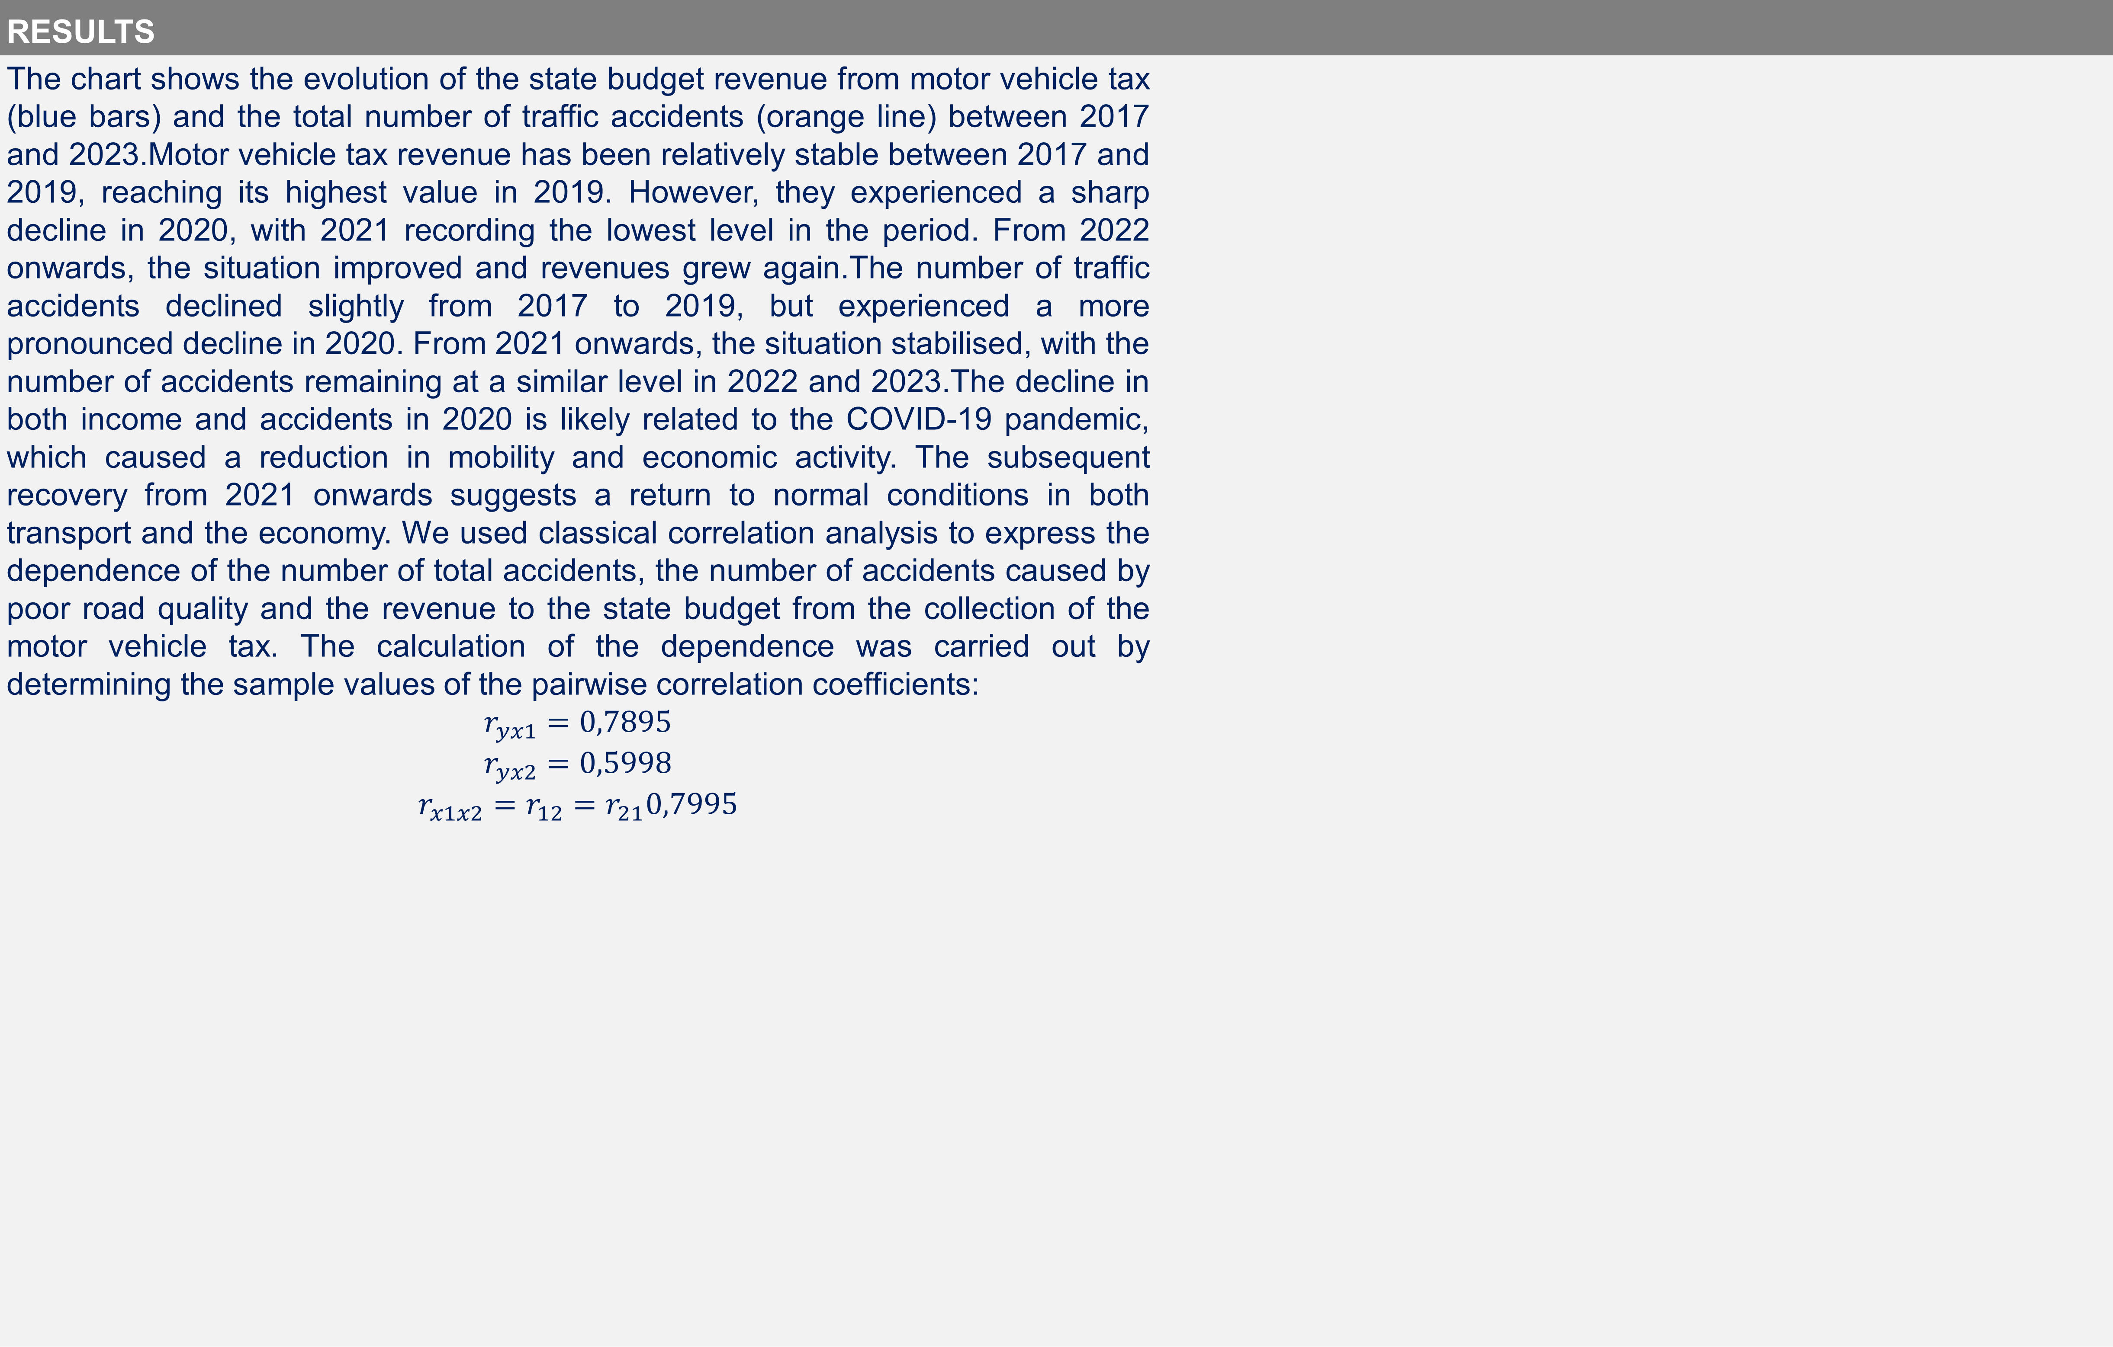
Impact of the efficient use of the motor vehicle tax on road infrastructure quality and safety
TRANSCOM 2025: 16th International Scientific Conference on Sustainable, Modern and Safe Transport
Poliakova Adela¹,Malik Jakub¹,
1University of Žilina, Faculty of Operation and Economics of Transport and Communications, Univerzitna 1, 010 26 Zilina, Slovakia
introduction
Efficient public finance management plays a crucial role in road safety and road infrastructure development. Motor vehicle taxes are an important source of revenue for national and local governments and should be optimally used for road maintenance and modernization. | This article analyzes the relationship between the collection of motor vehicle taxes and the number of road accidents whose main cause is lack of road maintenance. Using statistical methods and an analysis of the available data, we investigate to what extent the efficiency of motor vehicle tax collection and distribution affects road safety. | The results of the study highlight the need to link tax policy with practical measures in road infrastructure maintenance, which is crucial for the protection of human lives and minimization of economic losses resulting from road accidents.
materials, methods & implementation
In researching this dependence, we assume that if the quality of road infrastructure improves as a result of increasing tolls, the incidence of accidents caused by poor road pavement quality will also decrease proportionally as a result of the improvement. As road user charges are not yet harmonised across the European Union and to ensure some comparability across countries in the ongoing research, for the purpose of this paper we have only analysed the revenue to the state budget of the SR from road tax collection. To determine whether there is a relationship between the amount of road tax collection and the accident rate due to the poor quality of the road network, we used a classical correlation analysis.
results
The chart shows the evolution of the state budget revenue from motor vehicle tax (blue bars) and the total number of traffic accidents (orange line) between 2017 and 2023.Motor vehicle tax revenue has been relatively stable between 2017 and 2019, reaching its highest value in 2019. However, they experienced a sharp decline in 2020, with 2021 recording the lowest level in the period. From 2022 onwards, the situation improved and revenues grew again.The number of traffic accidents declined slightly from 2017 to 2019, but experienced a more pronounced decline in 2020. From 2021 onwards, the situation stabilised, with the number of accidents remaining at a similar level in 2022 and 2023.The decline in both income and accidents in 2020 is likely related to the COVID-19 pandemic, which caused a reduction in mobility and economic activity. The subsequent recovery from 2021 onwards suggests a return to normal conditions in both transport and the economy. We used classical correlation analysis to express the dependence of the number of total accidents, the number of accidents caused by poor road quality and the revenue to the state budget from the collection of the motor vehicle tax. The calculation of the dependence was carried out by determining the sample values of the pairwise correlation coefficients: $$r_{yx1}=0,7895$$ $$r_{yx2}=0,5998$$ $$r_{x1x2}=r_{12}=r_{21}0,7995$$
conclusion & implementation path
Based on the results of the analyses, it can be concluded that the expected impact of vehicle taxation on accident reduction has not been confirmed. On the contrary, the relationships found show that accident rates do not decrease as tax revenues increase, but rather follow the opposite trend. This result suggests that the link between tax revenue and investment in road infrastructure maintenance and upgrading is weak. If the funds collected are not prioritised for this purpose, their contribution to improving road safety is questionable. The results therefore suggest that the effectiveness of the allocation of these funds should be analysed in more detail and possibly systematically adjusted. At the same time, it should be stressed that road safety is influenced by a number of factors, not only the amount of tax revenue collected. Road quality, road markings, the state of the fleet, driver discipline and the intensity of traffic police checks are equally important variables in assessing accident rates. Therefore, further research on this issue should adopt a multifactorial approach to achieve a more complete understanding of the relationship between tax policy and road safety. Future research should therefore focus on identifying effective measures to ensure that motor vehicle taxation actually achieves its main objectives of improving the quality of road infrastructure and reducing accidents.
acknowledgements
This paper was prepared with the support of the project of the Agency for Science and Research no. SK-CN-23-0009: "Dynamic Modeling and Management of Car-Bicycle Mixed Traffic Flow in Intelligent Connected Vehicle Environment"

