Slide 1


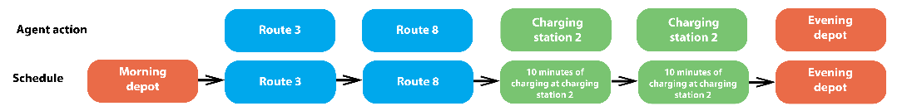
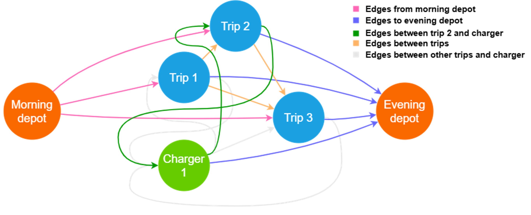
Formulating the Electric Bus Fleet Scheduling Problem for
Reinforcement Learning
TRANSCOM 2025: 16th International Scientific Conference on Sustainable, Modern and Safe Transport
Andrej Michalek¹, Peter Tarábek¹
1 University of Žilina, Žilina, Slovakia
introduction
The global push for sustainable and eco-friendly transportation has led to a rapid increase in the adoption of electric vehicles, including public transport fleets. Unlike traditional diesel buses, electric buses have limited battery capacity and require time-consuming charging, which must be carefully incorporated into bus schedules. | Electric bus fleet scheduling is an NP-hard problem. In the past, it has mainly been tackled using metaheuristics. However, there have also been attempts to solve combinatorial problems using an agent that learns to construct feasible solutions through interaction with the environment using actions and a reward system. | We focused on formulating the task of electric bus fleet scheduling as a reinforcement learning (RL) problem – we designed an environment that allows the agent to incrementally construct a solution, along with the state space and a system for masking inadmissible actions.
materials, methods & implementation
RL is a method designed for solving dynamic problems. We work with an environment that is a dynamic system. The environment evolves over time and is represented at each time step by its state. Within the environment, there is an agent capable of making decisions. For every decision made, the environment provides the agent with a new state, which results from processing the action associated with the decision, as well as a reward as feedback. The electric bus fleet scheduling problem is considered a static problem.
We need to transform electric bus flee scheduling into a dynamic problem. In our approach, we employ a constructive method to build the solution incrementally. The agent will progressively create the solution through its decisions.
results
For the agent to make good decisions, the state representation of the system must be well-designed. We have opted to use a graph structure, because it is natural representation of the problem. The nodes in the graph represent the events that a bus can select. There are three types of nodes in the graph: trips, depots and charging stations. Each node in the graph has several attributes. These attributes were designed to be as similar as possible between trips and charging stations to enhance the agent's understanding.
For each charging station we must also represent available charging windows in the state space. The time of the entire day is divided into discrete time intervals of a fixed length. Each interval can either be free (indicating no charging) or occupied (indicating a bus is charging at the station). We decided to use a sliding window approach. The environment internally keeps track of the occupancy status of individual charging stations throughout the entire day, but only a predefined time window (the nearest charging events) is included in the state representation presented to the agent.
The edges in the graph are established at the beginning of the process. An edge between a pair of events means that it is possible to transition between them from a temporal perspective.
Which action can be selected is, however, also constrained by other factors such as which event was served last, which route have already been served, and the current battery capacity. Therefore, in each state, we check which actions the agent can select, and based on that, we create a mask of admissible actions. When calculating the mask, it is not enough that the agent has enough energy to serve the next event, it must always be able to return to the evening depot.
conclusion & implementation path
The primary goal of our experiments was to validate the functionality of the proposed simulator and ensure that it generates feasible schedules for the electric bus fleet scheduling problem. We tested functionality of the proposed simulator on a set of 6 problem instances derived from real-world public transportation data provided by public transport provider in Žilina and verified that the agent is capable of learning and generating feasible solutions, although there is still significant room for improvement. We used a PPO agent with a transformer-based architecture for these tests. In the future, we plan to conduct further experiments with different state representation of charging events and action masking strategies, as detailed checks of admissible actions are very time-consuming and slow down the environment.
Results achieved by the agent trained in a simulation environment (Our agent) compared to the optimal results (Optimal)
Dataset | Bus trips count | Optimal | Our agent
DS1 | 51 | 4 | 6
DS2 | 79 | 4 | 13
DS3 | 85 | 6 | 13
DS4 | 107 | 9 | 17
DS5 | 135 | 13 | 18
DS6 | 162 | 13 | 24
The long-term goal of this research is the transferability of the agent's knowledge in solving combinatorial problems. We aim to develop a system in which the agent learns to generate good solutions on a selected set of tasks and is then able to apply its knowledge to solve previously unseen problems without the need to train from scratch.
acknowledgements
This publication was funded by the EU NextGenerationEU through the Recovery and Resilience Plan for Slovakia under the project No. 09I05-03-V02-00029.

