Slide 1


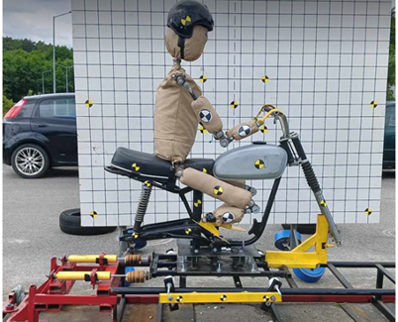
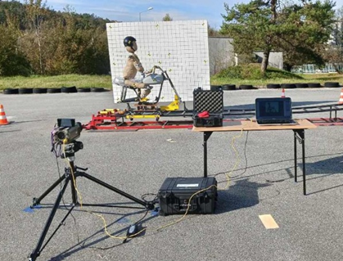
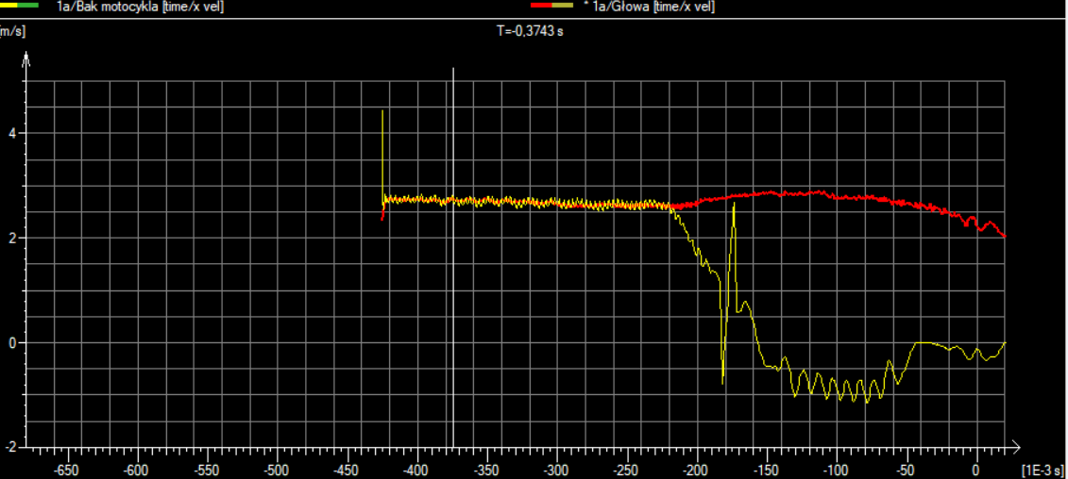
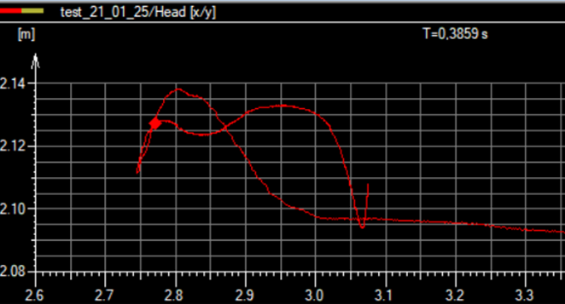
Analysis of the rear-end crash test of a motorcycle at low speed
TRANSCOM 2025: 16th International Scientific Conference on Sustainable, Modern and Safe Transport
Antoni Bańkowski¹, Marek Jaśkiewicz¹, Damian Frej¹, Rafał Chaba¹
1 Kielce University of Technology, Kielce, Poland
introduction
Currently, there is an increase in the number of two-wheeled vehicles in the world. A significant increase in the number of motorcycles is recorded in Asian countries. In India, Thailand, Malaysia, Cambodia and China, it can be seen that the number of two-wheelers has increased and there are more of them than motor vehicles Also in the European Union countries there is a noticeable increase in the number of motorcycles. In Poland, there is a significant increase in the number of newly registered motorcycles. | Motorcycle drivers are more likely to be injured in road accidents. It is estimated that motorcyclists are 27 times more likely to die as a result of an accident than drivers and passengers of cars. According to WHO data, more than a quarter of the fatalities of all accidents were motorcyclists Motorcyclists are more likely to be injured and killed in road accidents because motorcycles do not have the same safety systems as motor vehicles. The motorcyclist does not have protection in the form of a body like in a car. Due to the size differences, motorcycles do not have the same safety systems. | Drivers do not have the same protections, they mainly have to rely on protective elements such as helmets, jackets, gloves and boots. The tests carried out on the crash test stand enable a thorough analysis of the movement of the human body during an accident and in the future will allow the creation of a protective device that will be able to increase the safety of motorcyclists.
materials, methods & implementation
The aim of the study was to investigate the forces acting on the motorcyclist's head during a rear collision. The collision took place at a low speed of about 15 km/h. The tests were carried out on a modified crash test bench. The site is 10.72 m long and 2.41 m high. The trolley moves on rails and finally hits two shock absorbers acting horizontally to simulate a collision. The use of such a stand allows the same motorcycle to be used multiple times during crash tests. Tests are recorded using the Phantom v310 speed camera. The recorded image from the camera was then processed in the TEMA program. The program allows you to determine the relationships between the elements, thanks to which it is possible to collect data such as speed, displacement and acceleration.
Fig. 1. Dummy used for testing
Fig. 2. Test stand
Results
During the tests, a series of crash tests were carried out on the rear of the motorcycle. The collision took place at a low speed of about 15 km/h. Based on research, it can be seen that the motorcycle begins to lose speed after a collision, while the head tilts back after the impact, gaining speed. The head reaches the highest speed of 3.6 m/s after a collision and detachment of hands from the steering wheel. The speed of the marker on the head and tank of the motorcycle are shown in the figure 3.
Based on the research, it can be seen that the vehicle moves horizontally, then at the moment of impact, the front of the vehicle rises upwards. In the initial phase, the head tilts back, covering an average distance of 16 cm. After an impact, the head moves relative to the y-axis by an average of 4 cm. The trajectory of the head movement is shown in Figure 4. Based on the research, it can be observed that after an impact, the motorcyclist's hands fall off the handlebars and that the driver's feet slide off the footrests. Such a situation would lead to the motorcycle overturning. In several situations, it happened that after the dummy leaned back, the dummy fell completely from the vehicle, hitting its head on the ground. In a real event, such a situation would be very dangerous because the motorcyclist could suffer head injuries when hitting a vehicle or road surface.
Fig. 3. Velocity diagram of the marker located on the head and on the tank of the vehicle
Fig. 4. Trajectory of dummy head movement
conclusion & implementation path
Tests have shown that even at low speeds in the back of the motorcycle, head and cervical spine injuries can occur. After impact, the driver's hands may fall off the steering wheel and the feet may slip off the footrests, which may lead to the vehicle overturning along with the driver. During the research, it was observed that the position he takes on the seat of the motorcycle has a great impact on what happens to the motorcyclist during an accident. Depending on where you sit, you may jerk your body, but you may also lean back and fall off the vehicle. In the next stages of the research, the impact of the position of the body on the seat on what happens to the body will be checked in more detail. It will also be checked in further research on how the motorcyclist's posture affects the forces acting on him. In the further stages of the research, it is also planned to test different types of motorcycle helmets in order to check their impact on body behavior. The next stages of the research will be the modification of the crash test stand in order to more accurately reproduce the collision and thus it will be possible to create a computer simulation.
acknowledgements
Arun, N. H., Mahesh, S., Ramadurai, G., & Nagendra, S. S. 2017. Development of driving cycles for passenger cars and motorcycles in Chennai, India. Sustainable cities and society, 32, 508-512 Bańkowski A., Frej D., 2023 The safety of motorcycle users. Archiwum Motoryzacji 101.3 Jaśkiewicz M., Frej D., Šarkan B., 2020 Construction of the Knee Joint of the Dummy Designed for Crash Tests, Transportation Research Procedia, 44, 121-128 Newman J. A., Zellner J. W., Wiley K. D., 1991 A motorcyclist anthropometric test device MATD. In proceedings of the International IRCOBI Conference on the Biomechanics of Impacts, IRCOBI, France (pp. 285-293) Podosek K ., Jaśkiewicz M., 2023 Statistical analysis of road accidents of motorcyclists in Poland from 2011 to 2021, Transportation Research Procedia,Volume 74, Pages 1492-1499, ISSN 2352-1465, https://doi.org/10.1016/j.trpro.2023.11.311.

