Slide 1


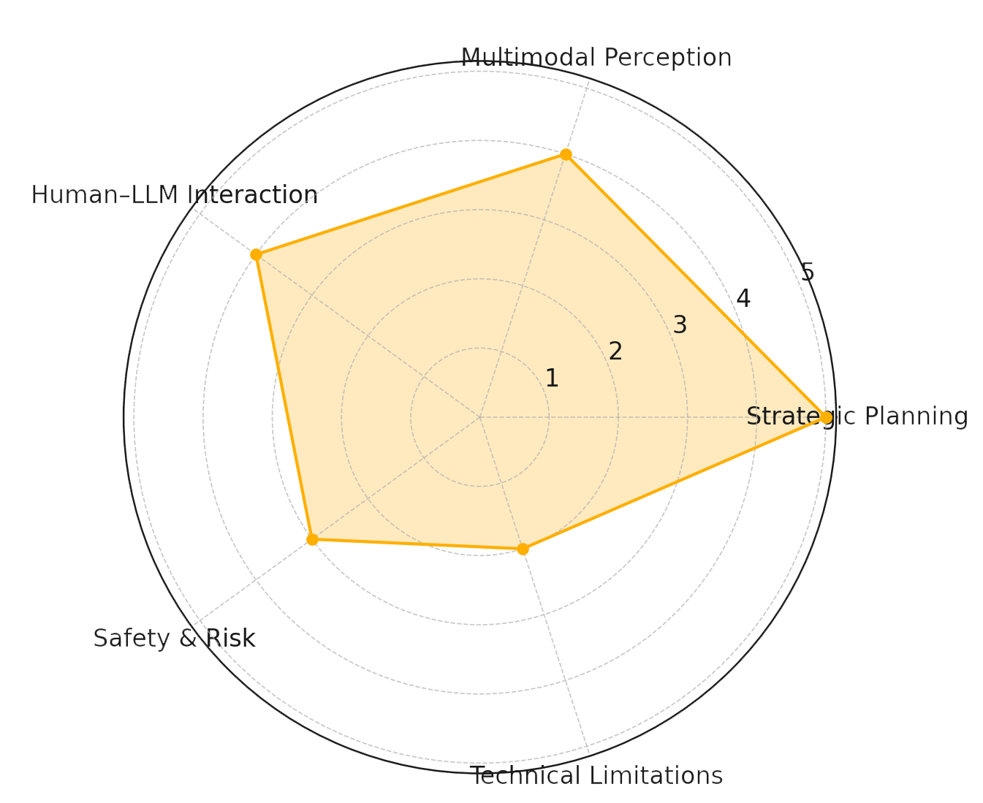
Using Large Language Models in Autonomous Driving Systems
TRANSCOM 2025: 16th International Scientific Conference on Sustainable, Modern and Safe Transport
Daniel Gachulinec¹, Lucia Madleňáková¹,
1 University of Žilina, Univerzitná 8215/1, 01026 Žilina, Slovakia
introduction
Autonomous transportation systems (ADS) have undergone a dynamic evolution in recent years, with traditional modular architectures encountering limits in complex environments. The rise of large language models (LLMs) brings a new approach enabling context-sensitive, explainable and adaptive decision making. | Despite the high potential of LLMs, there are key obstacles such as lack of real testing, delays in responses or unpredictability of outputs. These concerns are key for stakeholders such as vehicle manufacturers, ADS software developers and regulators seeking to balance innovation and safety. | The aim of this thesis is to analyse the possibilities of deploying LLMs in ADS at the level of strategic planning, user interaction and risk analysis. The results can contribute to the development of hybrid architectures that combine the flexibility of language models with the robustness of traditional systems, thereby increasing safety and confidence in autonomous transportation.
materials, methods & implementation
This research is based on a systematic literature search following the PRISMA methodology, focusing on the integration of large language models (LLMs) into autonomous transport systems (ADS). The search included 45 articles published between 2020-2024, from which the 26 most relevant studies were selected after a thorough filtering process. The analysis was thematically divided into five areas: strategic planning, multimodal perception, human-LLM interaction, risk prediction, and technical limits of real-time deployment. Data were extracted and synthesized to identify benefits, challenges, and research gaps. Based on this methodology, recommendations for the future development of secure and scalable hybrid ADS architectures were proposed.
results
An analysis of 26 studies revealed five main areas where large language models (LLMs) are fundamentally changing autonomous transport systems (ADS). In the area of strategic planning, LLMs enable interpretable decision making using natural language, increasing system transparency. In multimodal perception, LLMs have been proven to fuse sensor and language data, improving the understanding of dynamic traffic scenarios. Human interaction achieves higher personalization due to the ability of LLMs to adapt to passengers' driving preferences. In safety, models can predict risks by combining physiological and sensory data. Finally, research highlights the technical limitations of LLMs in low-latency applications mainly due to the speed of processing and the unpredictability of outputs. The results show the high potential of LLMs for practical deployment at the level of strategic driver support, contextual navigation and conversational assistants in the vehicle cabin. Systems such as Talk2Drive and LMDrive already enable natural voice interaction between human and vehicle, reducing the need for manual control. Models such as DriveGPT4 demonstrate the ability to adapt driving behavior based on scripted instructions or local rules without additional training. In safety, LLMs bring new capabilities for risk diagnostics, passenger stress detection and real-time preventive action suggestions. These innovations show that although LLMs are not yet suitable for low-level control, their deployment in the strategic layer of ADS can substantially increase the adaptability, trustworthiness and safety of autonomous systems.
conclusion & implementation path
This study provides a comprehensive overview of the emerging role of Large Language Models (LLMs) in autonomous driving systems (ADS), focusing on their applications in high-level decision-making. The findings confirm that LLMs offer considerable advantages in strategic planning, multimodal scene interpretation, and human interaction by enabling explainable and adaptable decision flows. However, current limitations in real-time processing, output reliability, and system validation still restrict their safe use in low-level control. The integration of LLMs can significantly enhance user trust, system transparency, and customization in autonomous mobility solutions. By shifting LLMs into non-critical strategic layers, developers can benefit from their semantic reasoning capabilities while maintaining operational safety. These findings pave the way for hybrid architectures where LLMs complement but do not replace traditional, deterministic control systems. Path to Implementation & Further Research For real-world deployment, further steps are required: Real-world validation through large-scale driving experiments Standardization of language interfaces for consistency and safety Advanced multimodal fusion to align visual, sensor, and textual data Integration of risk-aware reasoning and human-centered safety feedback
Relative Benefits of LLMs in Autonomous Driving Systems
acknowledgements
This work was supported by the Slovak Research and Development Agency under Grant number VV-MVP-24-0375: An ethical concept for the use of artificial intelligence in higher education.

