Slide 1


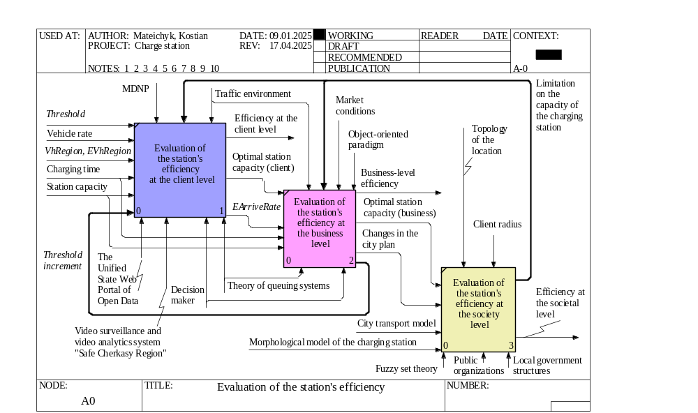
Study of the Influence of Traffic on the Charging Stations Efficiency
TRANSCOM 2025: 16th International Scientific Conference on Sustainable, Modern and Safe Transport
Miroslaw Smieszek¹, Vasyl Mateichyk^{1,3}, Nataliia Kostian^{2,3}, Petro Mateichyk³, Jakub Mosciszewski¹, Mykola Marchuk⁴
1 Rzeszow University of Technology, Rzeszow, Poland
2 Cherkasy State Technological University, Cherkasy, Ukraine
3 National Transport University, Kyiv, Ukraine
4 National University of Water and Environmental Engineering, Rivne, Ukraine
introduction
Which the increasing number of electric vehicles, it is necessary to provide a sufficient number of charging stations. The development of charging infrastructure ensures the creation of new jobs, contributes to the reduction of carbon emissions and the introduction of new technologies, which positively affect the economy. | The requirements of drivers, charging infrastructure company owners and society form a system of interrelated criteria. The majority of scientific studies on the optimization of charging station systems consider only one of them. And the impact of hourly traffic on the efficiency of charging stations is the least studied issue. | The purpose of the study is to develop and implement models for controlling the development of charging stations with the phased application of optimization criteria for different target groups taking into account the intensity of traffic, as well as to assess its impact on the efficiency of charging infrastructure.
materials, methods & implementation
Materials and Methods: Statistical data on the number of registered cars, including electric cars, from the Unified State Web Portal of Open Data (Ukraine). The IDEF0 standard and structural modeling tools for building a conceptual model of the system and determining parameters affecting the charging station's efficiency. Models of queuing systems for forming system optimization criteria and developing simulation model algorithms. | Methods and tools of object-oriented programming. Monitoring the intensity and composition of traffic flows. Regression analysis to determine the dynamics of the influence of traffic intensity on the efficiency of an electric vehicle charging station according to various criteria. Implementation: Software for simulating the operation of an electric vehicle charging station.
results
Academic Findings & Innovation: The conceptual model for comprehensive evaluation of the efficiency of an electric vehicle charging station based on various criteria has been developed. The criteria for optimizing the charging station for electric vehicles for three target groups have been clarified. mathematical models of the influence of traffic intensity in the client radius area on the efficiency of the charging station were obtained. Practical Applications: The conversion coefficients of transport flows for a given region have been determined. Algorithms and a software application have been developed to evaluate the efficiency of an electric vehicle charging station using various criteria. Recommendations have been developed for target groups on optimizing charging stations for electric vehicles.
conclusion & implementation path
Summary of Research Conclusions: The developed software package allowed to systematically assess the efficiency of the charging station and provide recommendations on its rational capacity to meet the needs of customers and business. The use of dynamic data structures based on the object-oriented paradigm provides greater flexibility of the proposed models and procedures in real charging station conditions. The efficiency of the charging station at the business level in monetary terms is determined by a 5th degree polynomial with a coefficient of determination equal to 0.9915. Efficiency at the client level is determined by a piecewise linear function. Impact & Future Research: On the one hand, the obtained dependencies make it possible to determine the optimal power of the charging station, based on the real values of the intensity and composition of the traffic flow in the client radius area. On the other hand, for charging infrastructure enterprises with restrictions on energy and financial resources, this shows a way to increase the efficiency of their work without costly changes in the production structure. This can be implemented through cooperation of such enterprises with municipal authorities. In the future, it is planned to expand this research to the scale of the charging station network.
acknowledgements
This research was conducted within the collaborative framework of Rzeszow University of Technology (Poland), Cherkasy State Technological University (Ukraine), National Transport University (Ukraine), and National University of Water and Environmental Engineering (Ukraine). We are grateful to all data analysts and operational staff who participated in this study.

