Slide 1


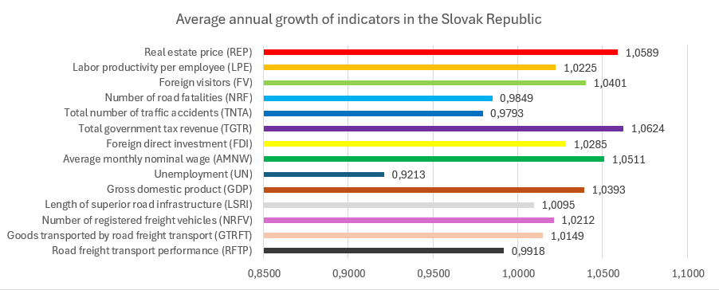
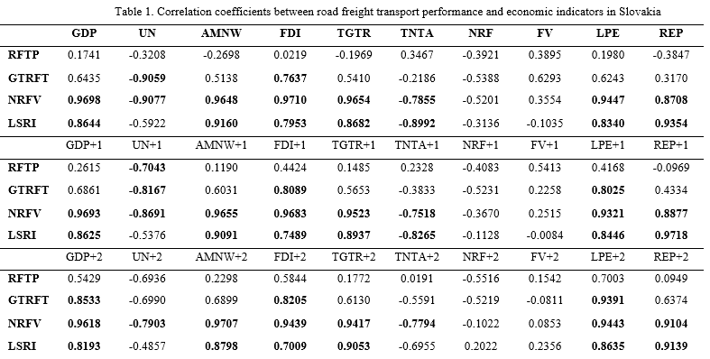
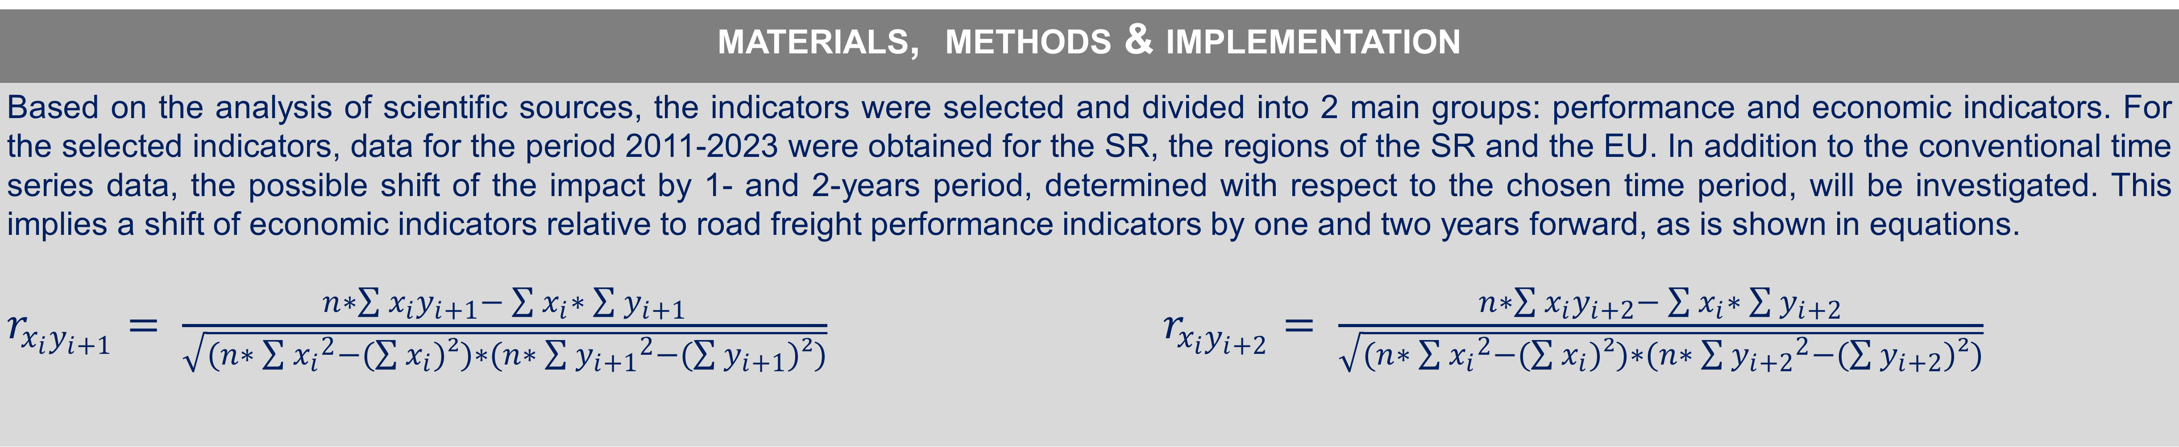
Research on positive externalities from road freight transport, considering the time lag of the studied indicators
TRANSCOM 2025: 16th International Scientific Conference on Sustainable, Modern and Safe Transport
Martin Zuzaniak¹, Vladimír Konečný¹
1 Department of Road and Urban Transport, Faculty of Operation and Economics of Transport and Communications, University of Žilina, Univerzitná 8215/1, 010 26, Slovakia
introduction
Road transport is an important factor in achieving the economic and social development of a country and thus measuring the efficiency of transport operations can be important. Road freight transport shows a significant sensitivity and relationship to the economy and its fluctuations. | Selected performance indicators of road freight transport and economy for the period 2011-2023 in the Slovak Republic, its individual regions and the European Union were examined. | The aim of the study is to analyze the positive externalities from road freight transport considering the time lag between transport and economic indicators.
materials, methods & implementation
Based on the analysis of scientific sources, the indicators were selected and divided into 2 main groups: performance and economic indicators. For the selected indicators, data for the period 2011-2023 were obtained for the SR, the regions of the SR and the EU. In addition to the conventional time series data, the possible shift of the impact by 1- and 2-years period, determined with respect to the chosen time period, will be investigated. This implies a shift of economic indicators relative to road freight performance indicators by one and two years forward, as is shown in equations. $r_{x_{i}y_{i+1}}= \frac{n∗\sum{x_{i}y_{i+1}}− \sum{x_{i}}∗ \sum{y_{i+1}}}{\sqrt{(n∗ \sum{{x_{i}}^{2}}−(\sum{x_{i})²)∗(n∗ \sum{{y_{i+1}}^{2}−(\sum{y_{i+1})²)}}}}}$ $r_{x_{i}y_{i+2}}= \frac{n∗\sum{x_{i}y_{i+2}}− \sum{x_{i}}∗ \sum{y_{i+2}}}{\sqrt{(n∗ \sum{{x_{i}}^{2}}−(\sum{x_{i})²)∗(n∗ \sum{{y_{i+2}}^{2}−(\sum{y_{i+2})²)}}}}}$
results
Figure below shows the average annual change in both transport performance and economic indicators over the period 2011-2023 in the SR. All indicators except transport performance show positive values. For fatalities, total accidents and unemployment the values less than 1 means a decrease, thus desired change. Table below shows the results of the correlation analysis carried out between the transport and economic performance indicators within the SR based on above equations. As can be clearly seen, the number of trucks and the length of the superior road infrastructure have the strongest correlation with the economic indicators. Relatively high values were also observed for the quantity of goods transported, where mostly a strong or medium relationship with economic indicators is found. The lowest values are for transport performance in ton-kilometers, which may be due to the data collection in SR for only small part of total performance and the resulting inaccuracies. Strong relationships are found between transport indicators and most other indicators, except for the number of fatalities and the number of visitors. For the number of vehicles and the length of superior infrastructure, the values obtained are similar for both the regular period and the 1- and 2-year shifts, with the strongest relationship being achieved largely without the shift. Thus, this implies the largest impact of the indicators in the regular period. In contrast, for transport capacity and freight quantity, the correlation is increased mostly for the 2-year shift. This may indicate a delayed effect or impact on economic indicators. In the EU, the relationships with economic indicators are even stronger, both for transport performance and for the number of trucks and the length of the superior road infrastructure. The values for both the regular and the shifted periods are at a similarly high level, and this implies an impact of the transport indicators in the same year, but also with a possible time lag of 1 to 2 years. In the regions, the situation is again similar to that in the SR, but the strength of the relationships is generally at a lower level.
conclusion & implementation path
The evolution of performance indicators in road transport and economy within the SR and its regions as well as in the EU for the period 2011-2023 has a positive trend, while the growth of economic indicators has been slightly higher compared to the transport ones. However, the Covid-19 pandemic may have had an impact on the overall results. The results of the correlation analysis showed a significant connection between economic and transport indicators, in particular the length of the superior infrastructure and the number of freight vehicles, but also the amount of goods transported. The only indicator where no correlation was found was the number of visitors. Within the EU, the correlations were generally stronger than in the SR. In the individual regions of Slovakia, the results were similar to those for the SR as a whole, with slightly weaker correlation values, with the Bratislava region showing the lowest values. Transport performance in the EU has a stronger relationship with economic indicators than SR. In terms of time lag, differences were not clearly visible, with similar levels of performance with slightly higher values in the non-shifted calculations. This implies the largest impact of the transport indicators in the common period. The effect of the time lag was more pronounced only in the case of transport performance and the quantity of goods transported within the SR, where the strength of the correlation increased significantly when shifted by 2 years. To research causality and the precedence of one indicator by another is used Granger causality, which application on studied data can be follow-up research.
acknowledgements
This work was supported by the Slovak Research and Development Agency under the Contract no. APVV-22-0524.

