Slide 1


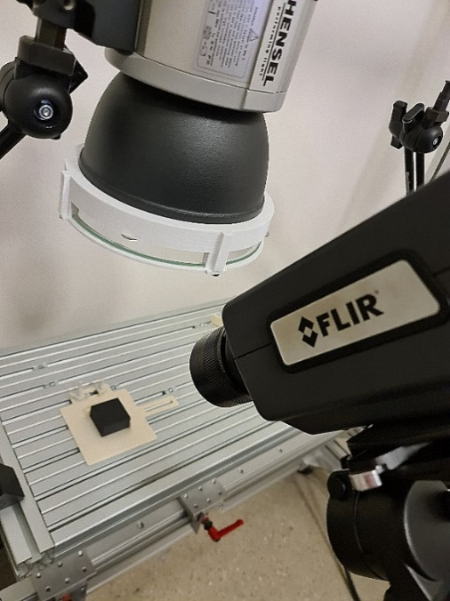
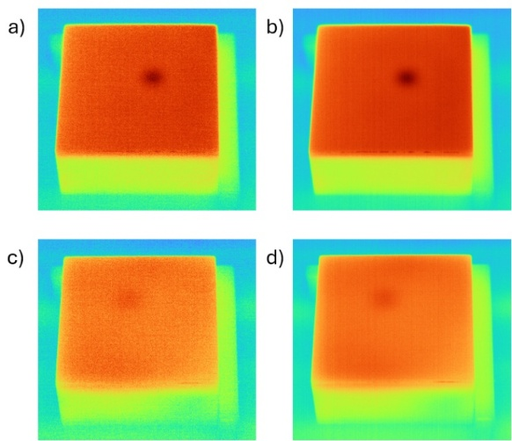
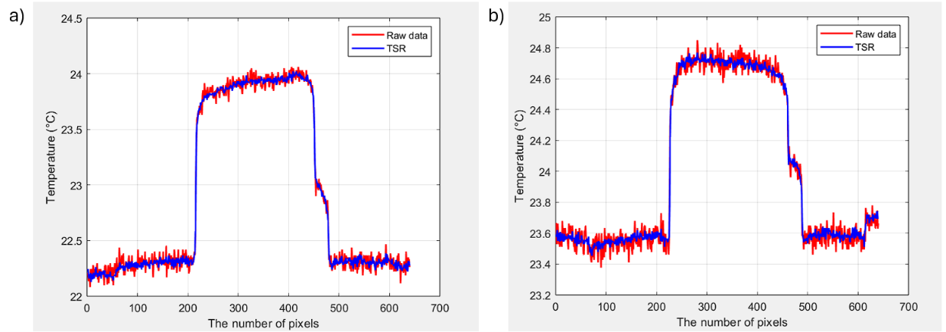
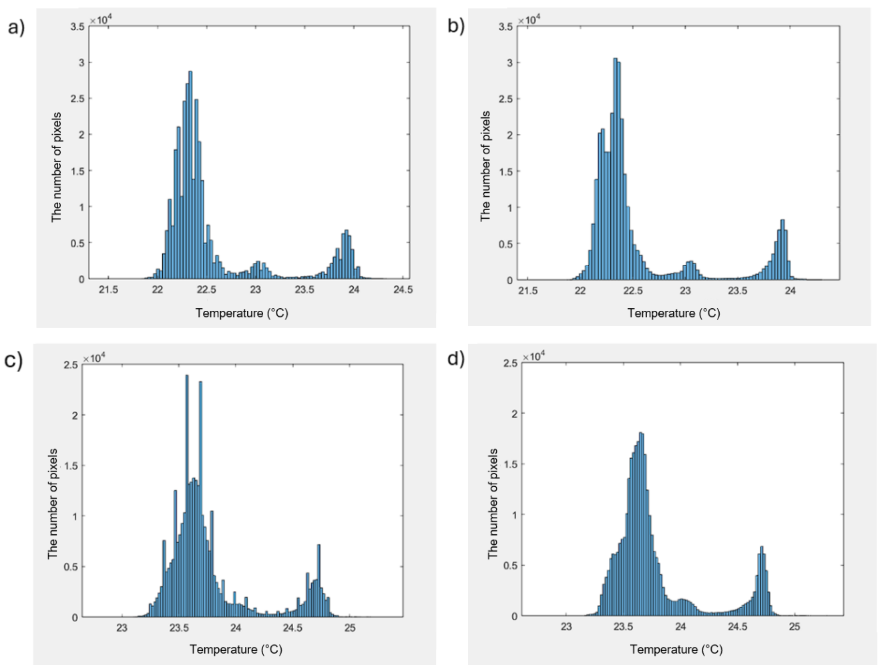
Defect Analysis in 3D-Printed PLA Materials Using Pulsed Thermography and Advanced Post-Processing Technique
TRANSCOM 2025: 16th International Scientific Conference on Sustainable, Modern and Safe Transport
Lucia Deganová¹, Vladimír Dekýš¹, Barbora Drvárová¹, Michal Švantner² , Alžbeta Sapietová¹
1 University of Žilina, Žilina, Slovakia
2 University of West Bohemia, Pilsen, Czech Republic
introduction
Background Information PLA is a biodegradable polymer commonly used for lightweight components in transportation. However, it is susceptible to defects such as voids and delaminations, which can compromise its structural integrity. | Problem statement PLA's low thermal conductivity often results in raw thermographic data lacking sufficient contrast, which makes defect detection in deeper layers challenging. | Research objective This study assesses Thermographic Signal Reconstruction (TSR) to improve defect visibility and minimize noise in pulsed thermography, thereby enhancing the reliability of defect interpretation.
materials, methods & implementation
Two PLA samples with artificial void-type defects at different depths
Pulsed thermography (PT) was employed, utilizing a 6 kJ Hensel flash lamp and a
FLIR A6751 IR camera
Each sample was recorded at a frequency of 20 Hz
The thermographic data were analyzed in MATLAB using TSR with a 4th-degree polynomial fit
Measurements were conducted under controlled conditions, maintaining a temperature of
22°C and humidity at 42%
results
CNR PROFILES
a & b) Raw vs TSR
Raw data curves (red) exhibit noticeable fluctuations due to noise, particularly for deeper defects. TSR (blue) offers smoother transitions and sharper defect boundaries by reducing noise and enhancing contrast.
THERMOGRAMS
HISTOGRAMS OF PIXEL INTENSITIES
a & c) Raw data (Turbo colormap)
Defects are represented as dark areas but are partially obscured by background noise, especially in deeper regions.
b & d) After Thermographic Signal Reconstruction
TSR enhances the visibility of defects by reducing noise and improving contrast, particularly for the deeper defect.
a & c) Raw data
The main peak represents the background while a secondary peak indicates the defect. Wide intensity spread suggests noise and low contrast.
b & d) After TSR
Peaks become smoother and more distinct, showing improved contrast and reduced noise.
conclusion & implementation path
This study demonstrated the effectiveness of Thermographic Signal Reconstruction (TSR) in enhancing defect detection in 3D-printed PLA materials using infrared non-destructive testing (IRNDT). By applying TSR to thermal image sequences, we achieved significant noise reduction and improved thermal contrast between defective and non-defective areas. This enhancement enabled clearer visualization of both surface-near and deeper subsurface defects. Histogram analysis and Contrast-to-Noise Ratio (CNR) evaluations confirmed that TSR provides sharper transitions and better separation of defective zones from surrounding material. The findings suggest that TSR is well-suited not only for PLA but also holds promise for broader applications in other polymeric and composite materials, including ABS, PET-G, and CFRP.
acknowledgements
This work has been supported by project VEGA 1/0753/24.

