Slide 1

The Impact of Hydrogen Percentage on the Combustion, Performance, and Emissions of NG-H₂-Diesel Naturally Aspirated Engine at High Load
2025
By
Hassan Sadah Muhssen, Ákos Bereczky, Máté Zöldy, Lukács Kristóf
Budapest University of Technology and Economics
And
Wasit University-Iraq

Slide 2
Introduction
Rising demand for efficient and cleaner internal combustion engines.
Hydrogen (H₂) enrichment enhances natural gas (NG) combustion efficiency.
Tri-fuel mode (H₂-NG-Diesel) combines the benefits of all three fuels.
Research gap: Lack of studies on naturally aspirated engines with mechanical diesel pumps.

Slide 3
Objectives
Experimental investigation of gradually increasing hydrogen (H2) percentage in fuel mixture on the combustion, performance, and emissions of H2-natural gas (NG)-diesel naturally aspirated engine at high load (20 kW).

Slide 4
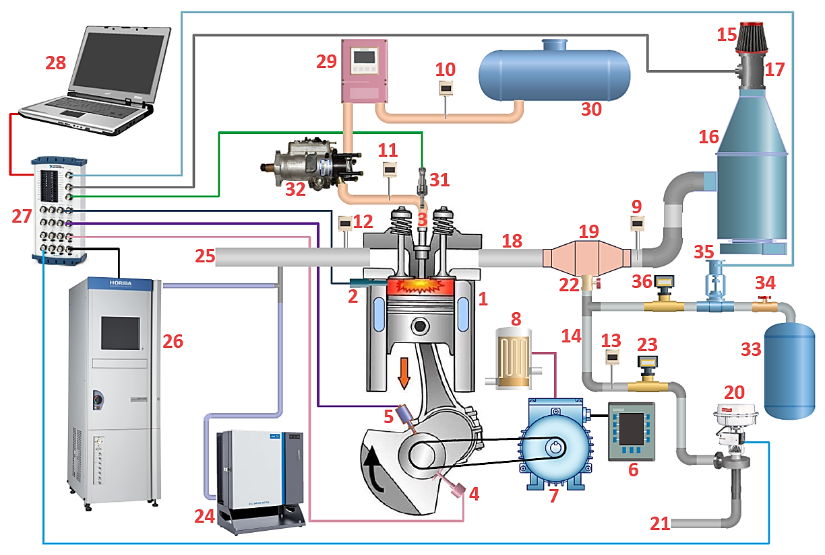
Experimental Setup
Engine: IVECO AIFO 8031 06.05, 3-cylinder, naturally aspirated, mechanical diesel injection pump (MDIP).
Fuel delivery: Diesel (mechanically controlled by MDIP), NG and H₂ (gaseous, via mixer).
Measurement: Flow meters, sensors, emissions analyzer.
Fig. 1. Diagram of the experimental setup, 1- Engine, 2- In-cylinder pressure sensor, 3- Diesel fuel injector, 4- Crank angle encoder, 5- Crank angle sensor, 6- Control and monitor board, 7- Electric generator, 8- Thermal load (water heater), 9, 10, 11, 12, 13- Temperature sensors, 14- Pipes, 15- Air filter, 16- Intake pulsation dumping tank, 17- Intake air flow meter, 18- Intake manifold, 19- Gas-air mixer, 20- NG flow controller, 21- NG inlet, 22- Manually ball valve, 23- NG flow meter, 24- Smoke meter, 25- Exhaust manifold, 26- Emissions meter, 27- Amplifier and A/D, D/A module, 28- PC, 29- Diesel fuel flow meter, 30- Diesel fuel tank, , 31- Diesel fuel pressure sensor, 32- Diesel fuel pump, 33- H₂ tank, 34- H₂ manually flow control valve, 35- H₂ pressure regulator, 36- H₂ flow meter.

Slide 5
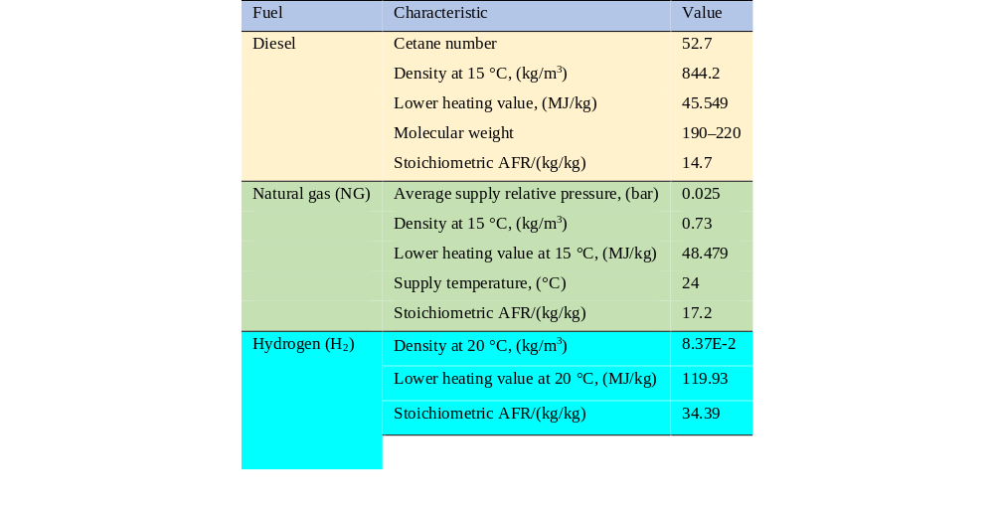
Fuel Properties
Table 1. Characteristics of diesel, natural gas, and hydrogen fuels

Slide 6
Methodology
High engine load (83%), and constant speed of 1500 rpm
Flow control for NG and H₂, automatically adjusted diesel, and constant diesel injection timing.
Tested with increasing H₂ flow: 0.02 to 0.1 m³/min.
Measure peak pressure, BSFC, emissions (CO, THC, NOx, smoke).

Slide 7
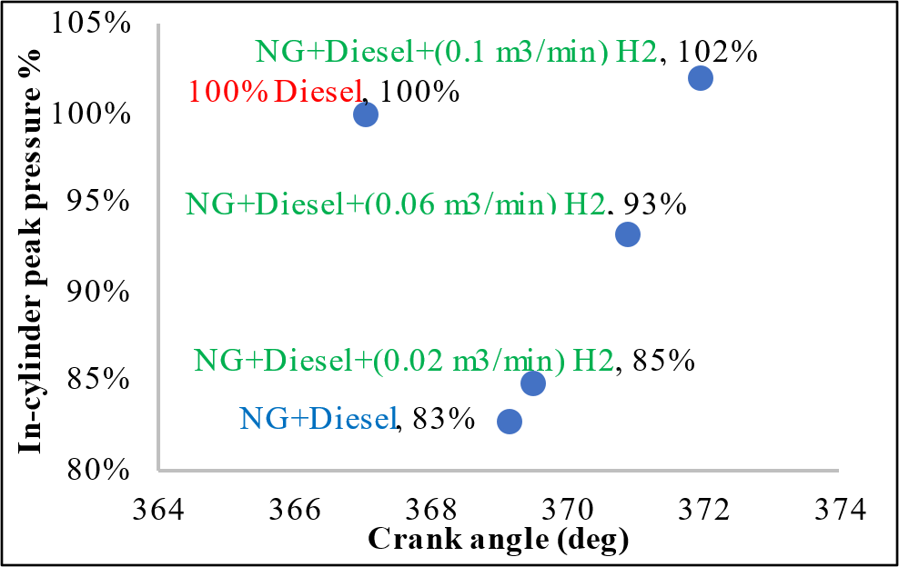
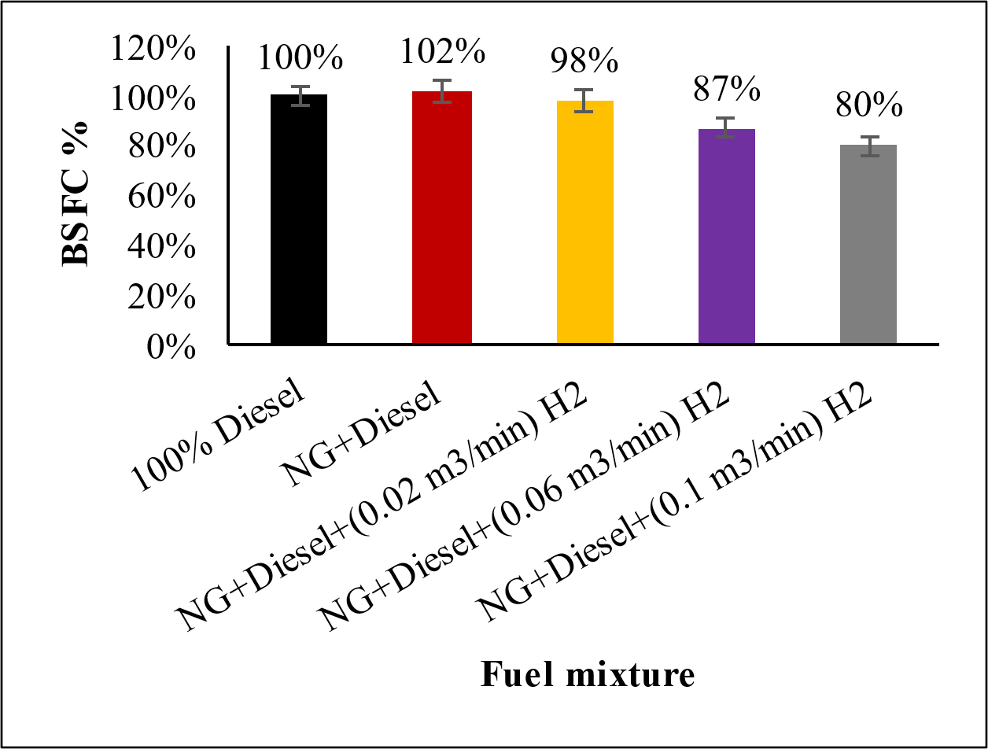
Results
In-Cylinder Pressure and BSFC
NG-diesel dual fuel shows the lowest peak in-cylinder pressure at 83% (369.141° CA), while adding H₂ from 0.02 to 0.1 m³/min raises it from 85% to 102%.
Fig. 2 . In-cylinder peak pressure% plotted against crank angle
Switching to NG-diesel increases BSFC to 102%, but adding H₂ from 0.02 to 0.1 m³/min reduces it from 98% to 80% of the diesel baseline.
Fig. 3 . BSFC% as a function of fuel mixture

Slide 8
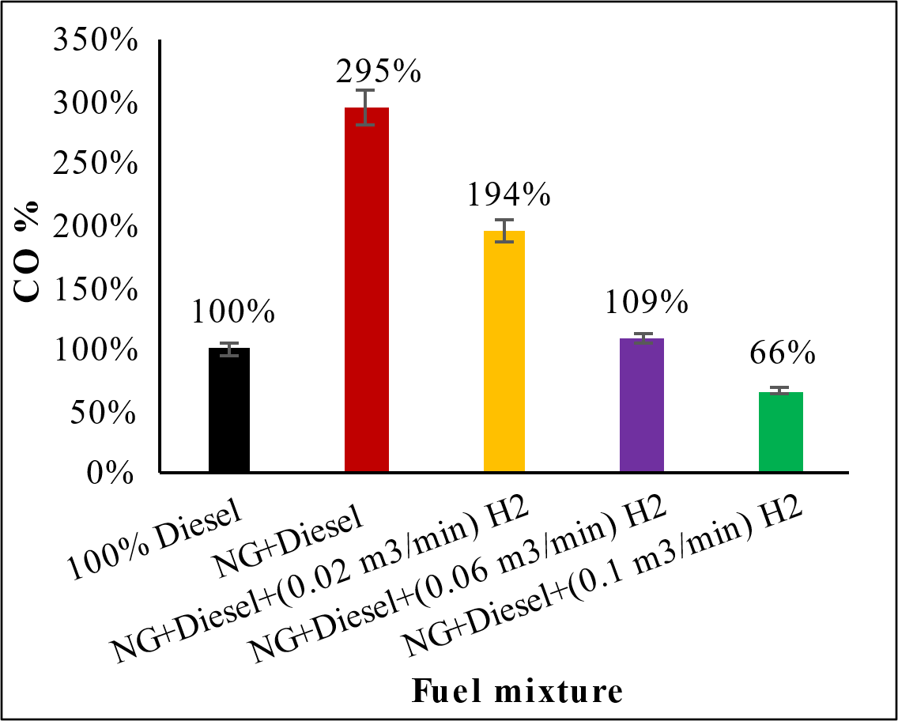
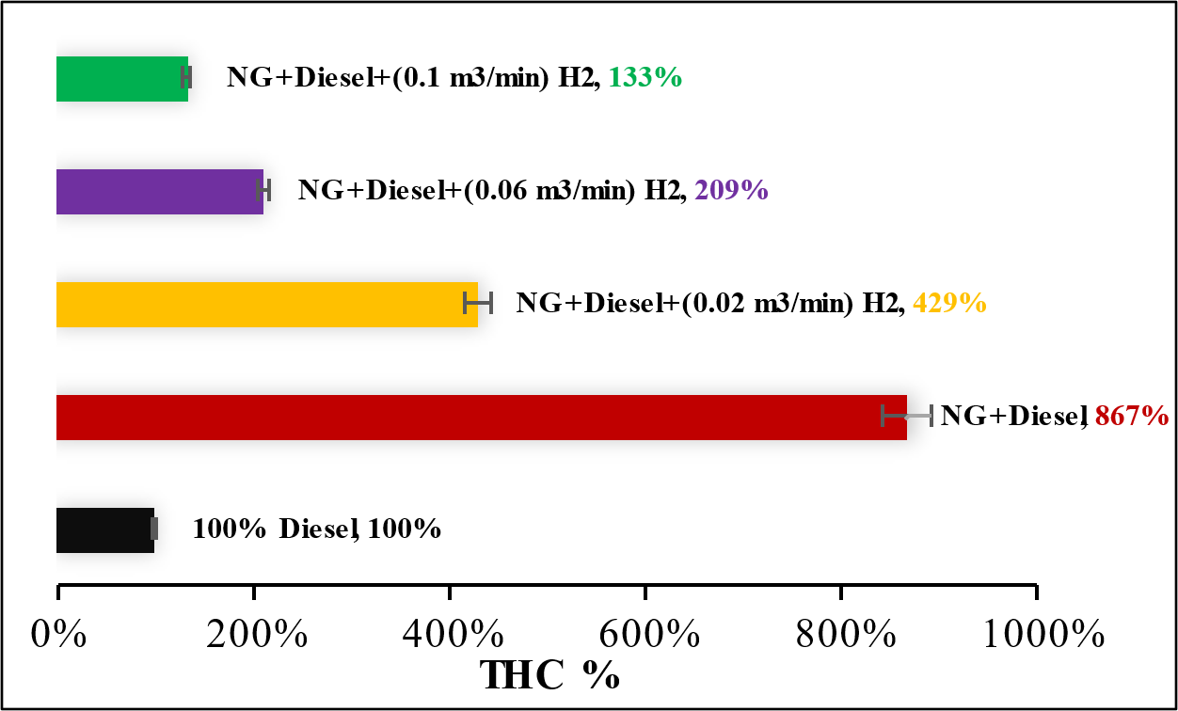
Results
CO and THC emissions
CO emissions peak at 295% with NG-diesel but drop from 194% to 66% as H₂ increases from 0.02 to 0.1 m³/min.
Fig. 4 . CO% vs. fuel mixture
THC emissions rise to 867% with NG-diesel but drop from 429% to 133% as H₂ increases from 0.02 to 0.1 m³/min.
Fig. 5 . THC% vs. fuel mixture

Slide 9
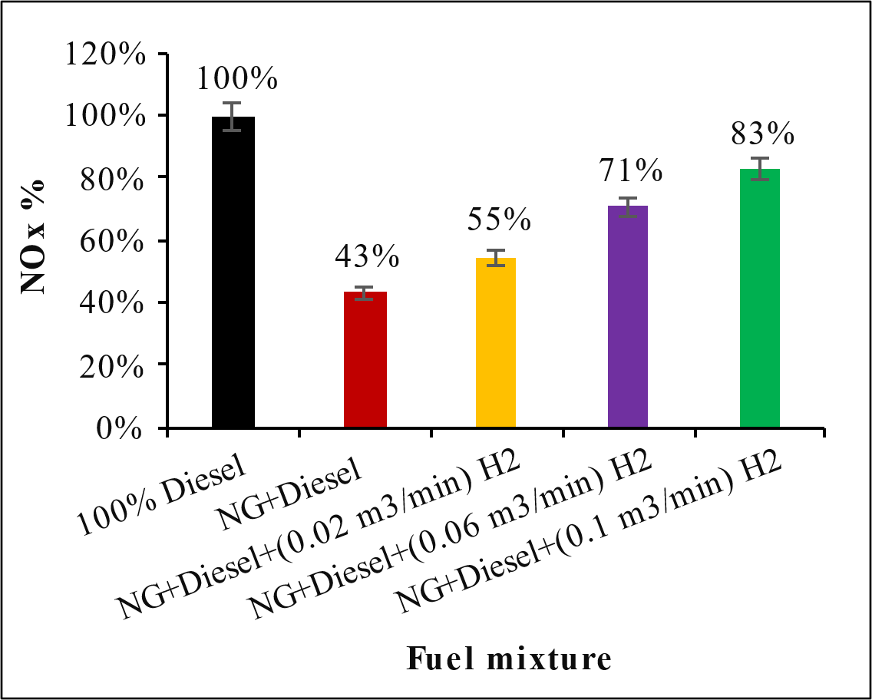
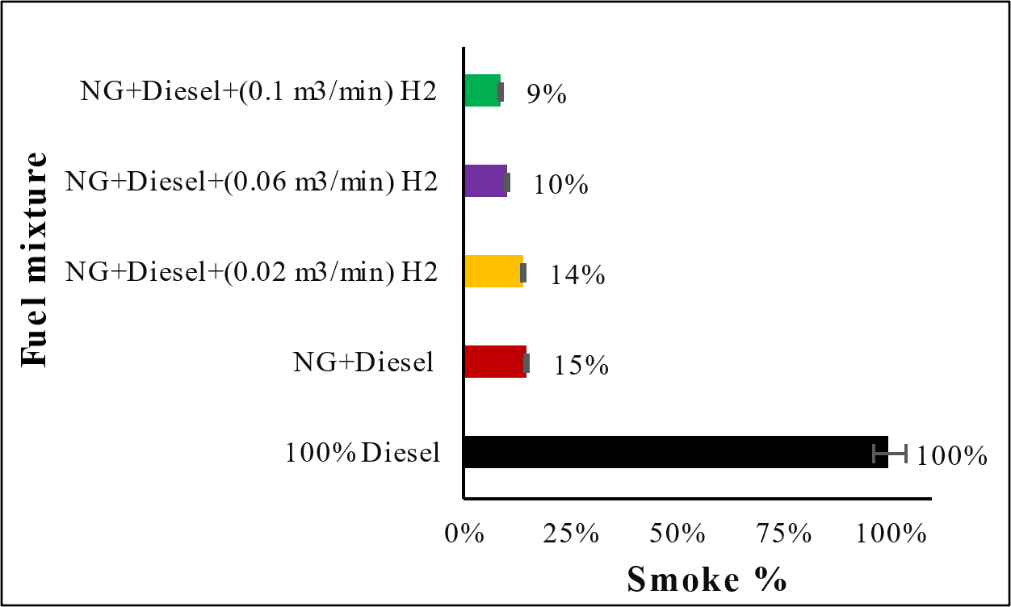
Results
NO_{x} and Smoke emissions
NOₓ emissions decrease from 100% with diesel to 43% with NG-diesel, then increase from 55% to 83% as H₂ rises from 0.02 to 0.1 m³/min.
Fig. 6 . NO_{x}% vs. fuel mixture
Smoke emissions decrease from 100% with diesel to 15% with NG-diesel, then drop from 14% to 9% as H₂ increases from 0.02 to 0.1 m³/min.
Fig. 7 . Smoke% vs. fuel mixture

Slide 10
Conclusion
NG-diesel mode shows the highest BSFC (102%), CO (295%), and THC (867%), while H₂ addition reduces these values to 80%, 66%, and 133%, respectively, with NOₓ rising to 83% and smoke decreasing to 9%.
H₂-NG-diesel offers a considerably improved efficiency and lower exhaust emissions, while further research should refine H₂ levels and fuel injection strategies for practical application can maximize the benefits of this research result.
The tested engine in this study can be used with tri-fuel mode in agriculture, power generation, and transportation, as it is already widely used with diesel fuel in many countries.

Slide 11
Thank you

