Slide 1
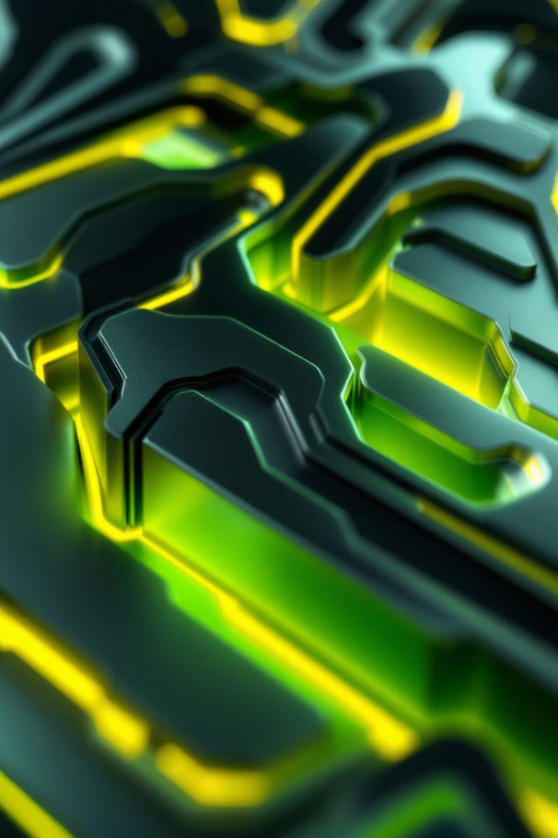
Anisotropy on the Surfaces of Additive Manufactured Models
Presented at the 16th International Scientific Conference on Sustainable, Modern and Safe Transport
by Peter Ficzere
from the Budapest University of Technology and Economics,
1

Slide 2
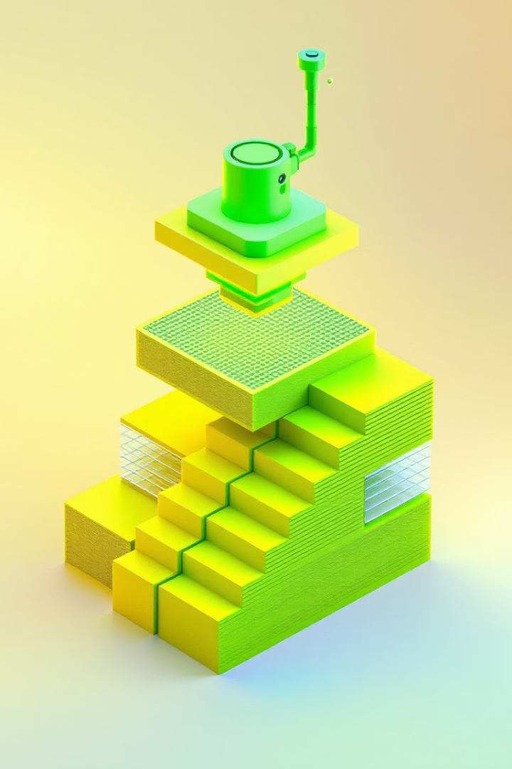
Introduction: The Stairs Effect and Surface Quality in Additive Manufacturing
Industry 4.0 Drivers
Surface Staircase Effect
Customization and low volume demands make additive manufacturing (AM) a preferred production route despite inherent challenges like surface quality anisotropy.
The characteristic layering creates visible stair-step surfaces, affecting anisotropy and mechanical behavior, requiring study to inform design and post-processing.
Post-processing and Improvements
Machining, coatings, and rescanning of layers influence surface quality and have implications for mechanical and tribological properties, especially in biomedical implants and transport parts.
2

Slide 3
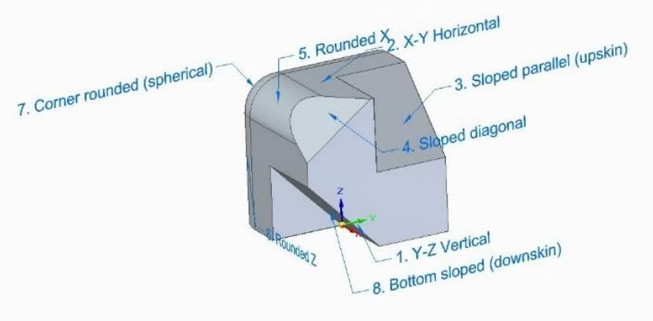
Methodology: Sample Design and Testing Approaches
Sample Geometry
The specimen was designed to allow measurement on various surfaces and orientations, enabling comprehensive roughness assessment without post-processing.
Surface Testing Methods
Both traditional contact profiling and modern microscopic scanning methods were considered, with emphasis on the latter for detailed surface mapping and roughness quantification.
3

Slide 4
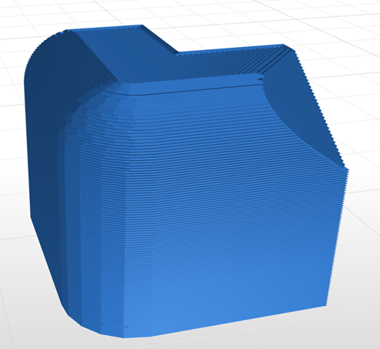
Toolpath and Surface Staircase Visualization
Toolpath Evidence
The staircase effect is clearly visualized in slicing software toolpaths, where layer boundaries and surface unevenness become apparent.
Implications for Roughness
Understanding this layered toolpath assists in anticipating anisotropic surface features that influence mechanical and tribological performance.
4

Slide 5
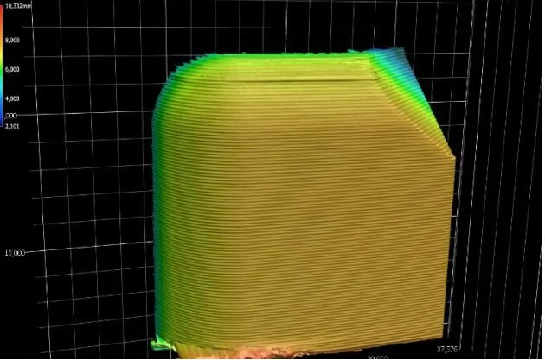
Microscopic Scanning of Surfaces
Microscopic Analysis
A Keyence VR 5200 microscope was used to scan the studied surface, highlighting visible layer structures and surface complexity across directions.
Measurement Standards
Surfaces were examined according to ISO 4287:1997 standards, ensuring consistent and reliable roughness characterization relevant to engineering applications.
5

Slide 6

Vertical Direction Roughness Results
Vertical Profiles
Surface Implications
Measurements perpendicular to the layer direction revealed distinctive roughness patterns. A base profile and parallel offsets were analyzed to capture surface variance.
The average roughness curves indicate variability affecting mechanical interaction in this direction, critical for design and wear predictions.
6

Slide 7
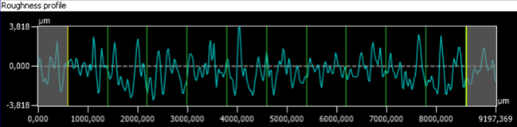


Horizontal Direction Roughness Results
Profile Analysis
Horizontal profiles followed groove edges, capturing surface roughness along the layer plane. Parallel profiles showed consistent anisotropic features.
Functional Relevance
These roughness characteristics directly impact tribological behavior, such as frictional resistance and wear patterns during part operation.
7

Slide 8
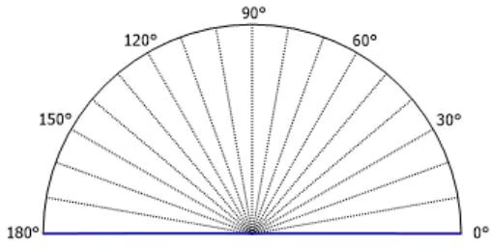
Surface Area Roughness and Angular Spectrum Analysis
Area Roughness Measurement
Expanding from line profiles, area-based roughness analyses provide more comprehensive insight on surface texture distribution and homogeneity.
Orientation Characterization
The angular spectrum quantifies the dominant surface orientations, confirming anisotropic directional features correlated with additive layering.
8

Slide 9
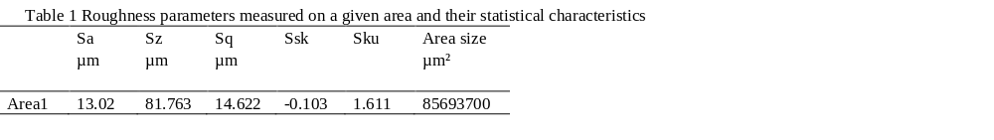
Surface Roughness Analysis and Metrics
Quantitative Findings
Significant differences in roughness parameters (Ra, Rsk, Rku) were observed between horizontal and vertical directions, reflecting anisotropic surface behavior.
Engineering Implications
The data indicate the need to account for surface orientation in material selection and component design to optimize friction, wear, and longevity.
9

Slide 10
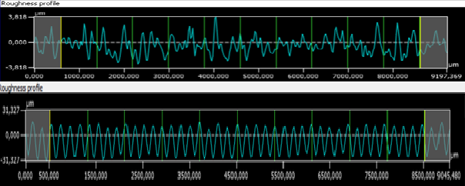
Conclusion: Impact of Surface Anisotropy in Additive Manufacturing
Anisotropic Surface Roughness
Design and Sustainability
Untreated 3D printed components exhibit clear anisotropic roughness, with implications for friction and wear characteristics inherent to build orientation.
Considering anisotropy in manufacturing orientation enables reduced friction losses, prolonged component lifetimes, and supports sustainable transport through emissions and noise reduction.
Future Directions
Integrated planning of production direction in additive manufacturing can optimize surface quality and mechanical performance for various transport applications.
10

Slide 11
References
Ahn, D., Kweon, J. H., Kwon, S., Song, J., & Lee, S. (2009). Representation of surface roughness in fused deposition modelling. Journal of Materials Processing Technology, 209(15-16), 5593-5600., https://doi.org/10.1016/j.jmatprotec.2009.05.016
Alzyod H, Takacs J, Ficzere P. Improving surface smoothness in FDM parts through ironing post-processing. Journal of Reinforced Plastics and Composites. 2023;0(0). doi:10.1177/07316844231173059
Alzyod, H., & Ficzere, P. (2024). Ironing process optimisation for enhanced properties in material extrusion technology using Box–Behnken Design. Scientific Reports, 14(1), 2300., https://doi.org/10.1038/s41598-024-52827-5
Boschetto, A., & Bottini, L. (2015). Roughness prediction in coupled operations of fused deposition modeling and barrel finishing. Journal of Materials Processing Technology, 219, 181-192., https://doi.org/10.1016/j.jmatprotec.2014.12.021
Chohan, J. S., Singh, R., & Boparai, K. S. (2016). Mathematical modelling of surface roughness for vapour processing of ABS parts fabricated with fused deposition modelling. Journal of Manufacturing Processes, 24, 161-169., http://dx.doi.org/10.1016/j.jmapro.2016.09.002
Delfs, P., Tows, M., & Schmid, H. J. (2016). Optimised build orientation of additive manufactured parts for improved surface quality and build time. Additive Manufacturing, 12, 314-320., http://dx.doi.org/10.1016/j.addma.2016.06.003
Ficzere, P. "Surface Anisotropy on 3D Printed Parts", Periodica Polytechnica Mechanical Engineering, 68(3), pp. 272–277, 2024. https://doi.org/10.3311/PPme.37770
Garg, A., Bhattacharya, A. & Batish, A. Chemical vapor treatment of ABS parts built by FDM: Analysis of surface finish and mechanical strength. Int J Adv Manuf Technol 89, 2175–2191 (2017). https://doi.org/10.1007/s00170-016-9257-1
Hanon, M.M., Alshammas, Y. & Zsidai, L. Effect of print orientation and bronze existence on tribological and mechanical properties of 3D-printed bronze/PLA composite. Int J Adv Manuf Technol 108, 553–570 (2020). https://doi.org/10.1007/s00170-020-05391-x
Hlinka, J., Berczeli, M., Buza, G., & Weltsch, Z. (2017). Wetting properties of Nd: YAG laser treated copper by SAC solders. Soldering & Surface Mount Technology, 29(2), 69-74.
Hussein Alzyod, Gábor Kónya, Peter Ficzere, Integrating additive and subtractive manufacturing to optimise surface quality of MEX parts, Results in Engineering,Volume 25, 2025, 103713, ISSN 2590-1230, https://doi.org/10.1016/j.rineng.2024.103713.
Jin, Y. A., Li, H., He, Y., & Fu, J. Z. (2015). Quantitative analysis of surface profile in fused deposition modelling. Additive Manufacturing, 8, 142-148., http://dx.doi.org/10.1016/j.addma.2015.10.001
Kiss-Nagy, K., Simongáti, G., Ficzere, P. Investigation of 3D Printed Underwater Thruster Propellers Using CFD, Structural Simulations, Periodica Polytechnica Mechanical Engineering, 2024. https://doi.org/10.3311/PPme.23795
Ko, S., Lee, D. Stiffness optimisation of 5-axis machine tool for improving surface roughness of 3D printed products. J Mech Sci Technol 31, 3355–3369 (2017). https://doi.org/10.1007/s12206-017-0625-z
Kónya, G. (2024) Investigating the Impact of Productivity on Surface Roughness, Dimensional Accuracy in FDM 3D Printing, Periodica Polytechnica Transportation Engineering. (2024), https://doi.org/10.3311/PPtr.22952
Kónya, G., & Ficzere, P. (2024). The Effect of Layer Thickness and Orientation of 3D Printed Workpieces, on The Micro-and Macrogeometric properties of Turned Parts. Acta Polytechnica Hungarica, 21(2)., DOI 10.12700/APH.21.2.2024.2.13
Kónya, G., Ficzere, P. The Effect of Layer Thickness, Orientation of the Workpiece on the Micro-, Macrogeometric Properties, the Machining Time of the Part during 3D Printing, Periodica Polytechnica Mechanical Engineering, 67(2), pp. 143–150, 2023. https://doi.org/10.3311/PPme.21473
Mathew, A., Kishore, S.R., Tomy, A.T. et al. Vapour polishing of fused deposition modelling (FDM) parts: a critical review of different techniques, and subsequent surface finish and mechanical properties of the post-processed 3D-printed parts. Prog Addit Manuf 8, 1161–1178 (2023). https://doi.org/10.1007/s40964-022-00391-7
Mu, M., Ou, C. Y., Wang, J., & Liu, Y. (2020). Surface modification of prototypes in fused filament fabrication using chemical vapour smoothing. Additive Manufacturing, 31, 100972., https://doi.org/10.1016/j.addma.2019.100972
Pandey, P. M., Reddy, N. V., & Dhande, S. G. (2003). Improvement of surface finish by staircase machining in fused deposition modeling. Journal of materials processing technology, 132(1-3), 323-331., https://doi.org/10.1016/S0924-0136(02)00953-6
Percoco, G., Lavecchia, F., & Galantucci, L. M. (2012). Compressive properties of FDM rapid prototypes treated with a low cost chemical finishing. Research Journal of Applied Sciences, Engineering and Technology, 4(19), 3838-3842
Perez, C. L. (2002). Analysis of the surface roughness and dimensional accuracy capability of fused deposition modelling processes. International Journal of Production Research, 40(12), 2865-2881., http://dx.doi.org/10.1080/00207540210146099
Sarka, F., Bihari, J., Takács, Á., & Tóbis, Z. (2020). Test method for investigation of reactive loads on gear drives with supporting function. In Vehicle and Automotive Engineering (pp. 265-272). Singapore: Springer Singapore, 10.1007/978-981-15-9529-5_23
Topa, M., Dömötör, Cs., Fröccsöntő szerszám tervezése. Multidiszciplináris Tudományok, 10(2), 25-29., (2020), https://doi.org/10.35925/j.multi.2020.2.4
Yaman P, Ekşi O, Karabeyoğlu SS, Feratoğlu K. Effect of build orientation on tribological and flexural properties of FDM-printed composite PLA parts. Journal of Reinforced Plastics and Composites. 2024;43(1-2):97-110. doi:10.1177/07316844231157790
Zhang, X., & Chen, L. (2020). Effects of laser scanning speed on surface roughness and mechanical properties of aluminum/Polylactic Acid (Al/PLA) composites parts fabricated by fused deposition modeling. Polymer Testing, 91, 106785, https://doi.org/10.1016/j.polymertesting.2020.106785,
11

