Slide 1


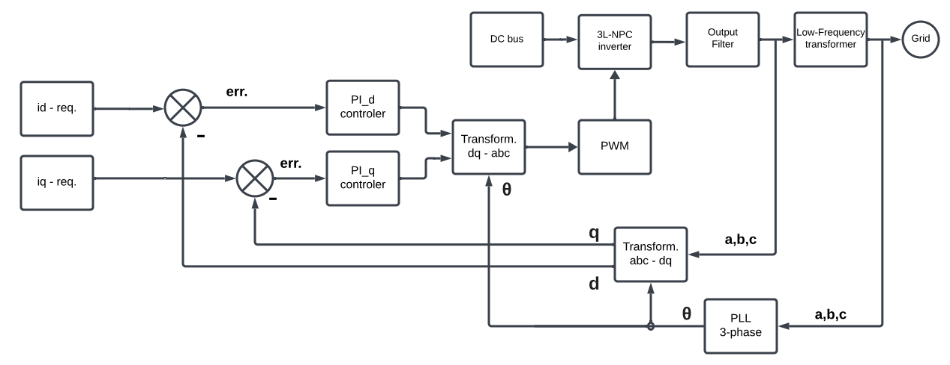
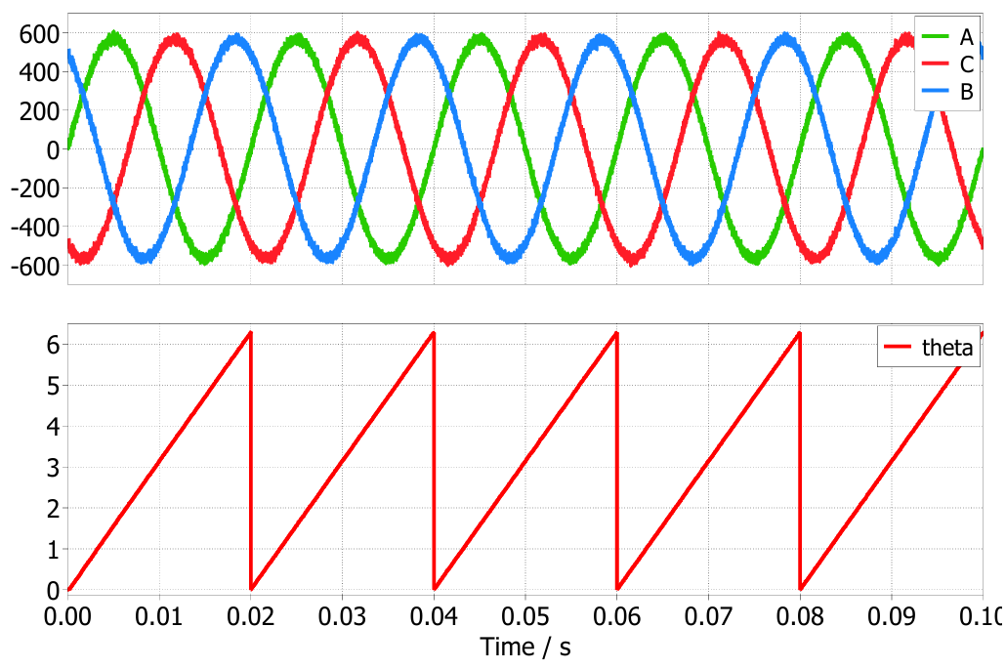
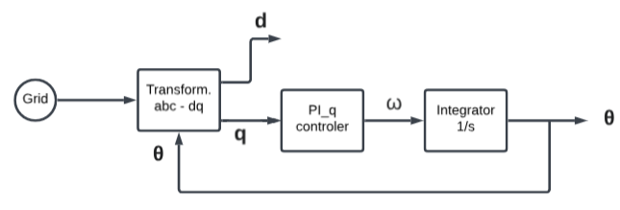
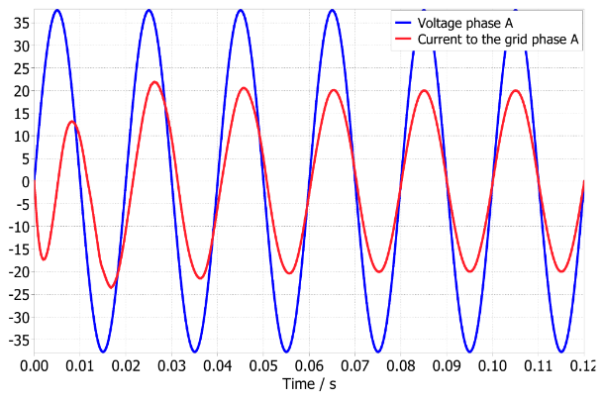
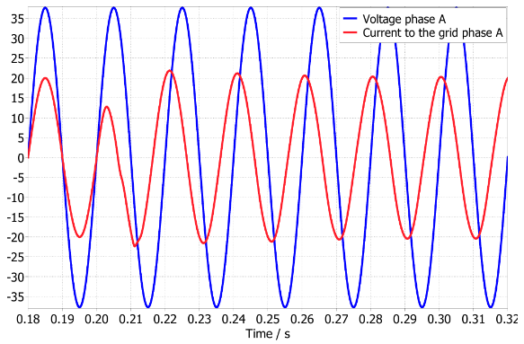
3-level neutral-point-clamped voltage source inverter control design for charging infrastructure support
TRANSCOM 2025: 16th International Scientific Conference on Sustainable, Modern and Safe Transport
Matej Sládek¹, Jozef Šedo¹, Michal Frivaldský¹
1 University of Zilina, Zilina, Slovakia
introduction
Backround information The article describes the block schematic of the power circuit of the inverter, the design of the output LCL filter, the frequency response and the resonance frequency of the output filter, the current control of the voltage source inverter, and the synchronization algorithm (PLL). | Problem Statement Implementing the synchronization algorithm into the control current loop and the control of power in the d-q reference frame for both directions — from the grid to the battery and vice versa — for a smart grid application. | Research Objectives Generating the required amplitude of the current injected into the grid with a required phase shift between the generated current and the grid voltage.
methods & implementation
The measured values are on the output side of the LCL filter. When we use a transformation from the “abc” system to the “d-q” system, we obtain constant values, and then we can use PI controllers... The output from the sum block is the error signal, which serves as the input for the PI controller. The PI controller reduces the error signal to zero. The output from the PI controller goes through the inverse transformation, and the output of the inverse transformation is a three-phase reference signal for switching the power semiconductor components. Block PWM generates sinusoidal PWM switching signals for the power components in the VSI. This block compares the three-phase reference signals from the transformation (dq–abc) with two sawtooth reference signals. We need two reference signals because each leg in the VSI is split into two switching Fig. 5. Block schematic for control in the current loop groups. The first reference signal is for S1 and S3, and the second reference signal is for S2 and S4.
results
 | At the input of the PLL, are transformations that result in constant d-q values. The next block is the PI controller, which reduces the error signal to zero. The function of the PI controller also includes filtering high frequency components because its transfer function is the same like low pass filter. As we can see on figure. The output value of the PI controller is angular frequency. When the angular frequency is integrated, we obtain the grid angle theta. In many cases, the integrator block is the angle from the 0 to the 2π. In the time domain, theta appears as a saw-tooth wave.
The synchronization of one phase between the grid voltage and the current generated by the inverter is shown in figure (left). The entire perfectly synchronized process took approximately three periods. At time 0.2 s, the condition for a phase shift of π/2, as shown in figure (right) is required. The voltage leads the current, meaning the VSI acts as a generator of inductive power against the grid. This demonstrates how the compensation of the capacitive reactive energy in the grid can be provided.
conclusion & implementation path
In this article, the synchronization algorithm PLL, the design of the output LCL filter, the current control loop of the VSI, decoupling in the LCL filter, and compensating active and reactive power are presented. Using the PLL algorithm, it took about 3 periods for accurate synchronization with the grid. When the phase shift ±π/2 was required, the VSI successfully generated reactive power (inductive or capacitive) to the grid. These simulation results demonstrate the capability of the inverter to effectively transfer energy from renewable sources to the grid while being capable of compensating power flow and power factor. In future work, we aim to focus in more detail on the methods of designing PI controllers, improving the dynamics and robustness of the PLL synchronization algorithm (especially its operation under asymmetric phases on the grid side). Additionally, we plan to analyze filter oscillations and their damping, comparing active damping implemented in software with passive damping in terms of efficiency. Furthermore, we aim to enhance control performance by replacing sine-modulated PWM with space vector PWM, thereby achieving better using of the DC bus and reducing switching losses.
acknowledgements
The authors would like to thank to the Slovak National Grant Agency VEGA for project funding 1/0274/24.

