Slide 1


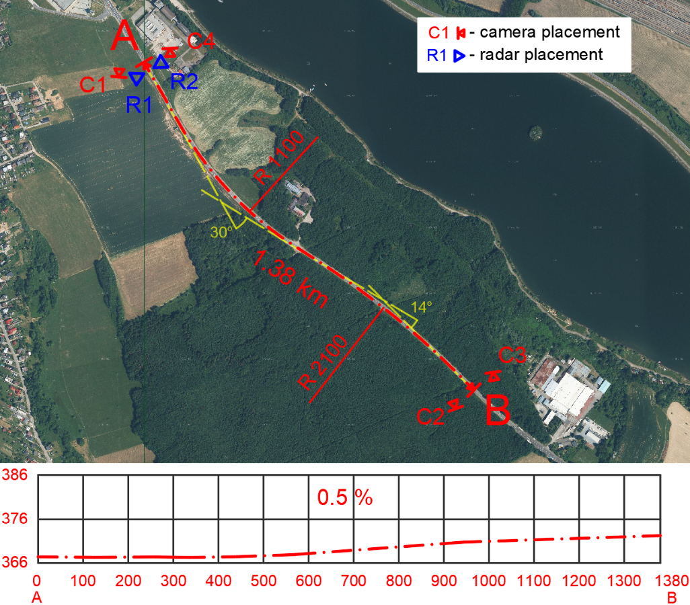
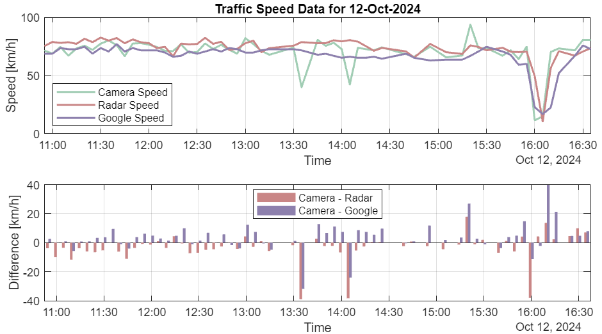
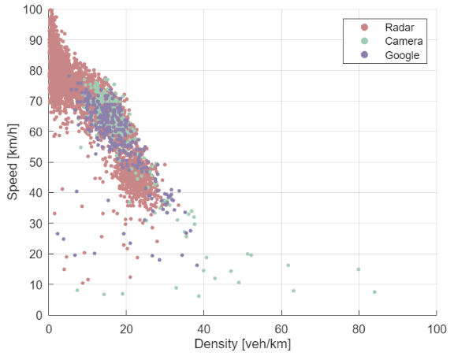
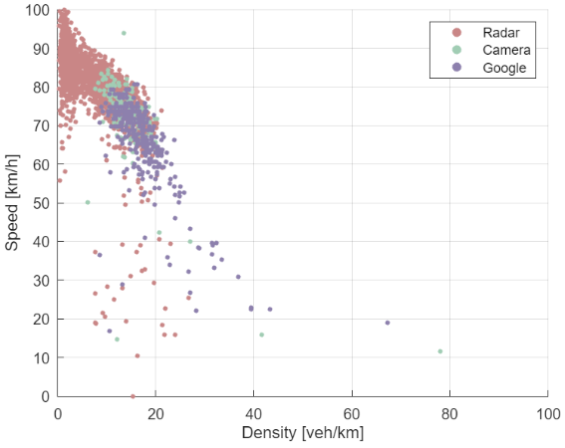
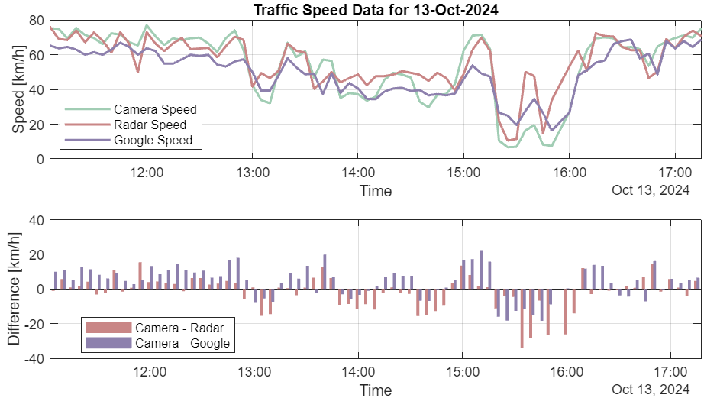
Analysis of Space-Mean Speed Measurement Methods
TRANSCOM 2025: 16th International Scientific Conference on Sustainable, Modern and Safe Transport
Adam Kniz¹, Andrea Kocianova¹
1 University of Zilina, Zilina, Slovakia
introduction
Space-mean speed is crucial for properly defining delay functions, computing travel times, and assigning traffic loads to road networks. Therefore, accurate measurement of space-mean speed is essential for effective traffic monitoring, traffic modeling, and infrastructure planning. Traditional and modern speed measurement techniques offer different levels of accuracy, cost, and applicability. The objective is to evaluate the reliability of these methods and determine their strengths and limitations.
methodology
Study area: I-class two-lane road (I/18). Average Annual Daily Traffic: 22 106 veh/24h (25% heavy vehicles). Speed limit: 90 km/h. Space-Mean Speed Measurement Techniques: Direct - by dividing the roadway length by the average travel time (Turner et al., 1998). Indirect – as the harmonic mean of spot speeds (De Moor et al., 2005). Technology: Video cameras (direct): high precision, used as the reference method. Google Maps API (direct): cost-effectiveness, extensive geographic scope, and ability to gather data from numerous mobile phone users. Radar (indirect): ease of use, reliability, and ability to estimate traffic volume. Data Collection: Two-week survey period. Speed measurement for both directions separately. Data aggregated into five-minute intervals. Evaluation Metrics: Mean Absolute Error (MAE): to evaluate the precision of radar and Google Maps API data compared to video-based recognition. Lower MAE values indicate closer agreement between datasets. | Figure 1. Depiction of geometric features and longitudinal profile of selected road section.
results
Comparative Analysis: Radar measurements demonstrated higher accuracy, MAE = 5.74 km/h (deviation = 15.77%). Google Maps API data showed greater deviations with MAE = 8.12 km/h (deviation = 19.86%). Key observations: Both radar and Google Maps data generally reflected traffic speed trends. Both methods tended to smooth out short-term speed fluctuations. At higher traffic densities, Google speeds aligned more closely with camera-based measurements. Despite discrepancies, both methods showed sufficient accuracy for traffic flow analysis.
Figure 2. Speed-density relationship : direction A-B (left) direction B-A (right). | Figure 3. Traffic speed analysis: direction A-B (top) direction B-A (bottom).
conclusion
Radar-based measurements demonstrated higher accuracy than Google Maps API data; however, both methods proved sufficiently reliable for traffic flow analysis, particularly in assessing speed-saturation relationships. Despite greater variability, Google Maps API remains a viable alternative due to its broad geographic coverage and cost efficiency. The integration of these methods presents a scalable approach for comprehensive space-mean speed surveys. Future research will focus on evaluating their performance on road segments with higher curvature and steeper longitudinal grades to enhance their applicability in diverse traffic conditions.
acknowledgements
This work was supported by the Slovak Scientific Grant Agency – grant VEGA 1/0206/22 and the Slovak Research and Development Agency - grant APVV-21-0416.

