Slide 1


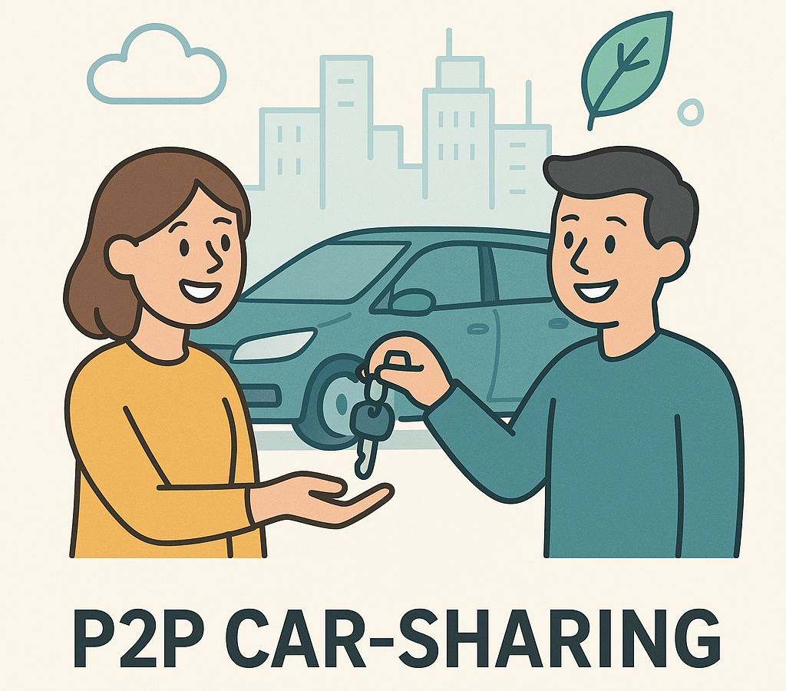
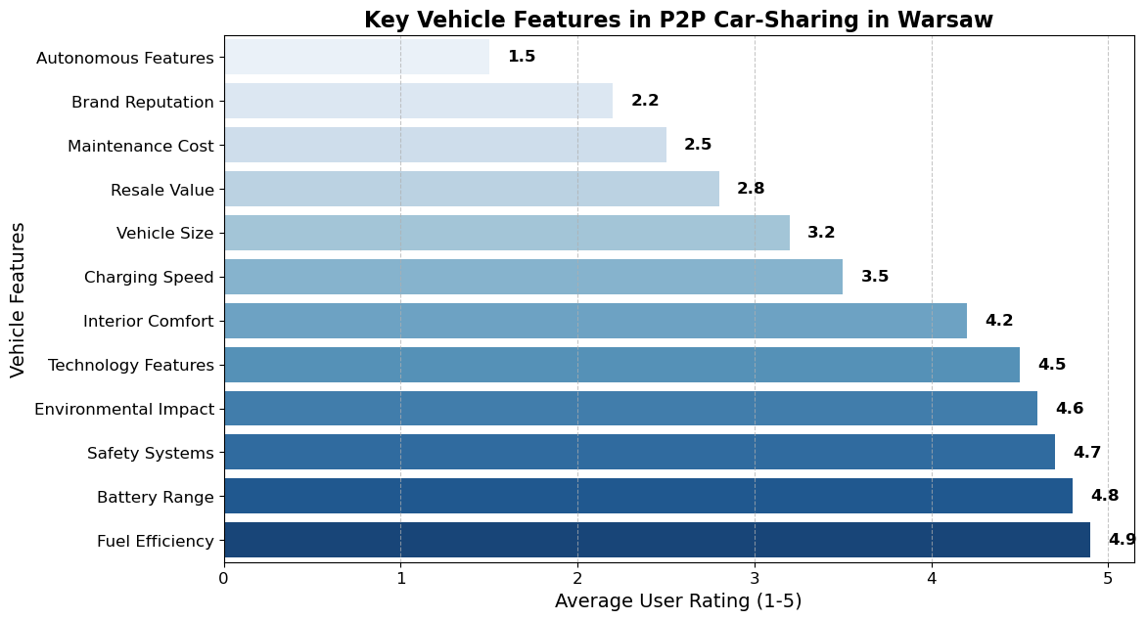
Vehicle Features Influence Peer-to-Peer Car-Sharing: A Social Network Analysis Findings from Emerging Car-Sharing System
TRANSCOM 2025: 16th International Scientific Conference on Sustainable, Modern and Safe Transport
Katarzyna Turoń¹, Andrzej Kubik¹
1 Silesian University of Technology, Katowice, Poland
introduction
Backround information & Market Context Peer-to-peer (P2P) car-sharing transforms urban mobility by enabling private vehicle owners to rent out their cars, reducing reliance on personal vehicles and environmental impacts. | Problem Statement & Stakeholders Research addresses the insufficient understanding of vehicle attributes influencing user preferences in peer-to-peer (P2P) car-sharing, especially in Central and Eastern Europe. Key stakeholders: city policymakers, P2P car-sharing platforms, vehicle manufacturers, users, and transport research institutions. | Research Objectives & Expected Impact The study aims to identify essential vehicle attributes driving user preferences for P2P car-sharing and analyze their interdependencies using Social Network Analysis (SNA). The expected impact is the optimization of vehicle fleets, increased adoption of sustainable vehicles, and improved competitiveness of car-sharing platforms.
materials, methods & implementation
Methods: - Social Network Analysis (SNA), utilizing computational tools (NetworkX in Python, R's SNA package, Gephi). Analysis of survey data from 1,043 participants collected in Warsaw between November 2023 and February 2024. Evaluation of 12 key vehicle attributes, including fuel efficiency, battery range, safety systems, and technology features. Materials: - Quantitative data from user surveys. - Computational tools for network analysis (Python, R, Gephi).
results
Academic Findings: Identification of main core clusters of vehicle preferences: # Sustainability & Efficiency (fuel efficiency, battery range, environmental impact) # Safety & Technology (Advanced Driver Assistance Systems [ADAS], infotainment integration) # Practicality & Cost (maintenance costs, resale value, vehicle size) # Fuel efficiency exhibits the highest centrality (betweenness centrality = 0.212), highlighting its role as a pivotal attribute influencing multiple vehicle features. Innovation & Practical Applications: # Recommendations for investing in vehicles that emphasize fuel efficiency, advanced safety systems, and intuitive technology interfaces. # Utilization of Social Network Analysis (SNA) results to optimize fleet composition and enhance competitive market positioning. # Integration of open innovation approaches, encouraging collaboration between P2P platforms, vehicle manufacturers, tech companies, academic researchers, and policymakers to co-develop innovative vehicle features and business models. # Fostering transparent data-sharing practices and user feedback loops to accelerate innovation cycles and align product offerings more closely with real-time consumer needs and sustainability targets. | Fig. 1. Key vehicle features in P2P car-sharing system in Warsaw
conclusion & implementation path
Conclusions: - User preferences for P2P car-sharing in Warsaw prioritize fuel efficiency, battery range, safety features, and environmental sustainability. - Lesser importance is attributed to autonomous driving features and brand reputation, distinguishing the Warsaw market from Western markets. Impact: Increased adoption and integration of eco-friendly vehicles (electric and hybrid) in shared mobility. Influence on urban policy development towards sustainable mobility. Areas of future resrarch: - Deeper exploration of municipal policy impacts on the growth of P2P car-sharing. - Comparative studies between Central-Eastern European markets and Western Europe or North America. - Long-term analysis of user behavioral changes following the implementation of recommended vehicle attributes and policies.

